Slide 1
Self-Regulation in Star Formation
What stops accretion, sets M*, & the IMF?
Feedback + N-body dynamics ?
The “Feedback Ladder”
Progression of ever stronger feedback impacts
Protostar Outflows => local, all M*, couples directly to cloud
FUV/heating =>
EUV/ionization =>
Stellar winds =>
Radiation pressure =>
M.S. dynamic interactions / mergers =>
Post-M.S. outflows =>
SNe => global, high M* ; P, E
Black holes vented away from SFRs.
Feedback failure => High SFE, bound clusters?

Slide 2
Accretion + Spin + Magnetic Fields
Fossil record of accretion history, N-body dynamics
Feedback Impact in Self-Regulation
Couple P, E, directly into parent cloud
Most (all ?) YSOs have them
All accreting, spinning, magnetized systems?
Total impact on GMCs can exceed UV, winds, SNe…
(or radiation)
Outflow
Turbulence
(Nakamura & Li 2009; Carroll+ 2009; Arce+2010; Nakamura+2011;
Federrath+ 2015; Plunkett+2013; 2015; Li+2015; Feddersen+2018; 2019)

Slide 3
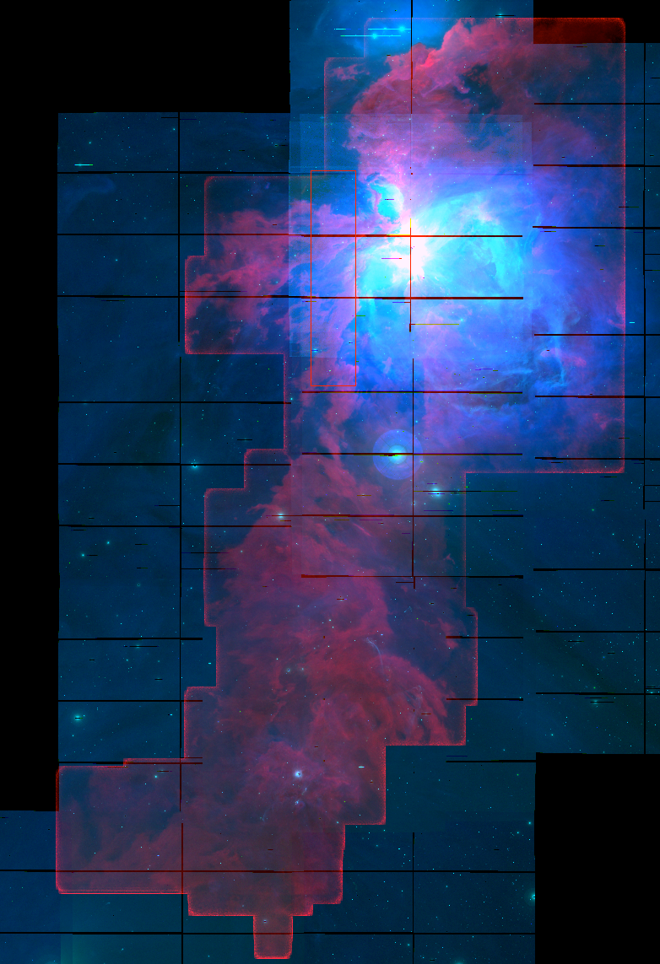
Orion A
CO 1-0 T_{peak}
CARMAOrion
(Kong S. et al. 2018)
[SII] CTIO 4m
NGC 1977
M 43
M 42
NGC 1980
ι Ori

Slide 4
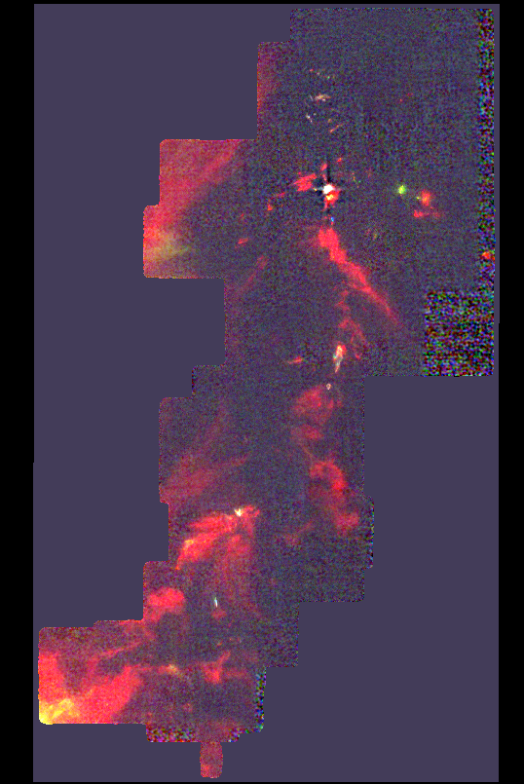
Orion OMC1:
N-body dynamics in dense gas => Orbit decay
=> N-body dynamics: important for IMF
CO 1-0
V = 4 – 12 km/s
Kong S. et al.2018

Slide 5
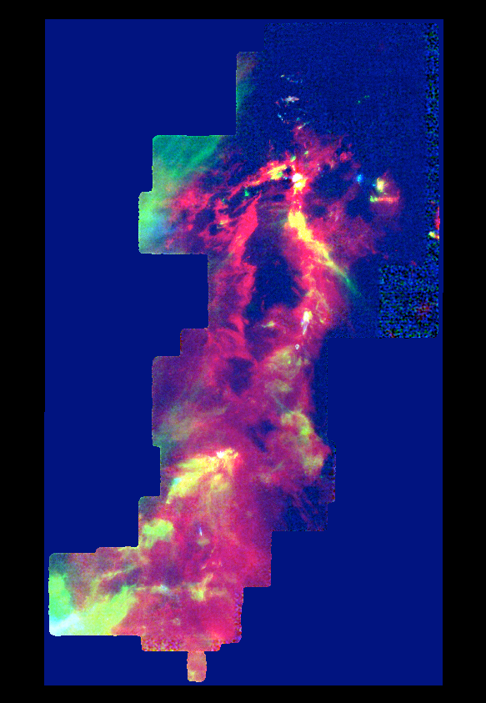
=> Novae, stellar mergers, SNe, Protostellar mergers?
CO 1-0
V = 4 – 12 km/s
Kong S. et al.2018

Slide 6
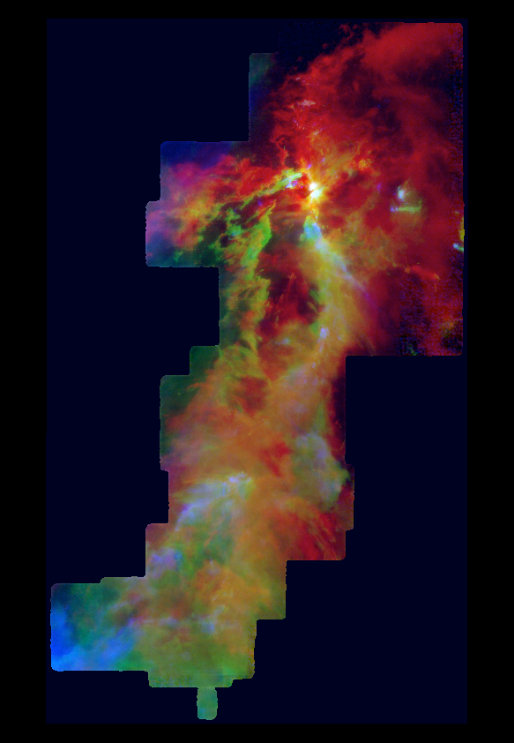
=> Novae, stellar mergers, SNe, Protostellar mergers?
CO 1-0
V = 4 – 12 km/s
Kong S. et al.2018

Slide 7
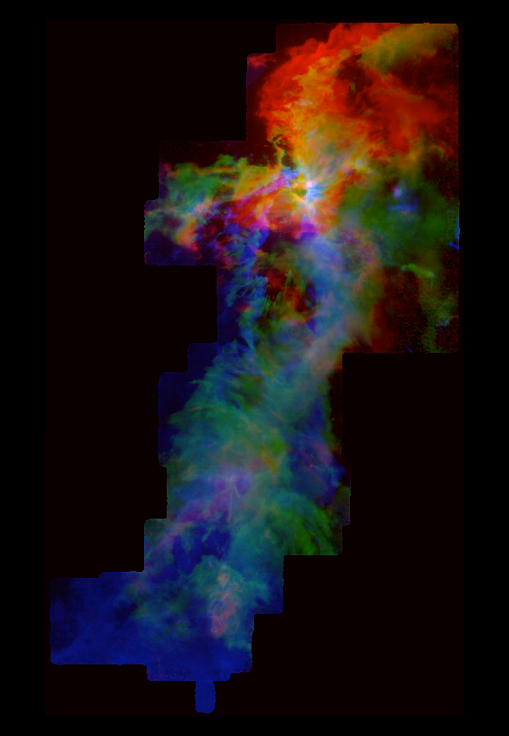
=> Novae, stellar mergers, SNe, Protostellar mergers?
CO 1-0
V = 4 – 12 km/s
Kong S. et al.2018

Slide 8
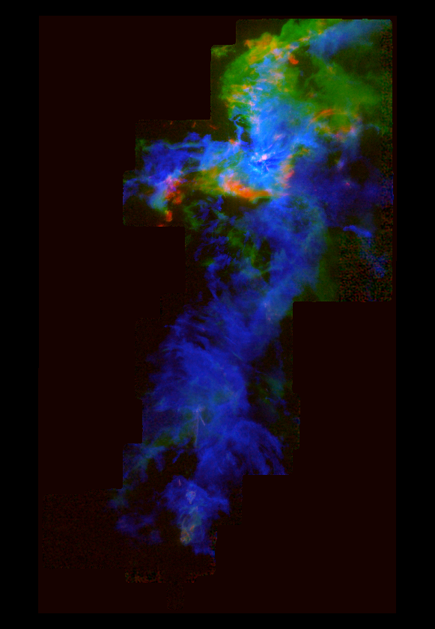
?
CO 1-0
V = 4 – 12 km/s
Kong S. et al.2018

Slide 9
Orion A
CO 1-0 T_{peak}
CARMAOrion
(Kong S. et al. 2018)
[SII] CTIO 4m
NGC 1977
M 43
M 42
NGC 1980
ι Ori

Slide 10
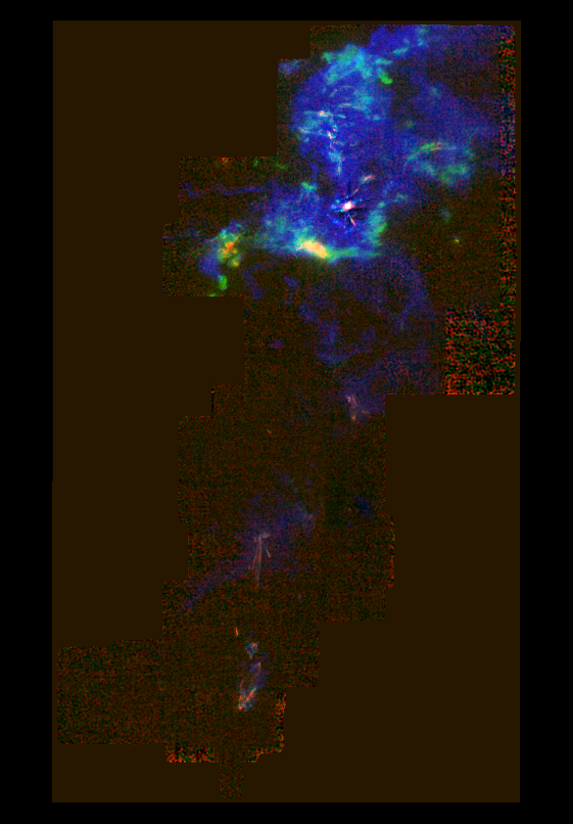
How?
CO 1-0
V = 0-4 12-16 km/s
Kong S. et al.2018

Slide 11
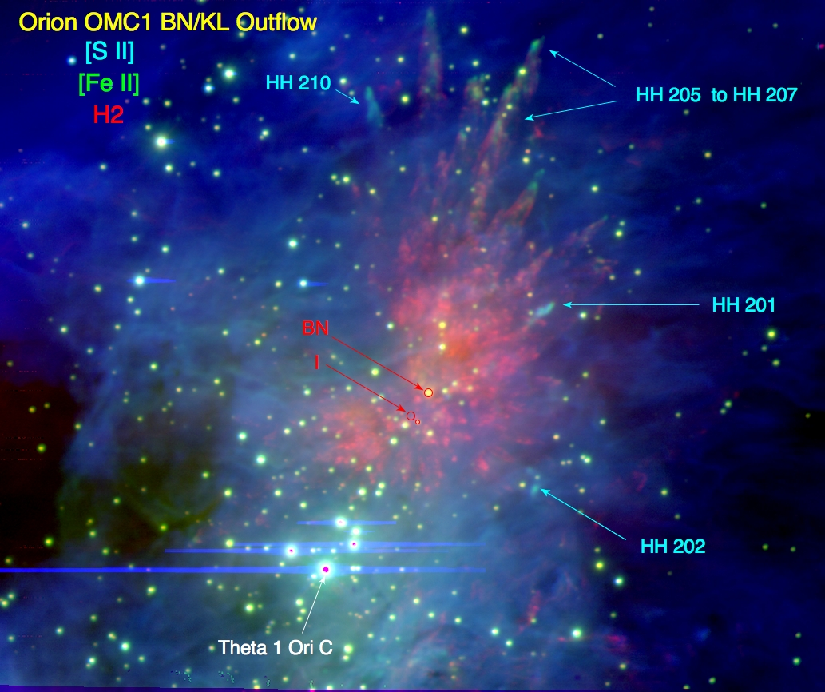

Slide 12
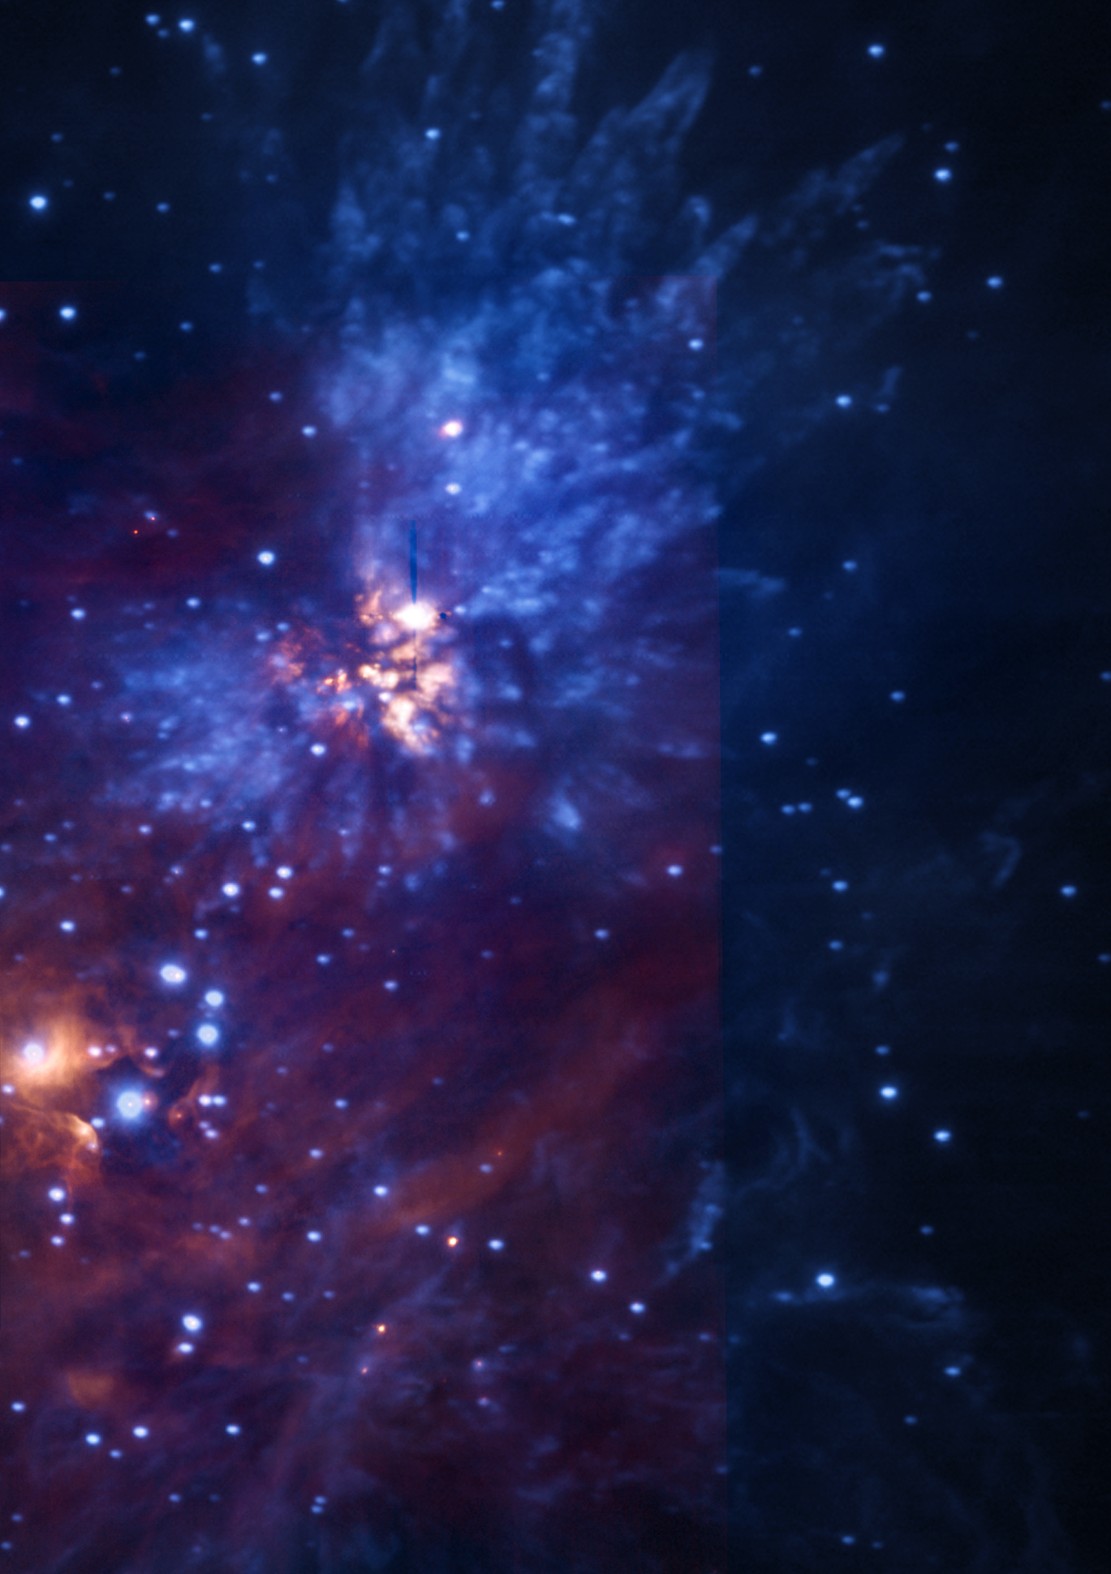

Slide 13
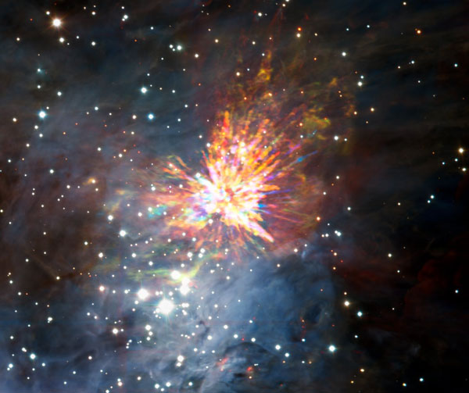
Orion Nebula & OMC1
BN/KL outflow
K_{s} H₂ CO 2-1

Slide 14
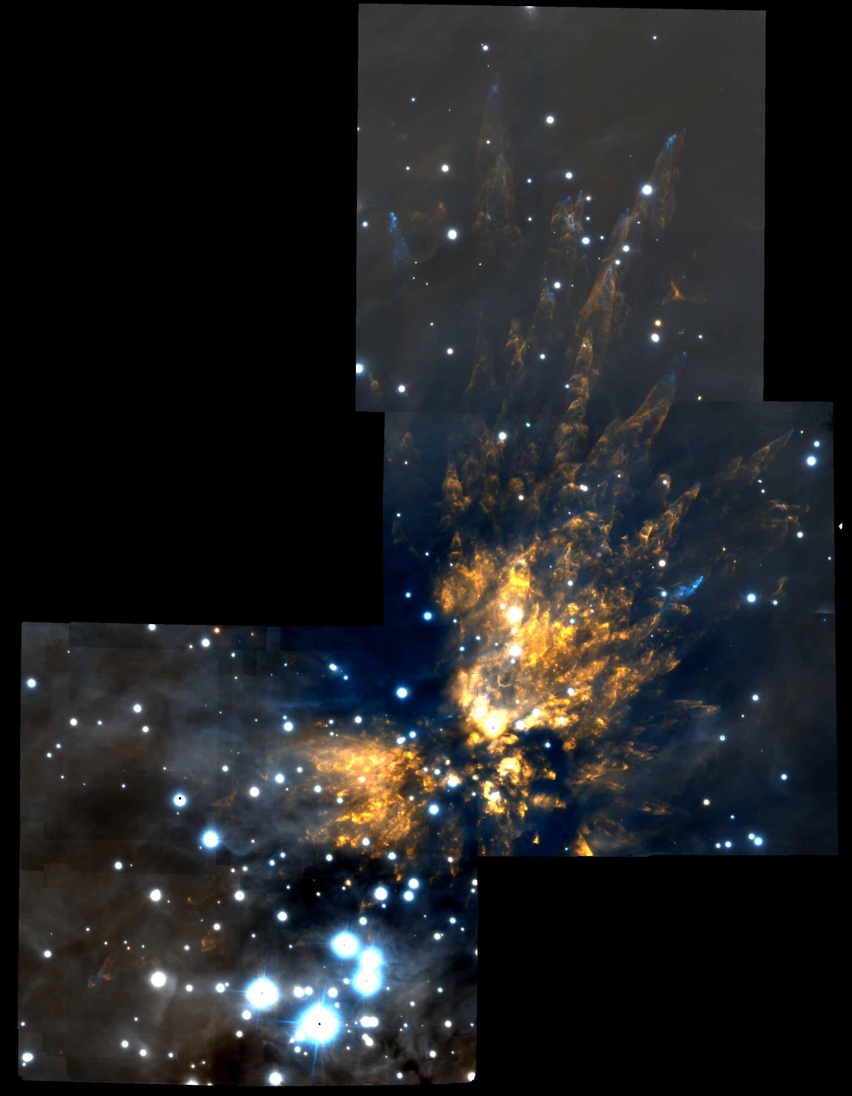
The Orion Explosion
Near-infrared (2 μm)
Gemini-S
GSAOI + GEMS
(Bally et al. 2015)

Slide 15
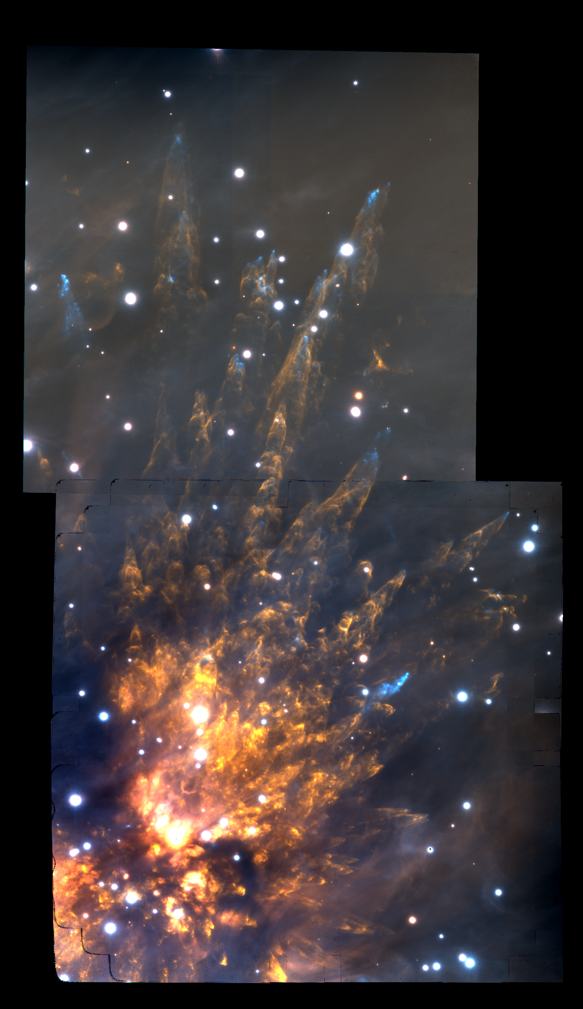

Slide 16
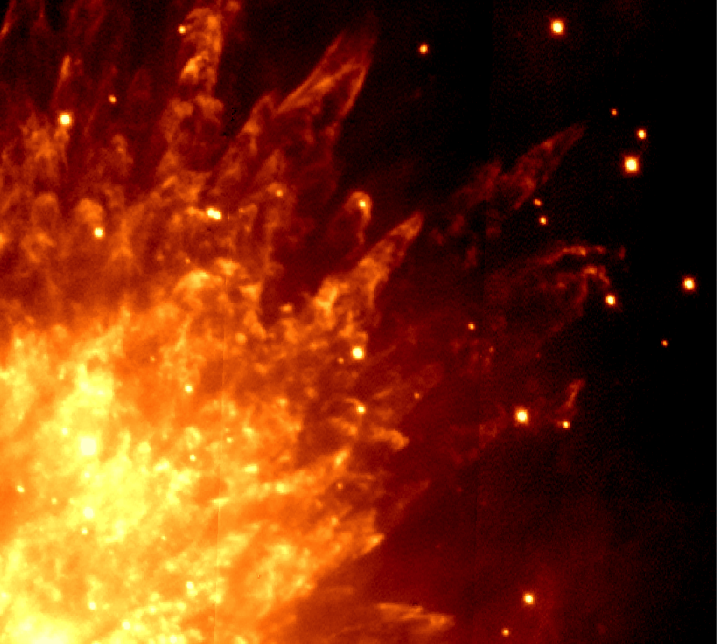
1999

Slide 17
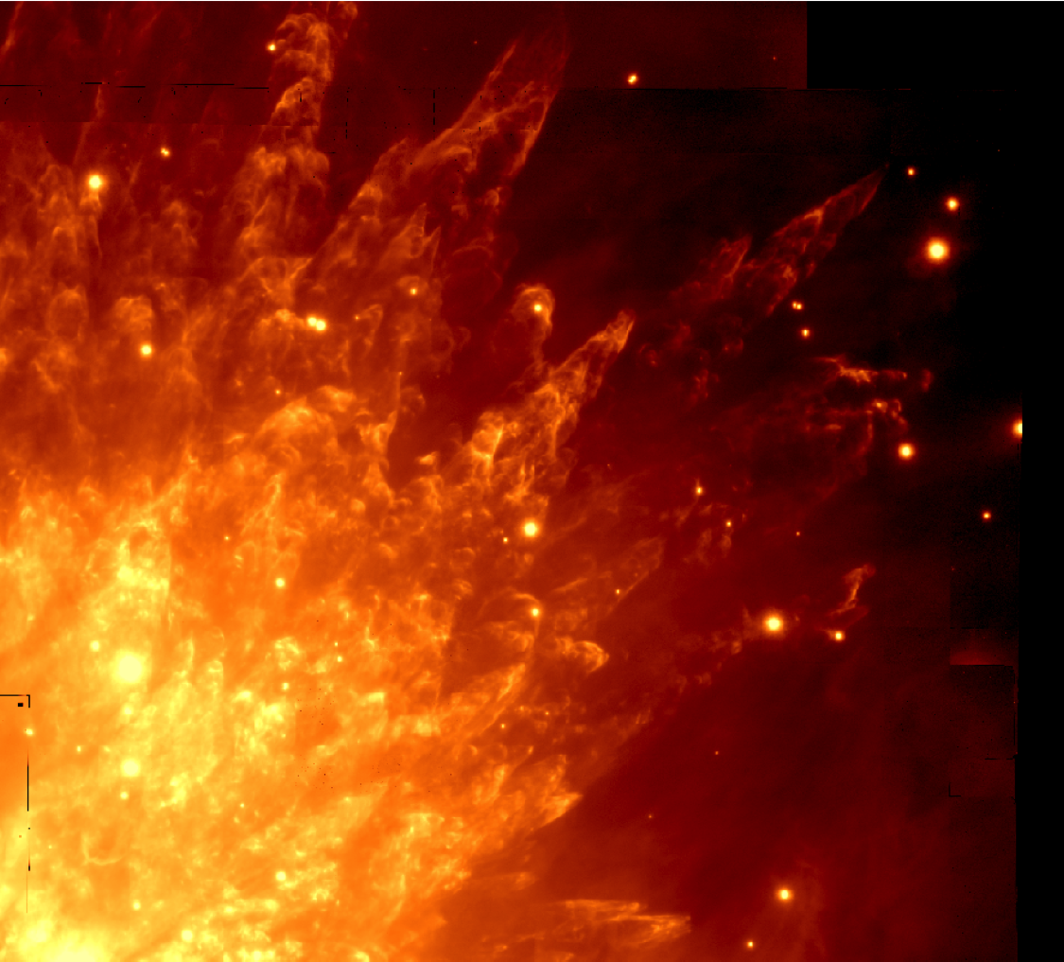
2013

Slide 18
BN
n
Lonsdale “source x”
V = 55 km/s (Luhman et al. 2017)
1999 Subaru 2.12 μm H₂ Kaifu et al. 2000

Slide 19
BN
n
Lonsdale “source x”
V = 55 km/s (Luhman et al. 2017)
2013 Gemini S 2.12 μm H₂ Bally et al. 2015

Slide 20

BN
Source I
n
IRc 4
Source x
2013 Gemini S H₂ at 0.002 mm

Slide 21
ALMA

Slide 22
2015 ALMA
CO at 1.3 mm
(Bally+ 2017)
~3 M_{o} Src X
V_{PM} = 55 km/s
~15 M_{o} Src I
V_{PM} = 13 km/s
~10 M_{o} BN
V_{PM} = 26 km/s

Slide 23
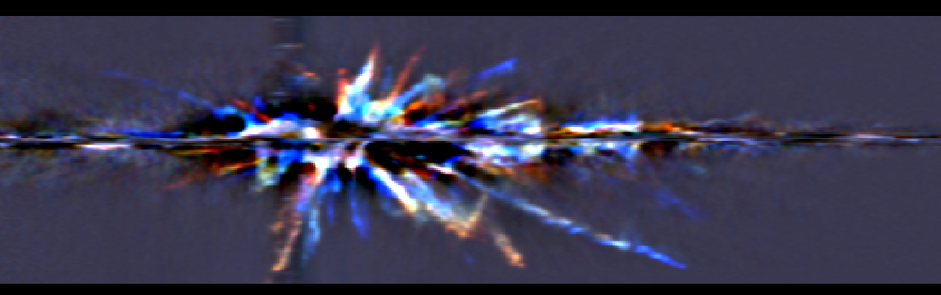
North-South Cut
V =+120 km / s
V = -120 km/s
No deceleration in most wakes !
ρ >> ρ_{ambient} ρ > 10⁸ cm⁻³
M_{clump}~10²⁸ - 10³⁰ grams ?

Slide 24
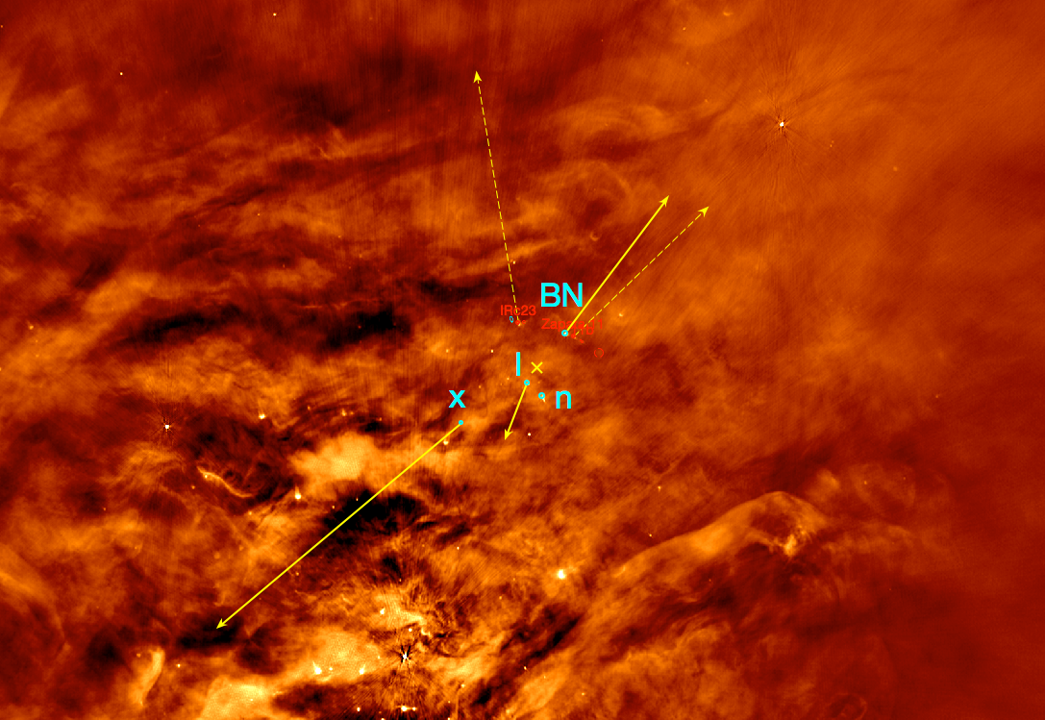
JVLA 4 – 8 GHz
Proper motions over 2kyr:
(Rodriguez et al. 2017,
Dzib et al. 2017,
Luhman et al. 2017)

Slide 25
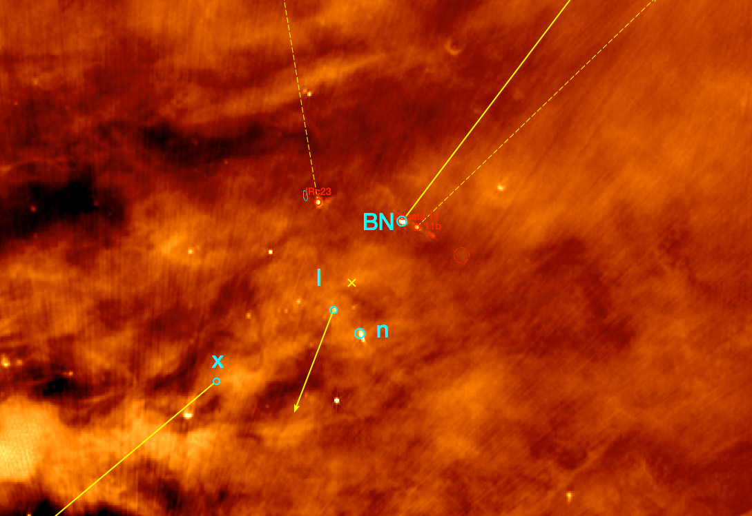
JVLA 4 – 8 GHz

Slide 26
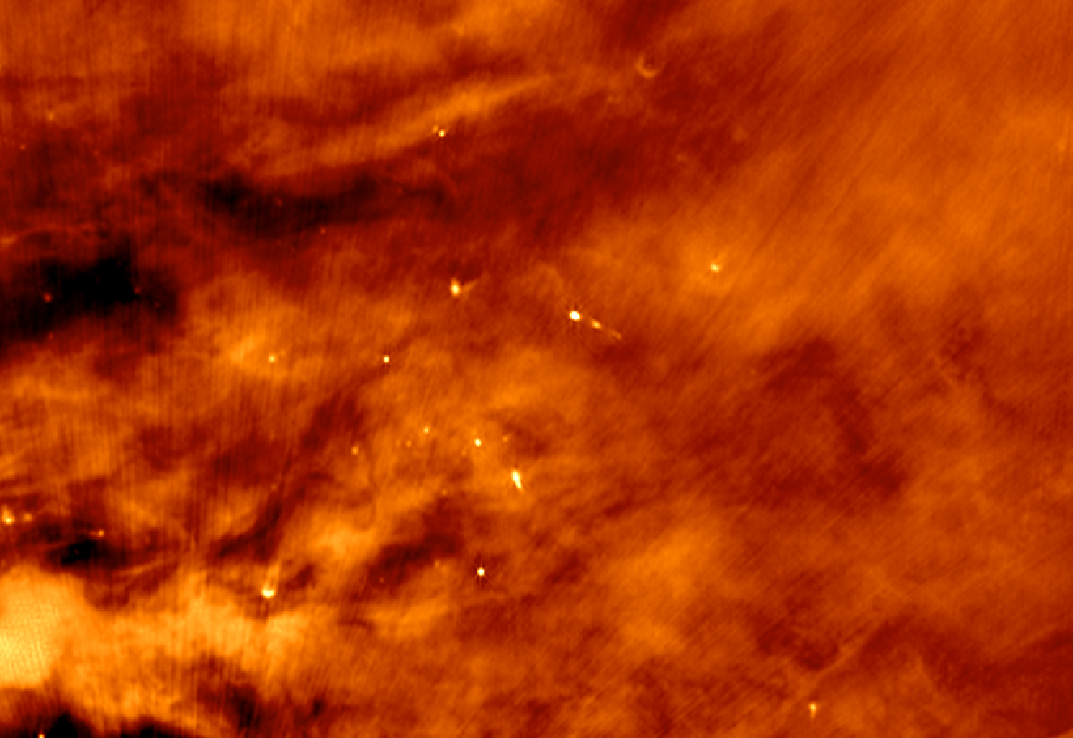
JVLA 4 – 8 GHz

Slide 27
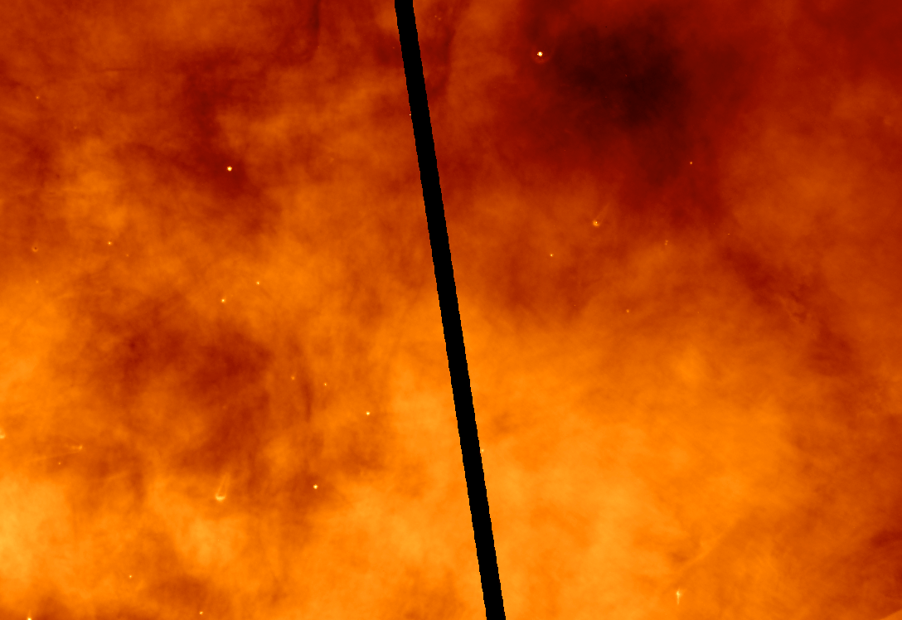
HST H-alpha

Slide 28
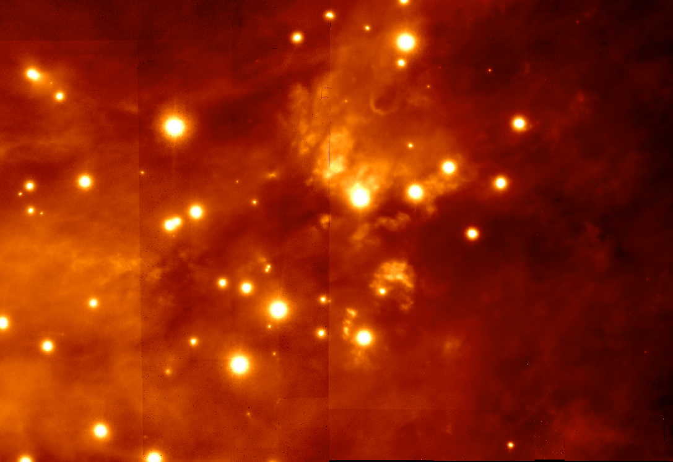
[Fe II] 1.64 μm (GSAOI)

Slide 29
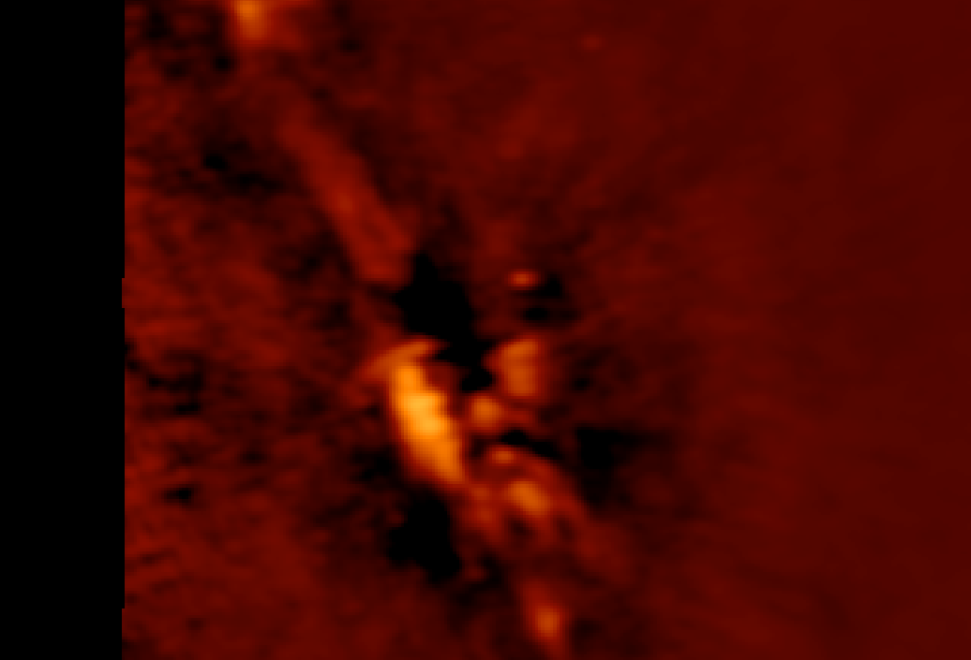
ALMA 1.3 mm continuum (1”)

Slide 30
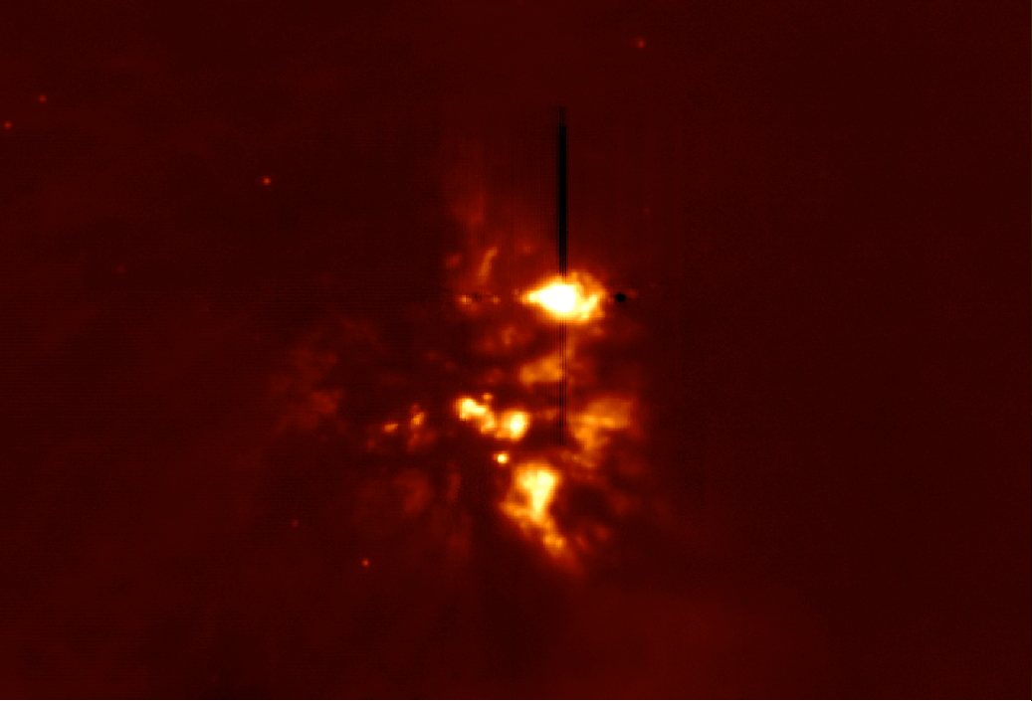
11.7 μm continuum (TReCS)

Slide 31
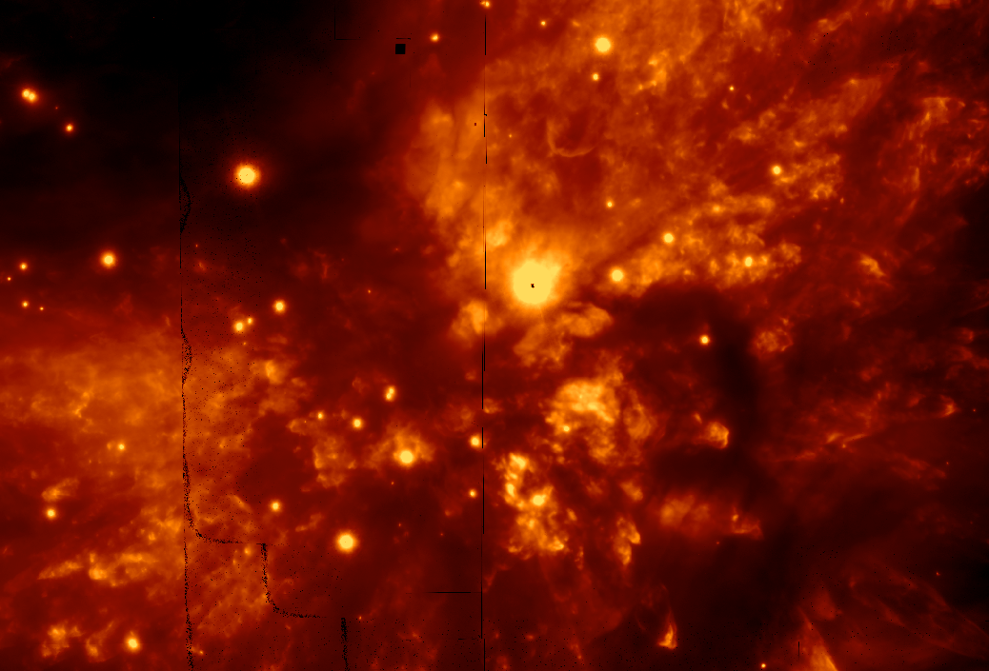
H₂ 2.12 μm (GSAOI)

Slide 32
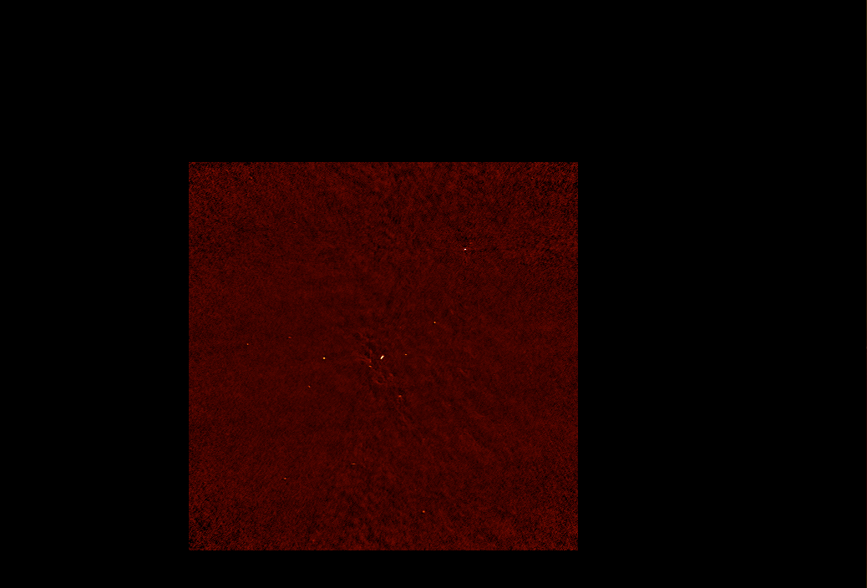
ALMA 1.3 mm continuum (0.05”)

Slide 33
JVLA 4 – 8 GHz

Slide 34
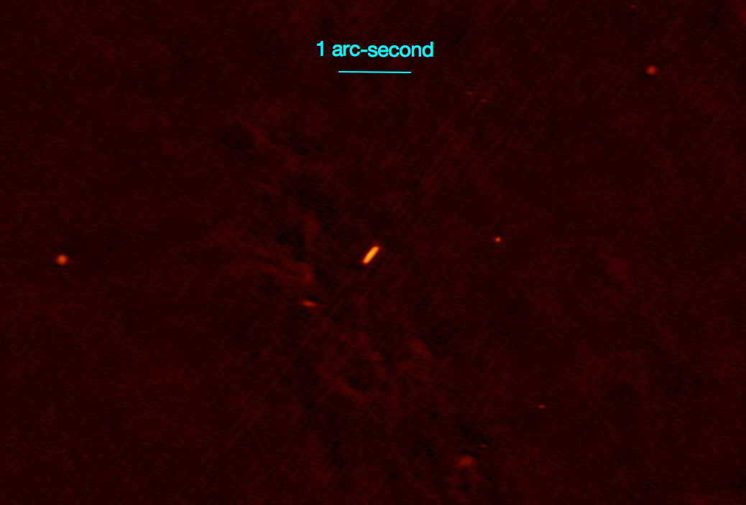
ALMA 1.3 mm continuum (0.05”)

Slide 35
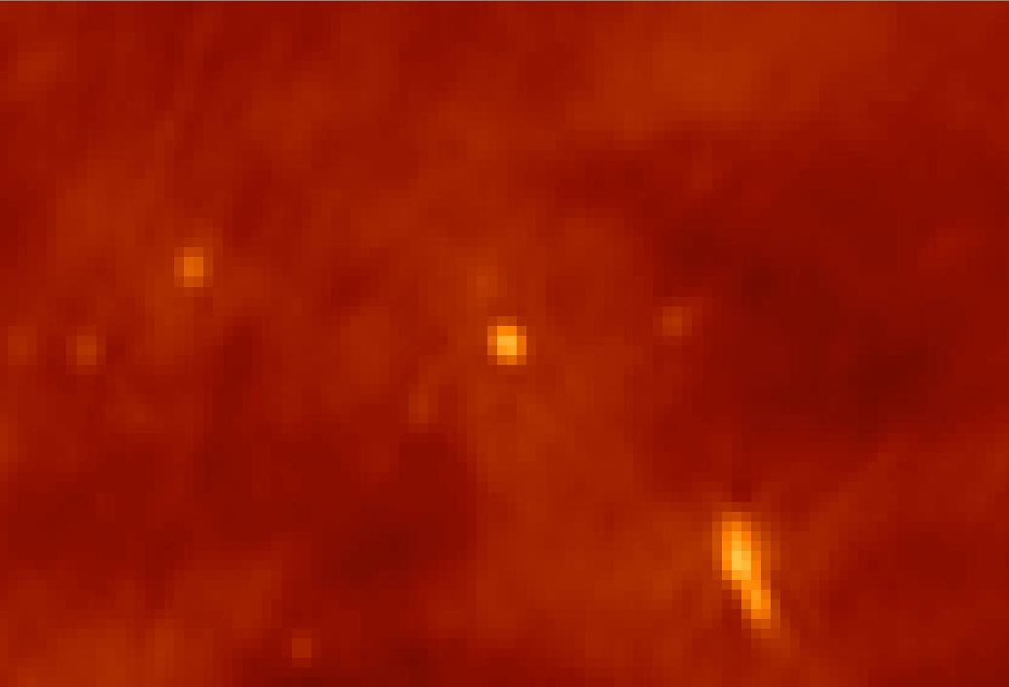
JVLA 4 – 8 GHz

Slide 36
ALMA 1.3 mm continuum (0.05”)

Slide 37
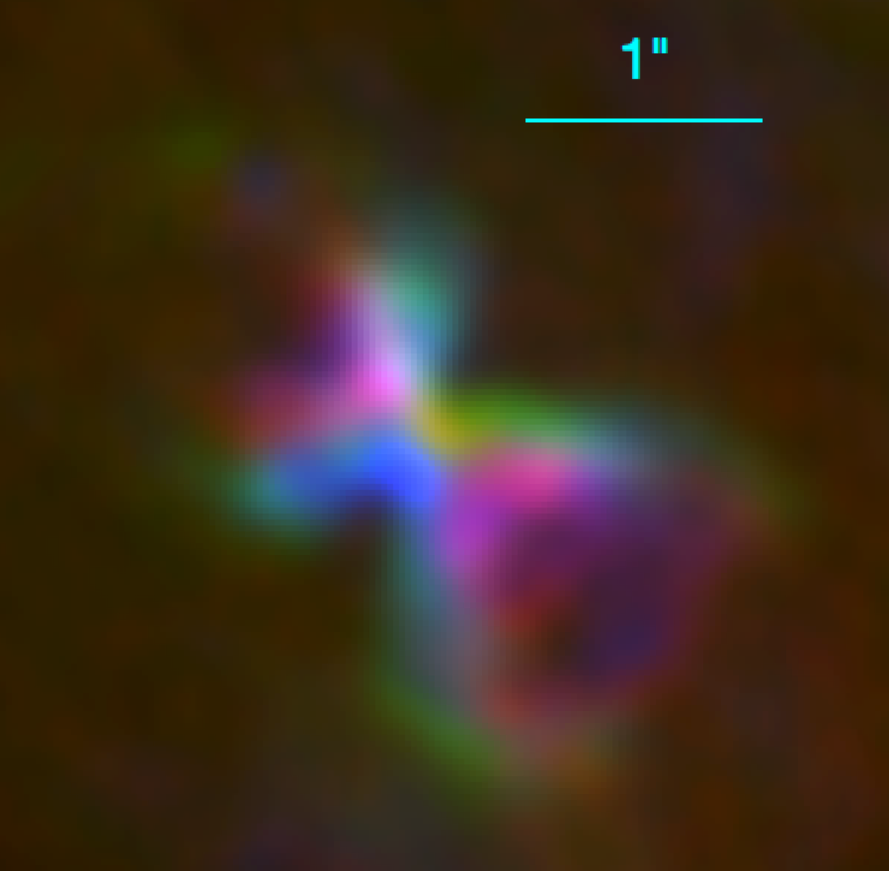
ALMA 1.3 mm SiS (0.05”)

Slide 38
Proper Motions from OMC1: K_{s} & H2 6 GHz
In prep. (2019)

Slide 39
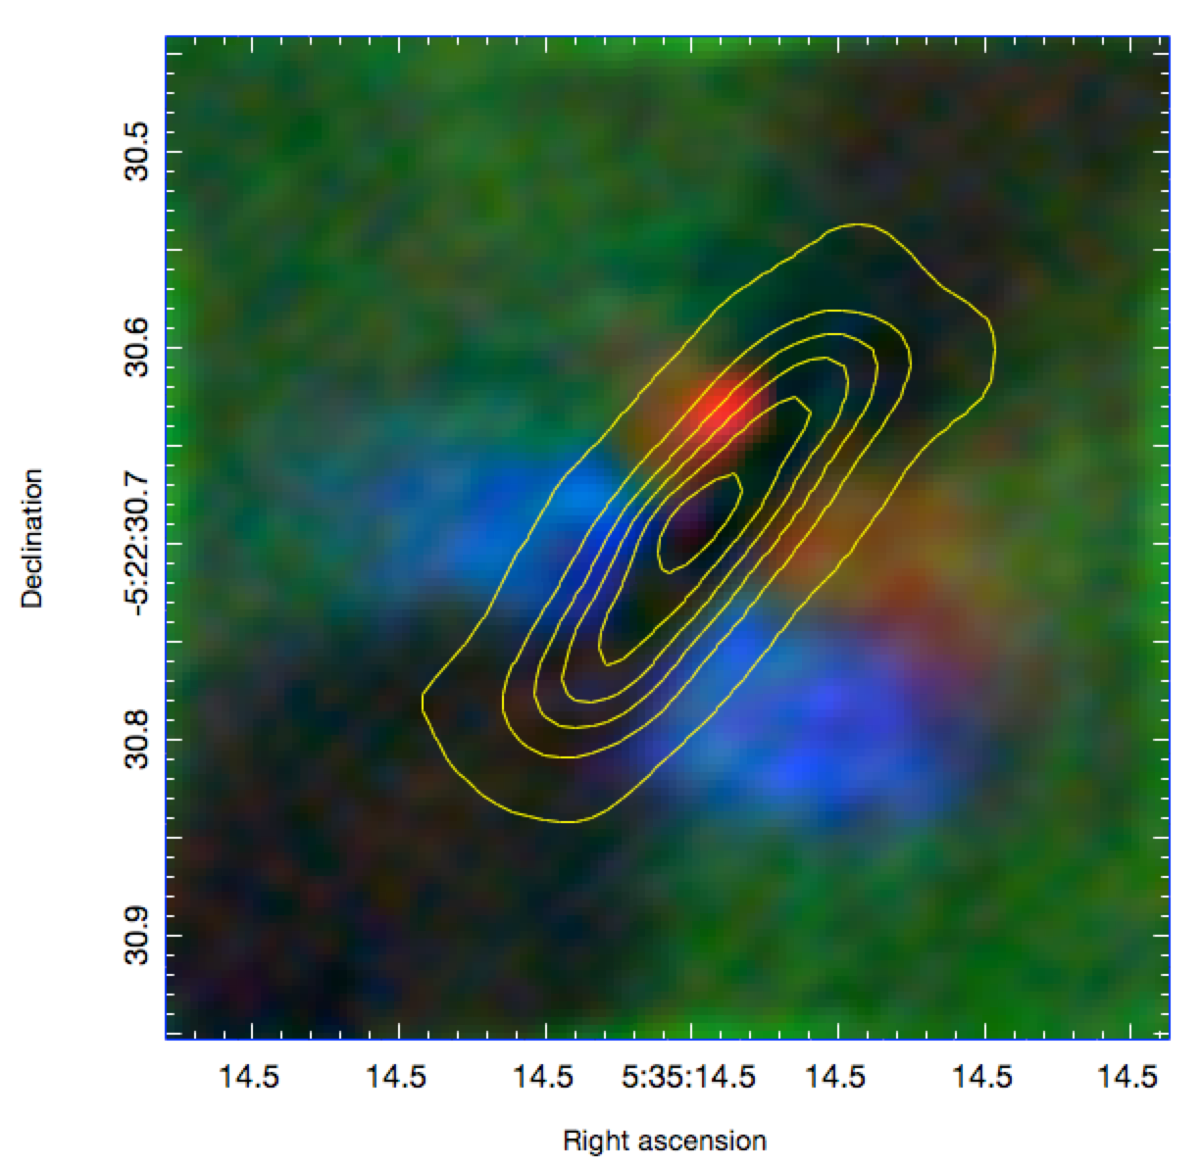
ALMA SiO 8-7 Scr I (0.05”)
850 μm continuum

Slide 40
The Becklin-Neugebauer (BN) object
H-band polarimetry of
BN reflection nebula
(Jiang et al. 2005 Nature)

Slide 41
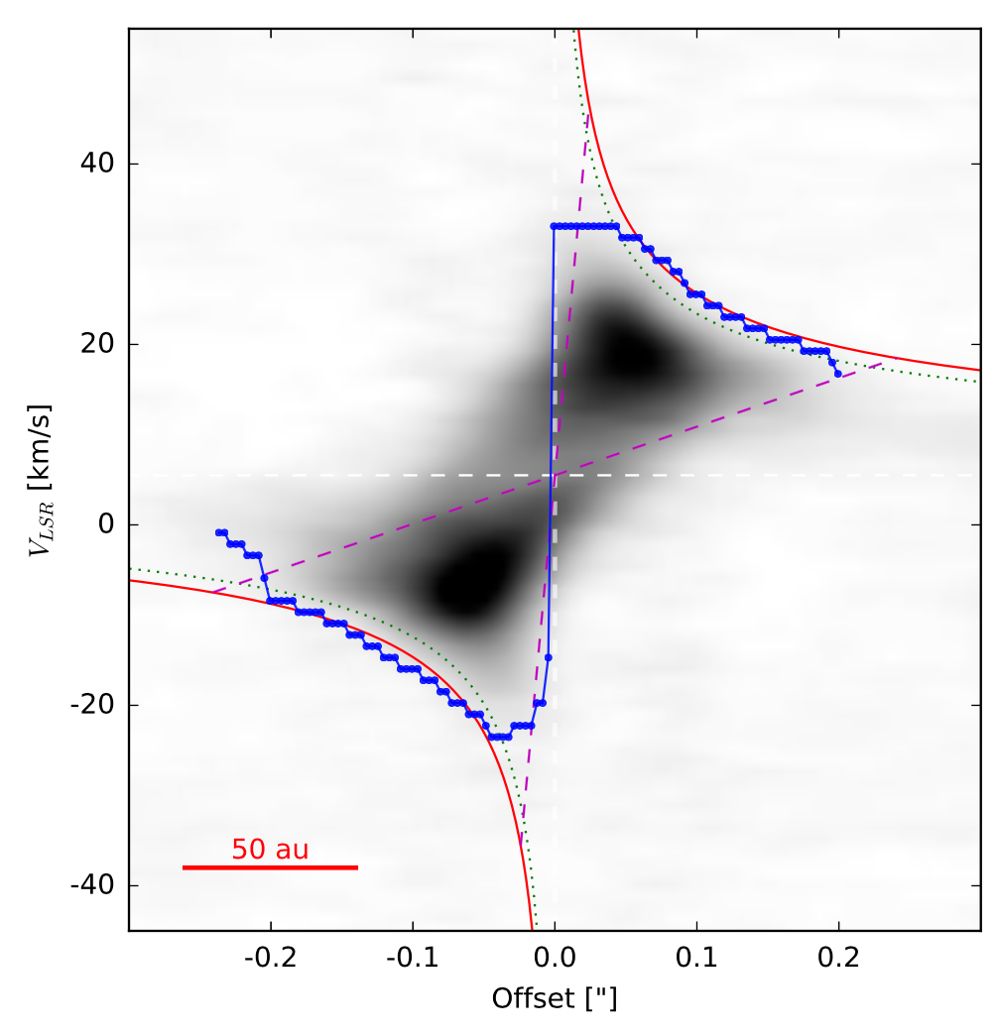
Mass of Src I
H₂O 5_{5,0}-6_{4,3}
232.6867 GHz
M ~ 15 M_{o}
Blue:
Fit to emission
Edge
Ginsburg+ 2018
See Seifried, Sanchez-Monge, Walch, & Banerjee 2016 for method

Slide 42
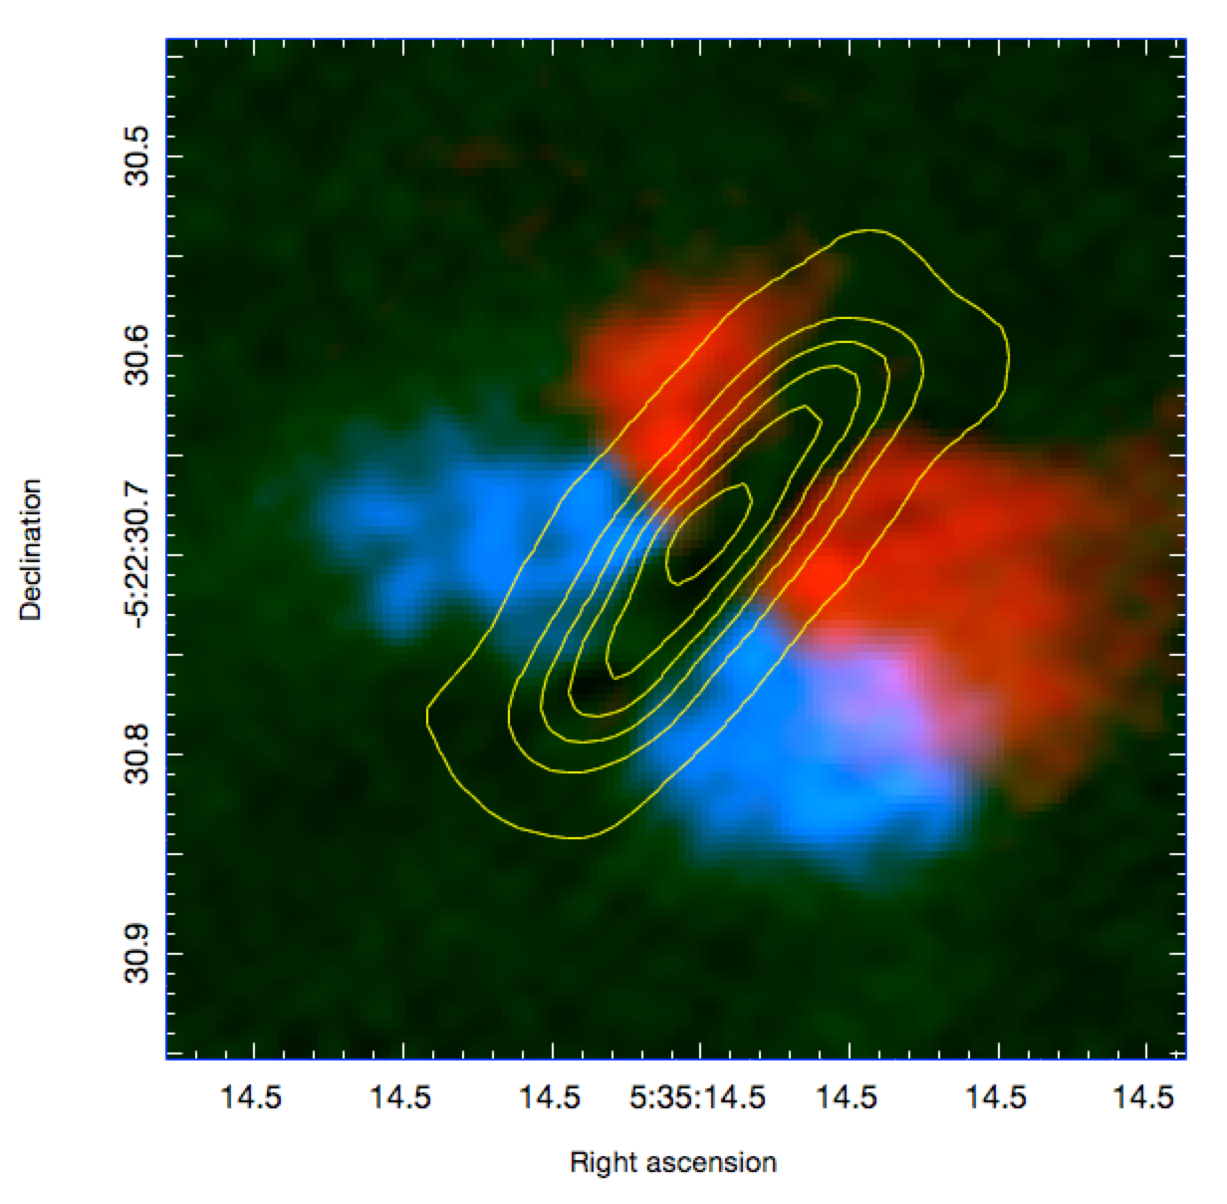
ALMA SiO 8-7 Low V
850 μm continuum

Slide 43
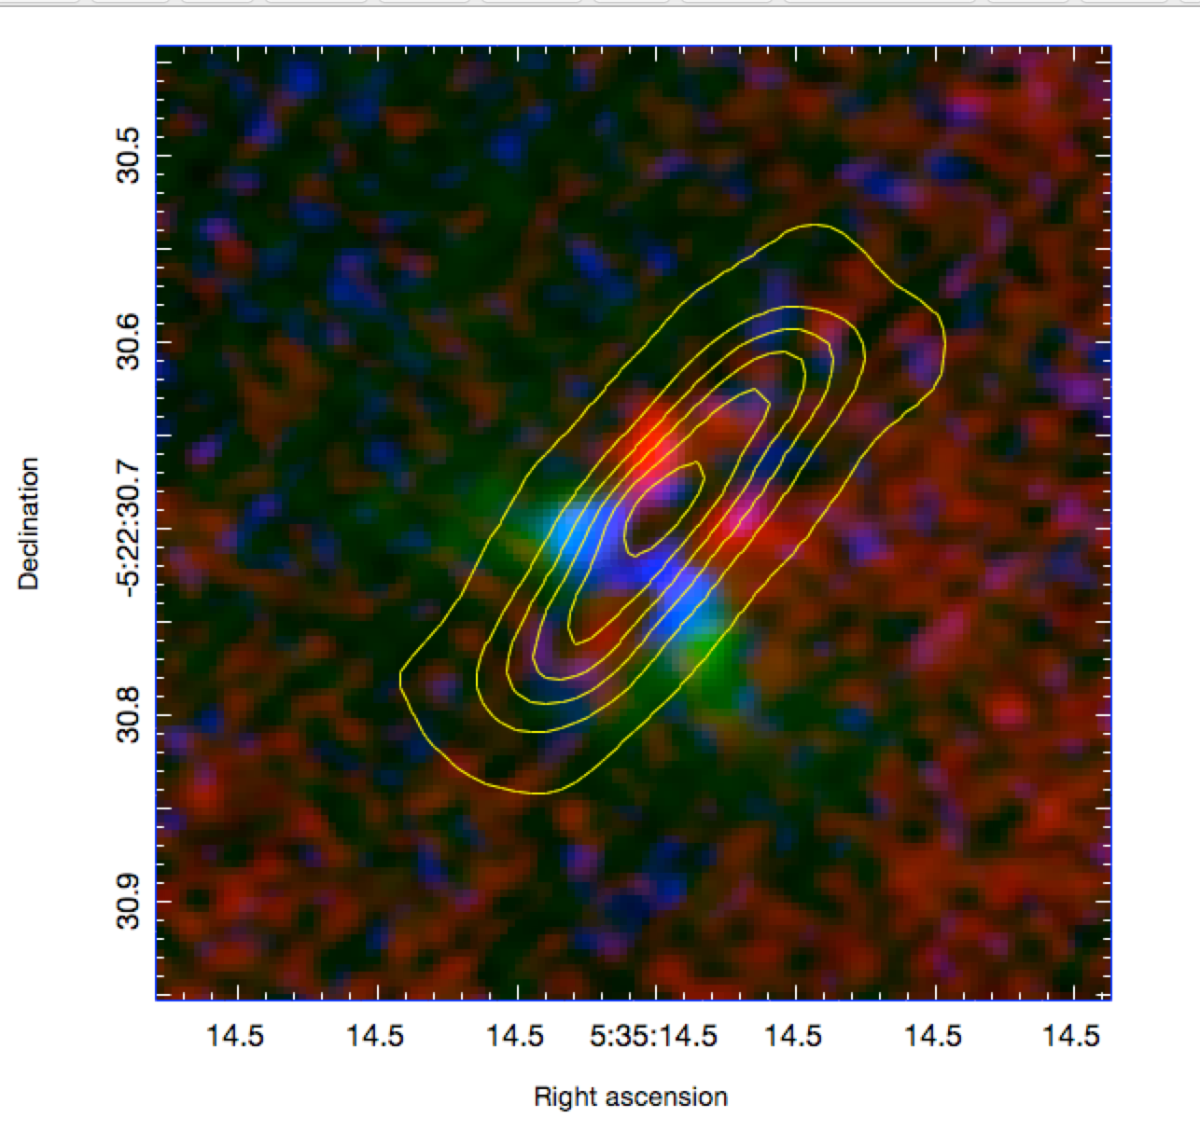
ALMA SiO 8-7 Scr I (0.05”)
ALMA SiO 8-7 High V
850 μm continuum

Slide 44
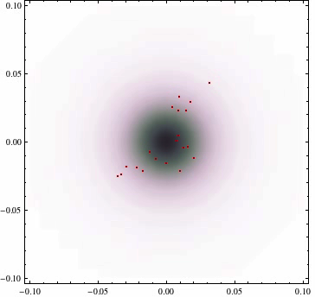

Slide 45
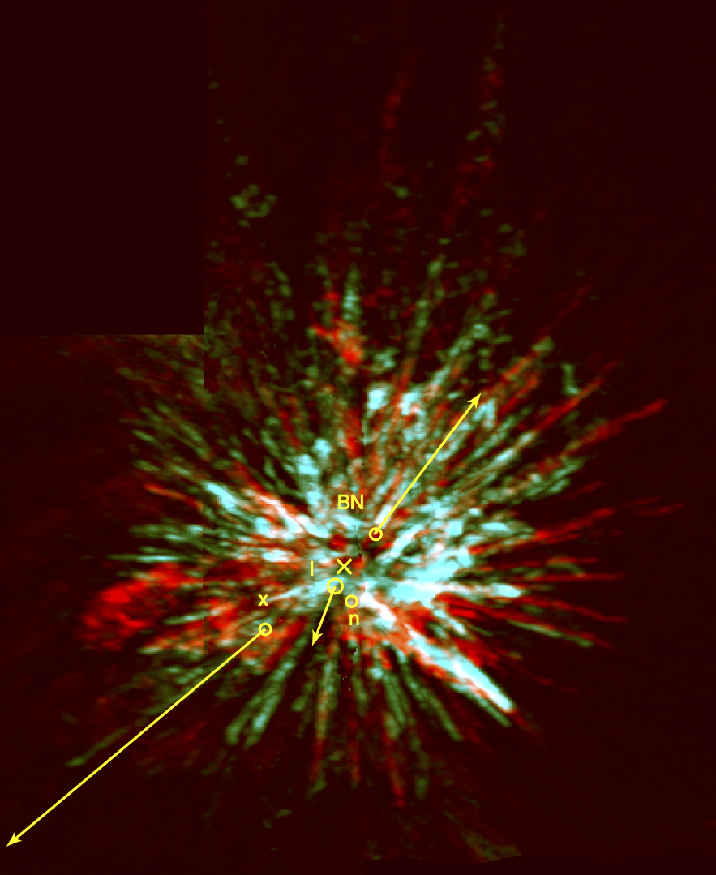
Conclusions:
Gravitational collapse & fragmentation
Most stars form in “transient” clusters
Jets, explosions, and UV
Self-regulation of star formation
4-star interaction in Orion:
A.D. 125+/-25 year
D = 1350 l.y. => 1475 A.D.
Eject 3 stars: BN, Src I, x
10⁴⁸ erg explosion in 10 M_{o} of gas
Src I - a 15 M_{o} merger remnant
N-body interactions / ejections
as important as
initial conditions for
stellar masses

Slide 48
M(Src I)~ 16.0 M_{o}
M(BN)~ 12 M_{o}
M(X)~ 3 M_{o}

Slide 51
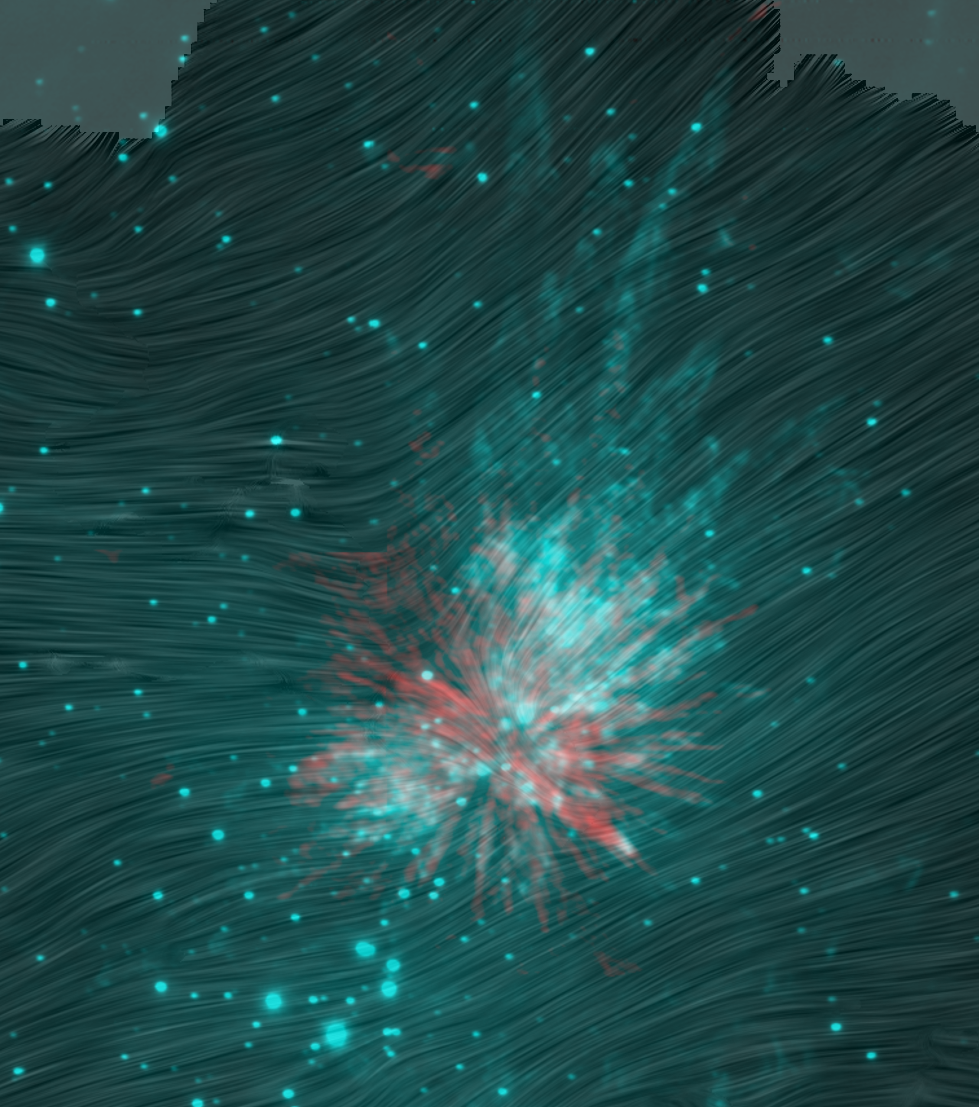
B-fields?
HAWC+
Chuss+2019

Slide 52
Pre-explosion
cavities
by pre-existing
outflows?

Slide 53
~10⁴⁸ erg explosion in Orion OMC1:
Orbit decay
Non-hierarchical system
Form ~1 AU binary or merger (Src I)?
~550 years ago ~10⁴⁸ ergs
Explosion in gas:
~10 M_{o} <V> ~ 20 km/s (V_{max}~400 km/s)
Eject 3 stars:
BN (~10 M_{o}) Src I (~15 M_{o}) Src x (~3 M_{o})
30 km/s 10 km/s 55 km/s
(CB or merger remnant?)
=> Luminous IR-transient (1475+/-25 AD)
(175 AD = 1475 – 1300 l.y)
=> N-body dynamics => IMF ? (Mikkola & Reipruth 2015)

Slide 54
How Common are Explosive Outflows?
isotropic for ~10³ yrs
bipolar for ~10⁵ yrs
…. Few % of outflows:
Orion Src I, DR21, G34.26+0.15, IRAS05506, G5.89-0.39, W49 Src G,..
Luminous Extra-Galactic IR-transients ….
~ 3.6 & 4.5 μm Spitzer SPIRITS Sources
(Kaslilwal+ 2017)
Novae, stellar mergers, SNe, supernova impostors
Protostellar mergers?

