Slide 1
Star & Planet Formation in Orion:
An update
John Bally¹
¹Center for Astrophysics and Space Astronomy (CASA)
Department of Astrophysical and Planetary Sciences (APS)
University of Colorado, Boulder
Frank Dibbell

Slide 2
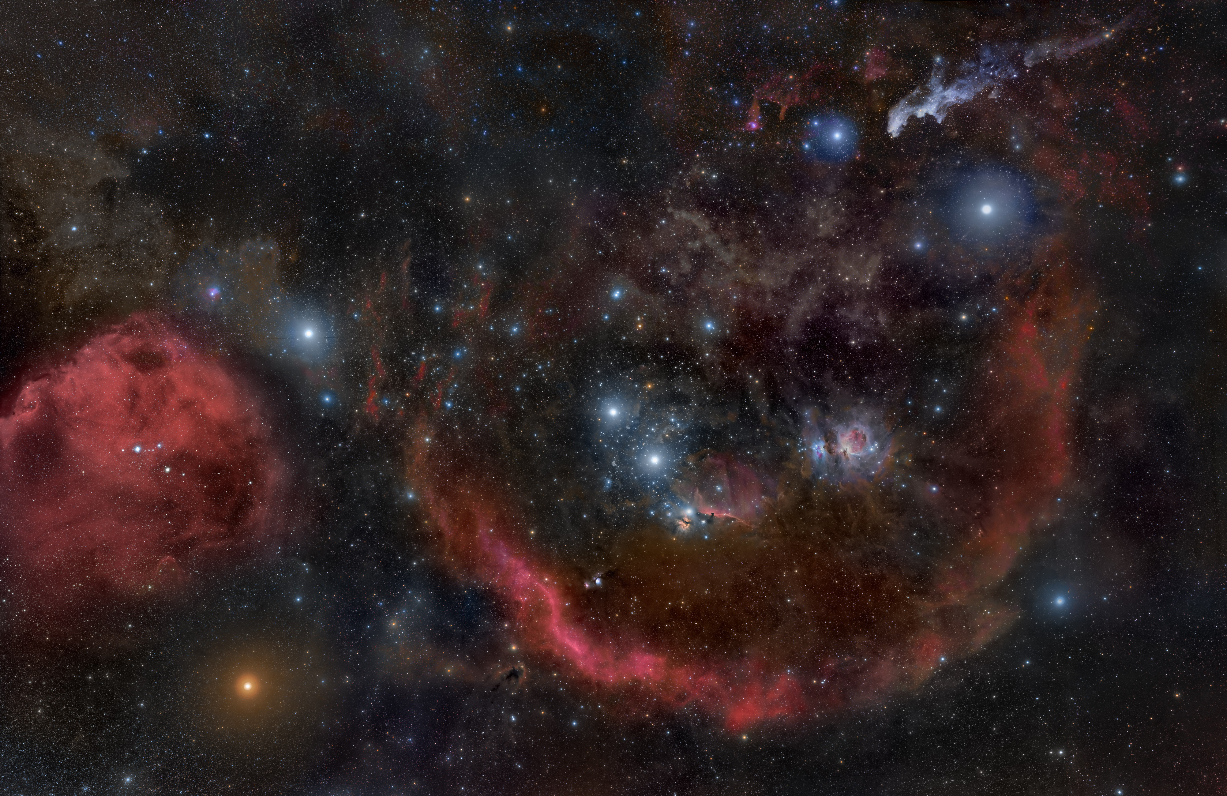
Orion
Visual
Rogelio Bernal Andreo

Slide 3
Nearest, Most-studied Star-Forming Region (SFR)
- Orion: Hierarchical structure (0.001 to ~300 pc) [1 pc ~ 3 light-years ~ 3 x 10¹⁸ cm]
Orion-Eridanus Super-bubble (100 – 300 pc) (Soft-Xray bubble, HI + dust shell)
Extremely-low-density (ELD) HII region (10 – 300 pc) (Barnard’s Loop, Eridanus-Loop)
HII (ionized hydrogen) regions (0.1 – 10 pc) (M42, M43, NGC 1977, NGC 2024, s-Ori, … )
Giant Molecular Clouds (GMCs) (1 – 100 pc)
Orion A, B ~50,000 M_{o} each
Dozens of smaller cometary clouds (1 – 20 pc) (L1622, IC2118, etc.)
Filamentary structure
Hundreds , clumps, cores, disks … (10 AU – 1 pc)
- 10⁴ to 10⁵ Young Stars: GAIA + V_{radial} 3D positions, 3D velocities
The Orion OB1 association
Subgroup a, Age ~ 15 Myr
b, 10 Myr
c, 5 Myr
d forming now
- Dissipation in self-gravitating clouds Star formation !
- Feedback + N-body dynamics Stellar masses (“Initial Mass Function”)
“Initial Conditions” Emerge from previous states; feedback from older generation stars
Sweep-up shells, compress, shape, heat, ionize, accelerate, disperse …

Slide 4
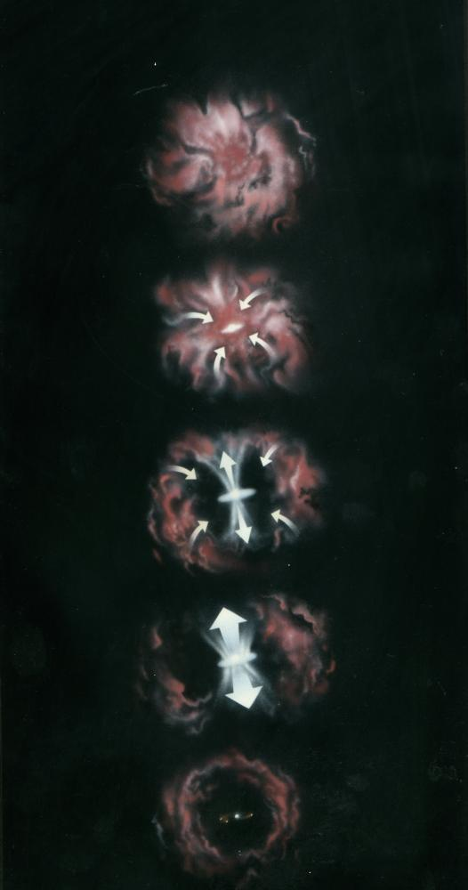
Star Formation
Shrink size by 10⁷; increase density by x 10²¹ !
Where planets also form
Giant Molecular Cloud Core
Raw material for star birth
Gravitational Collapse & Fragmentation
Proto-stars, proto-binaries, proto-clusters
Rotation & Magnetic Fields
Accretion disks, jets, & outflows
Planets
Most may form in clusters!
C. Lada

Slide 5
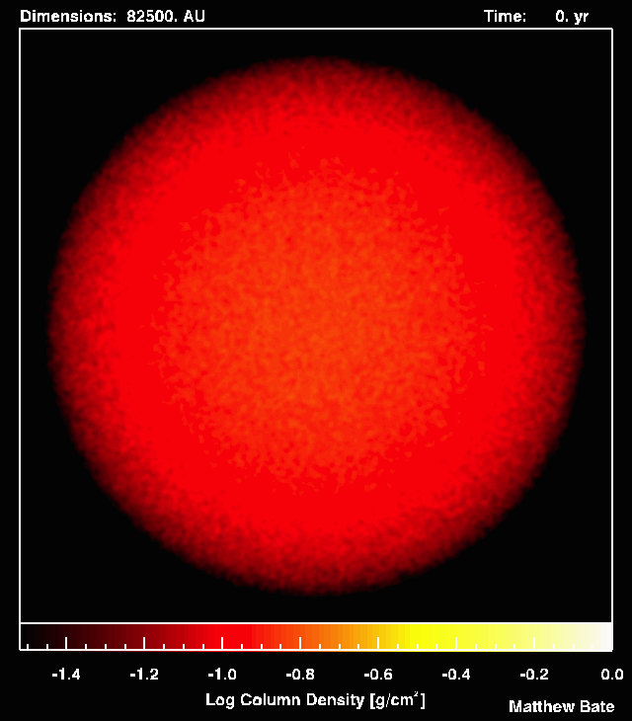
Most
stars
form
in
Clusters
SPH:
- No radiation
- No B
- No outflows
Bate, M. R.,
Bonnell, I. A.,
Bromm, V.,
2002, MNRAS,
332, L65-L68.

Slide 6
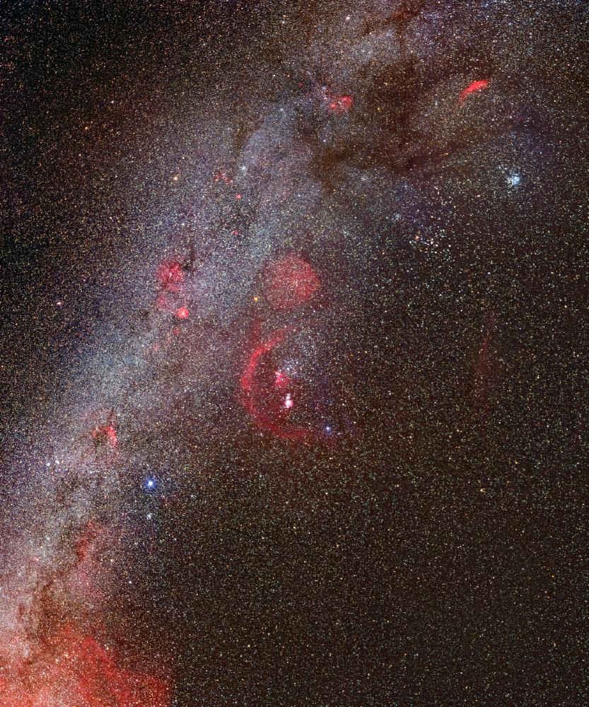
The Winter sky (Visual):
λ = 0.5 μm

Slide 7
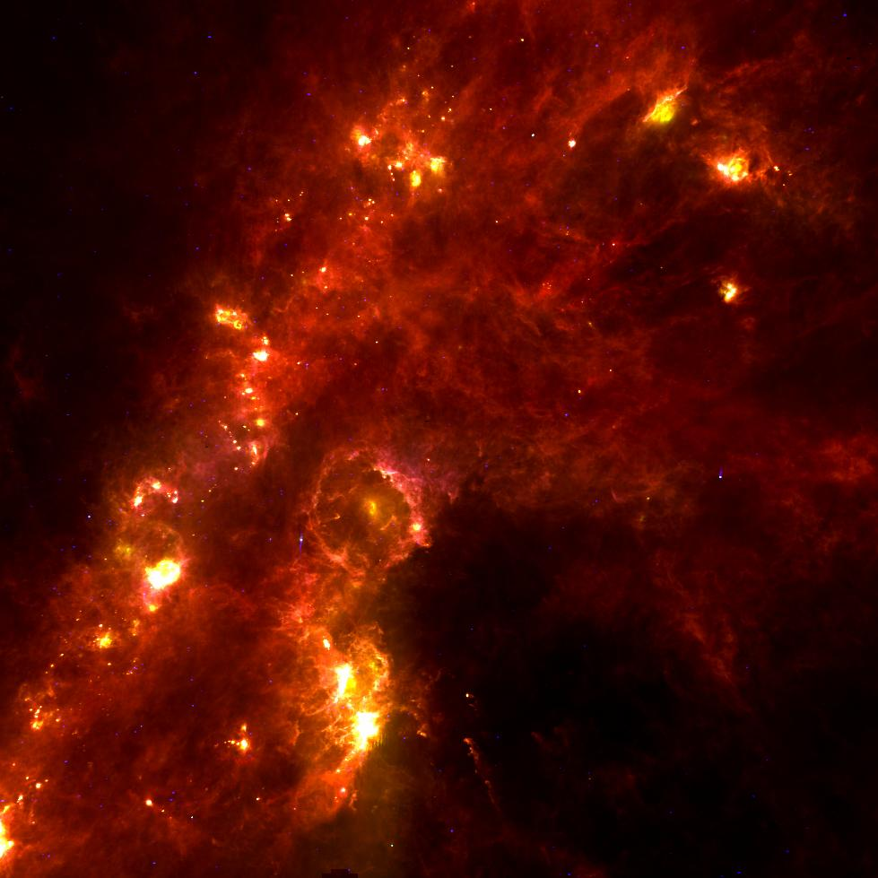
The Winter sky (IR):
λ = 100 μm

Slide 8
Ejected massive stars:
2.6+/- 0.05 Myr ago
AE Aur
150 km/s
Pleiades
i Ori
m Col
117 km/s

Slide 9
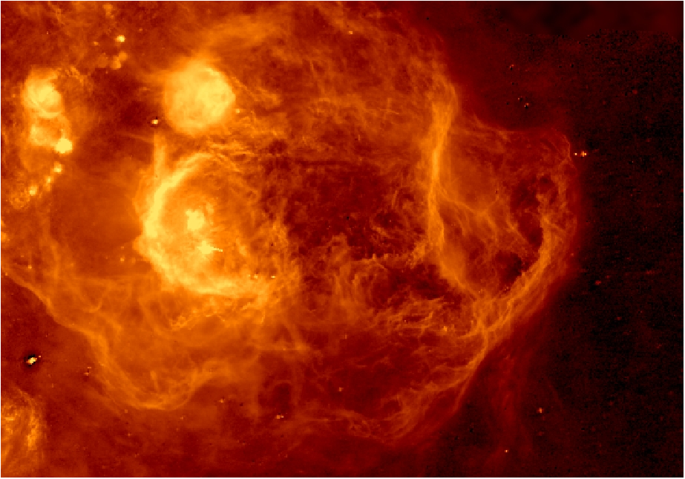
Orion / Eridanus superbubble: Hα
Pon, Johnstone, Bally, & Heiles 2014

Slide 10
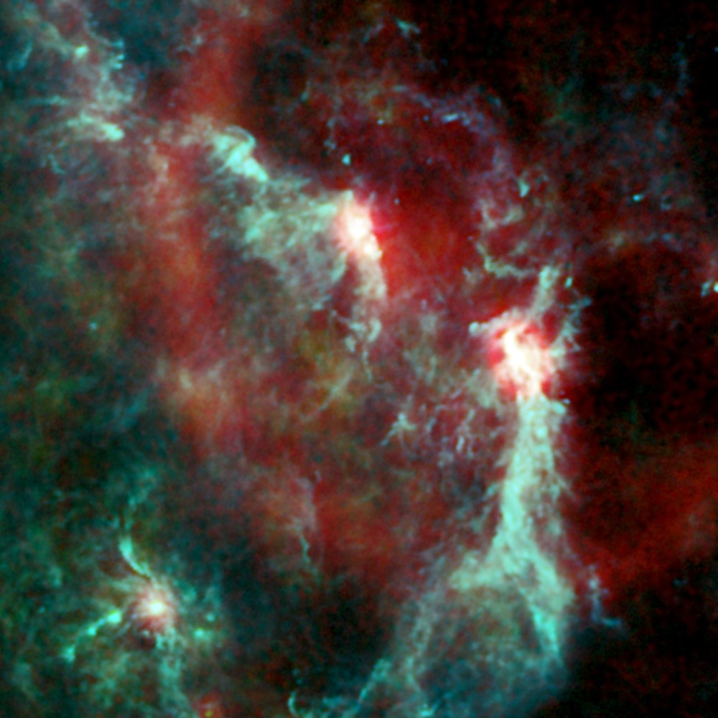
Orion (Planck)
Dust 545 GHz
Plasma 30 GHz

Slide 11
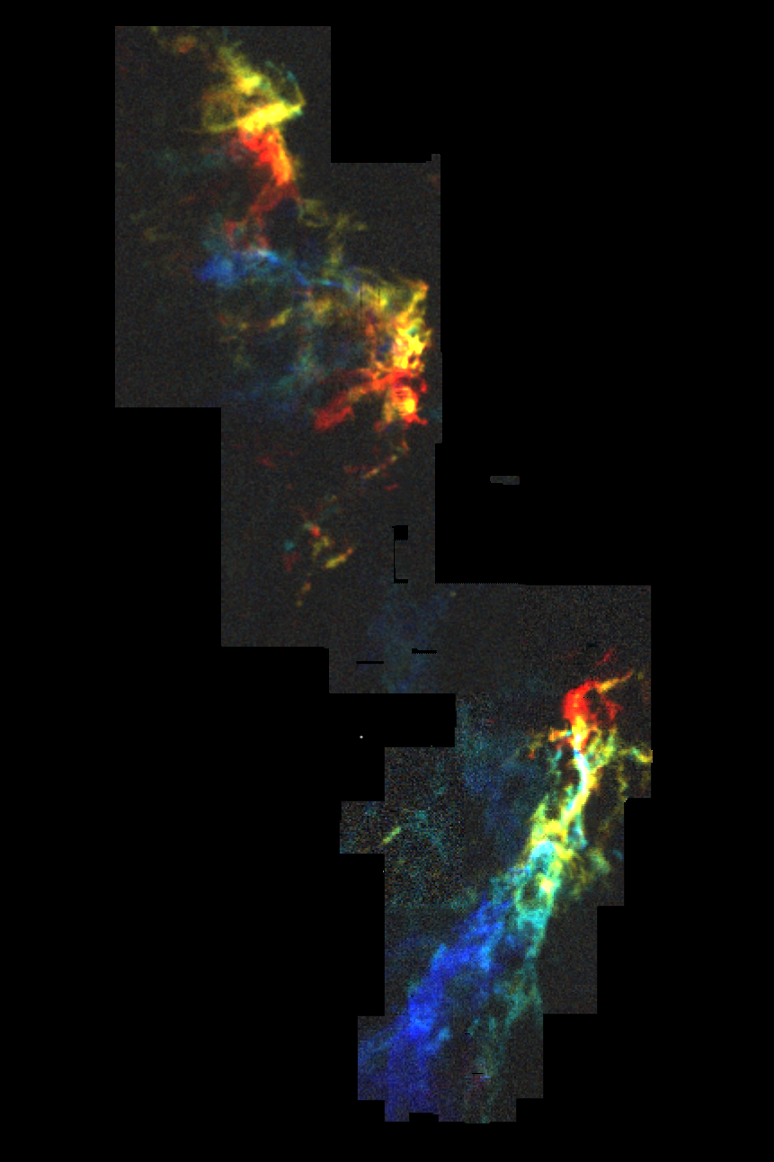
Orion Molecular
Clouds
Orion B
¹³CO
(2.6 mm)
Orion Nebula
Orion A
(AT&T Bell Labs
7 meter)

Slide 12
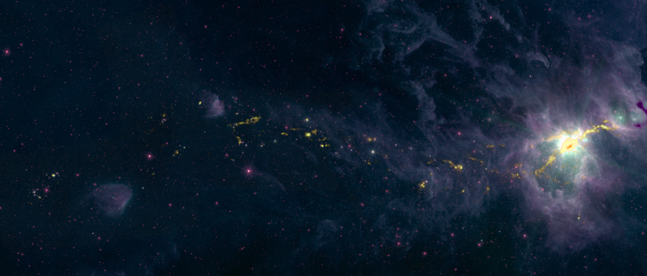
Orion A: 1.1 mm (BGPS) + WISE 22 μm
Orion Nebula

Slide 13
Orion A: H₂ Column density (Herschel Space Observatory)

Slide 14
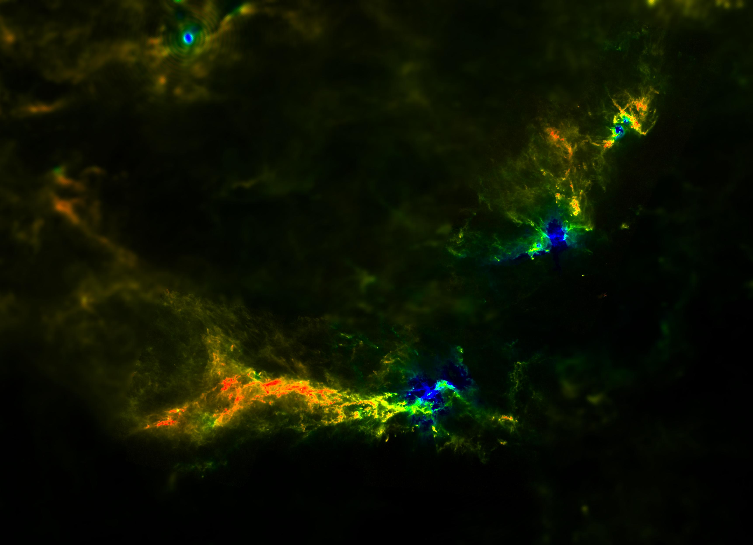
Orion A & B: Dust temperature (Herschel+ Planck)

Slide 15
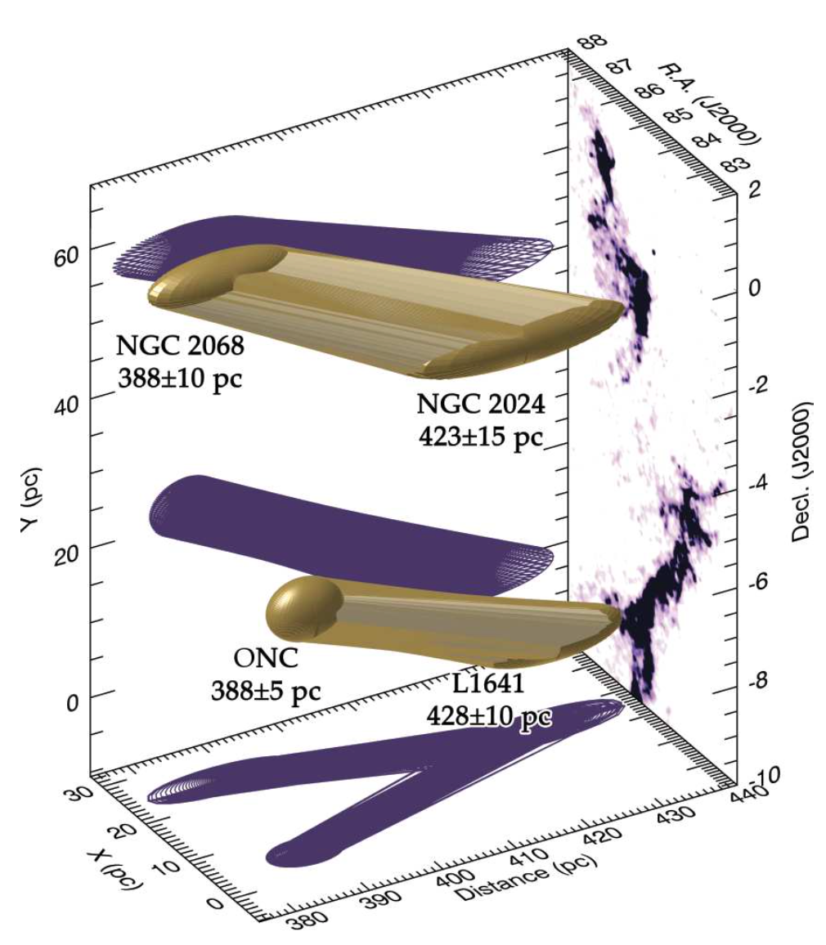
Orion
Distances:
VLBA
radio parallax
Kounkel M. et al.
2014, ApJ, 790, 49
Kounkel M. et al.
2016,
arXiv1609.04041v1

Slide 18


Slide 19
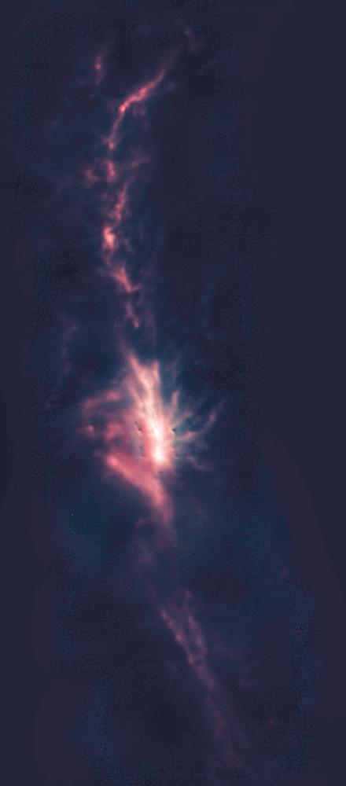

Orion A “Integral Shaped Filament”: 850 um (SCUBA / JCMT)
¹³CO Doppler shifts: 0 – 4 km/s: 4 – 8 km/s: 8 – 12 km/s (AT&T Bell Labs)
850 μm
2.6 mm ¹³CO

Slide 20
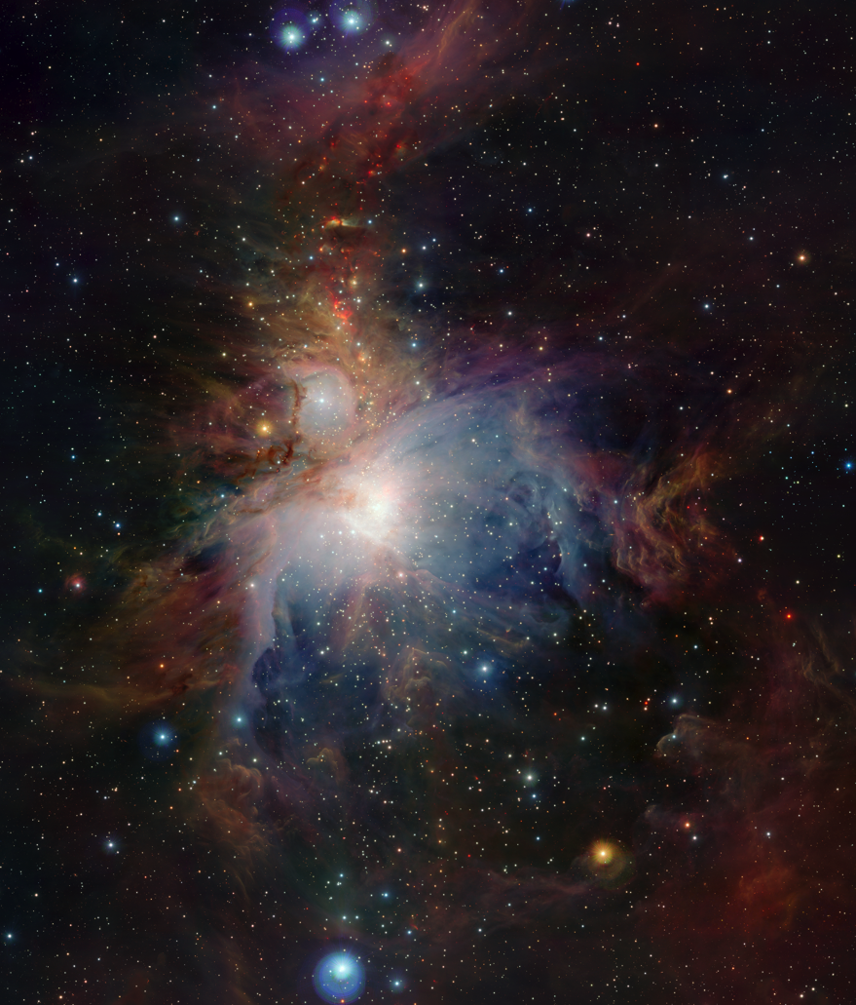
Orion A “Integral Shaped Filament”: 1.2, 1.6, 2.2 um (VISTA)

Slide 21
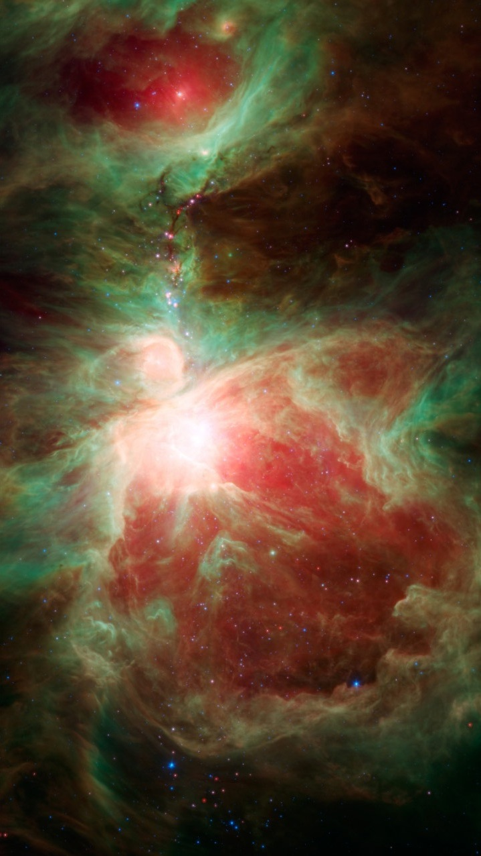
Orion A “Integral Shaped Filament”: 4.5, 8.0, 24 um (Spitzer)

Slide 22
Orion A “Integral Shaped Filament”: 70,170, 350 um (Herschel)

Slide 23
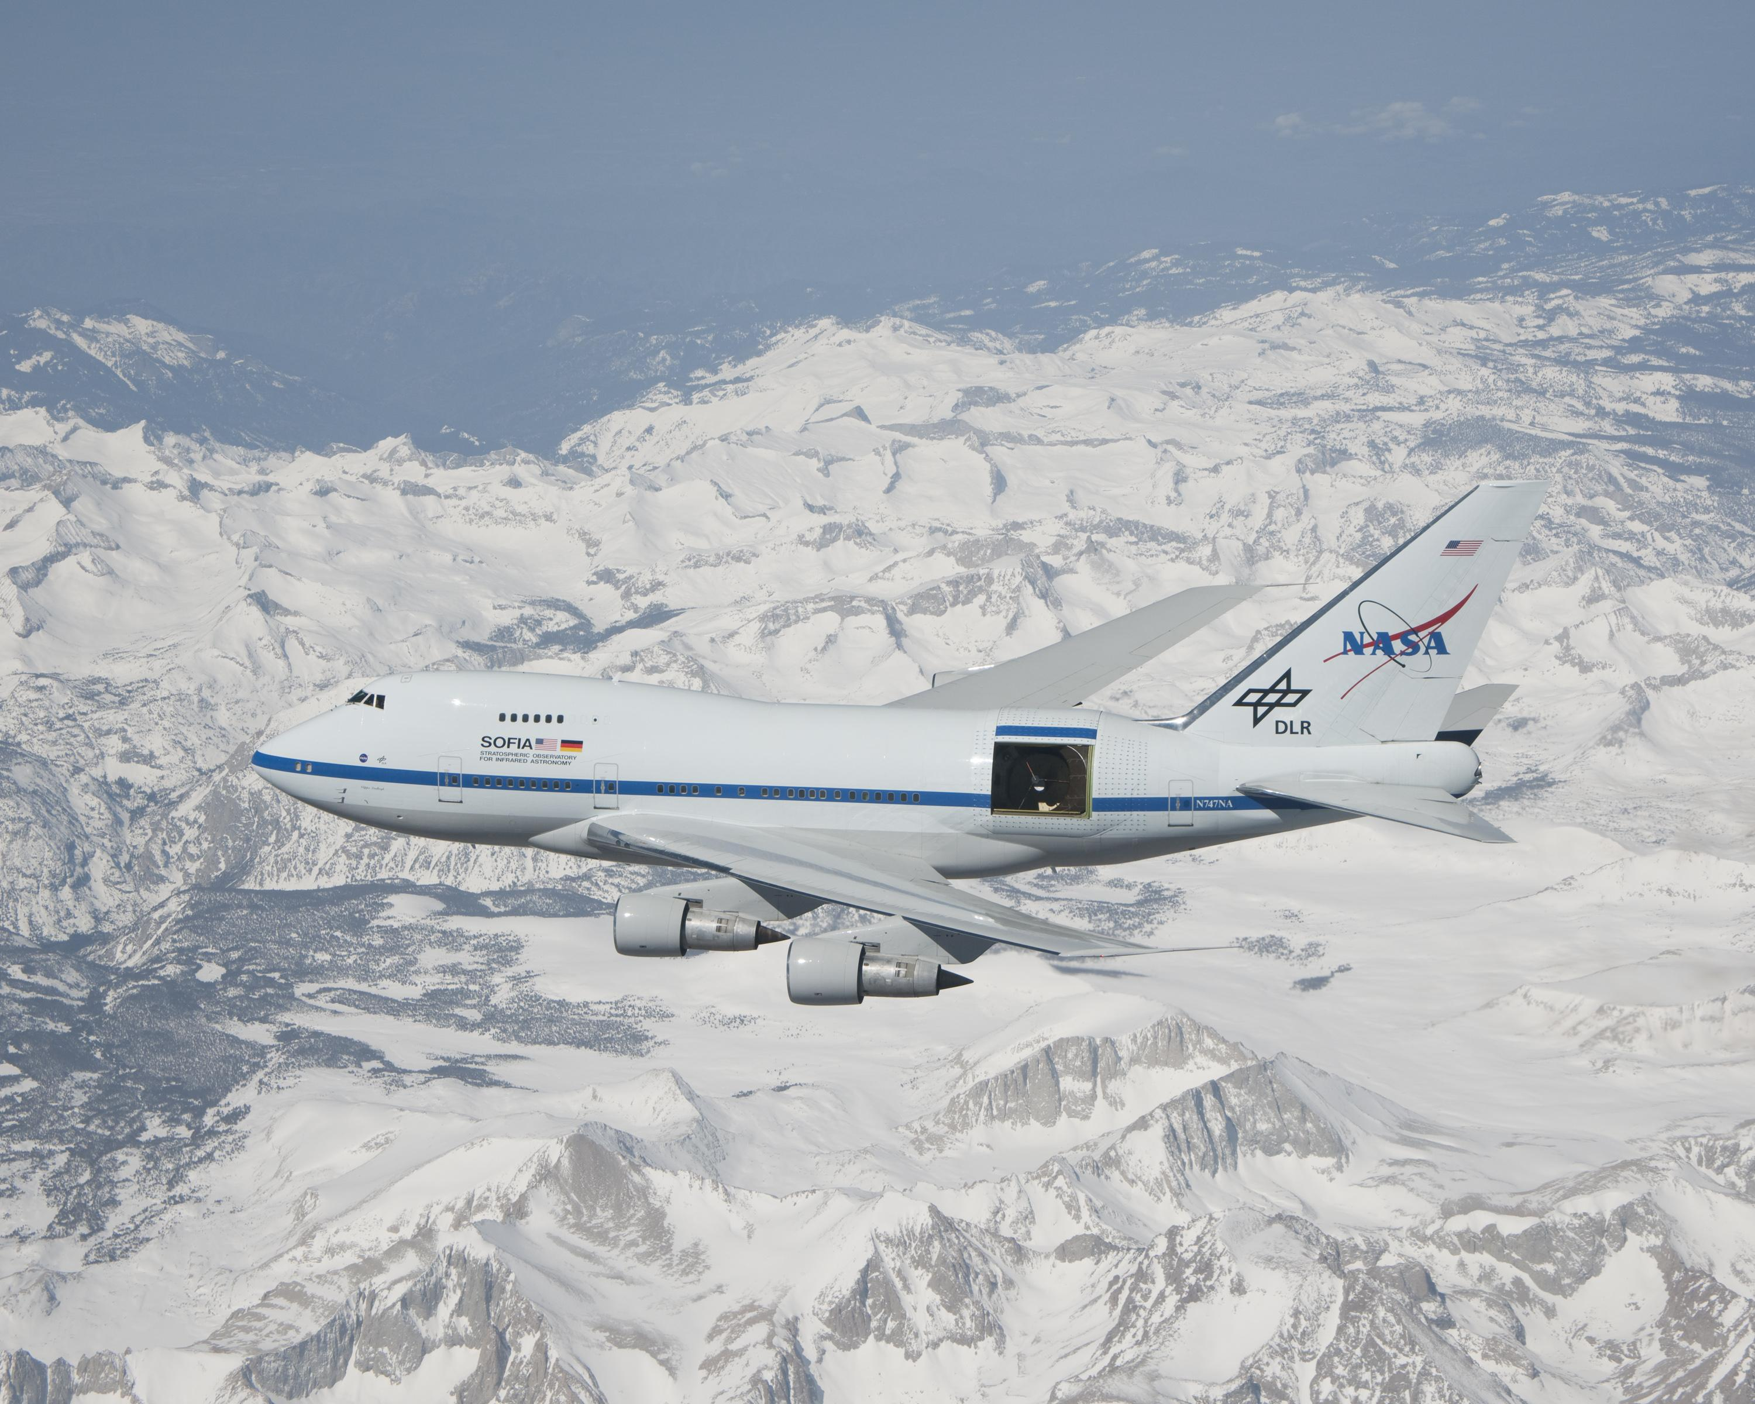
SOFIA: Stratospheric Observatory for Infrared Astronomy
2.5 meter telescope + GREAT => 158 um C⁺ mapping

Slide 24
How Common are Explosive Outflows?:
Several `fossil’ Galactic candidates exist
~ isotropic for ~10³ years
bipolar on longer times (e.g. DR 21)
=> Few % of known (massive-star) outflows
Luminous Extra-Galactic IR-transients
~150 IR-only transients in ~20 nearby star-forming
galaxies
Orion C+ 158 μm
SOFIA/GREAT
Pabst+ (2019)

Slide 25
How Common are Explosive Outflows?:
Several `fossil’ Galactic candidates exist
~ isotropic for ~10³ years
bipolar on longer times (e.g. DR 21)
=> Few % of known (massive-star) outflows
Luminous Extra-Galactic IR-transients
~150 IR-only transients in ~20 nearby star-forming
galaxies
Orion C+ 158 μm
SOFIA/GREAT
Pabst+ (2019)

Slide 26
How Common are Explosive Outflows?:
Several `fossil’ Galactic candidates exist
~ isotropic for ~10³ years
bipolar on longer times (e.g. DR 21)
=> Few % of known (massive-star) outflows
Luminous Extra-Galactic IR-transients
~150 IR-only transients in ~20 nearby star-forming
galaxies
Orion C+ 158 μm
SOFIA/GREAT
Pabst+ (2019)

Slide 27
How Common are Explosive Outflows?:
Several `fossil’ Galactic candidates exist
~ isotropic for ~10³ years
bipolar on longer times (e.g. DR 21)
=> Few % of known (massive-star) outflows
Luminous Extra-Galactic IR-transients
~150 IR-only transients in ~20 nearby star-forming
galaxies
Orion C+ 158 μm
SOFIA/GREAT
Pabst+ (2019)

Slide 28
How Common are Explosive Outflows?:
Several `fossil’ Galactic candidates exist
~ isotropic for ~10³ years
bipolar on longer times (e.g. DR 21)
=> Few % of known (massive-star) outflows
Luminous Extra-Galactic IR-transients
~150 IR-only transients in ~20 nearby star-forming
galaxies
Orion C+ 158 μm
SOFIA/GREAT
Pabst+ (2019)

Slide 29
How Common are Explosive Outflows?:
Several `fossil’ Galactic candidates exist
~ isotropic for ~10³ years
bipolar on longer times (e.g. DR 21)
=> Few % of known (massive-star) outflows
Luminous Extra-Galactic IR-transients
~150 IR-only transients in ~20 nearby star-forming
galaxies
Orion C+ 158 μm
SOFIA/GREAT
Pabst+ (2019)

Slide 30
How Common are Explosive Outflows?:
Several `fossil’ Galactic candidates exist
~ isotropic for ~10³ years
bipolar on longer times (e.g. DR 21)
=> Few % of known (massive-star) outflows
Luminous Extra-Galactic IR-transients
~150 IR-only transients in ~20 nearby star-forming
galaxies
Orion C+ 158 μm
SOFIA/GREAT
Pabst+ (2019)

Slide 31
How Common are Explosive Outflows?:
Several `fossil’ Galactic candidates exist
~ isotropic for ~10³ years
bipolar on longer times (e.g. DR 21)
=> Few % of known (massive-star) outflows
Luminous Extra-Galactic IR-transients
~150 IR-only transients in ~20 nearby star-forming
galaxies
Orion C+ 158 μm
SOFIA/GREAT
Pabst+ (2019)

Slide 32
How Common are Explosive Outflows?:
Several `fossil’ Galactic candidates exist
~ isotropic for ~10³ years
bipolar on longer times (e.g. DR 21)
=> Few % of known (massive-star) outflows
Luminous Extra-Galactic IR-transients
~150 IR-only transients in ~20 nearby star-forming
galaxies
Orion C+ 158 μm
SOFIA/GREAT
Pabst+ (2019)

Slide 33
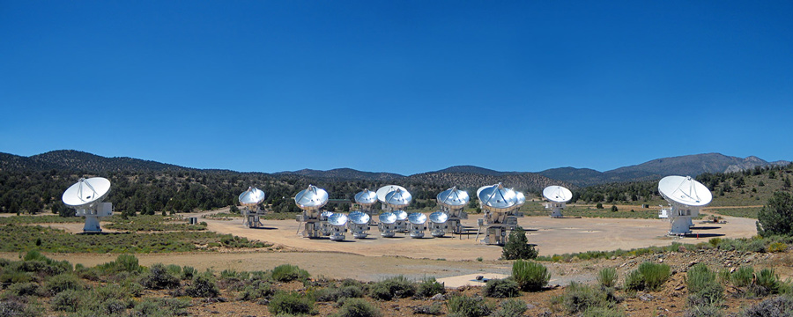
CARMA
(California ARray for Millimeter Astronomy)
R.I.P. 2015

Slide 35
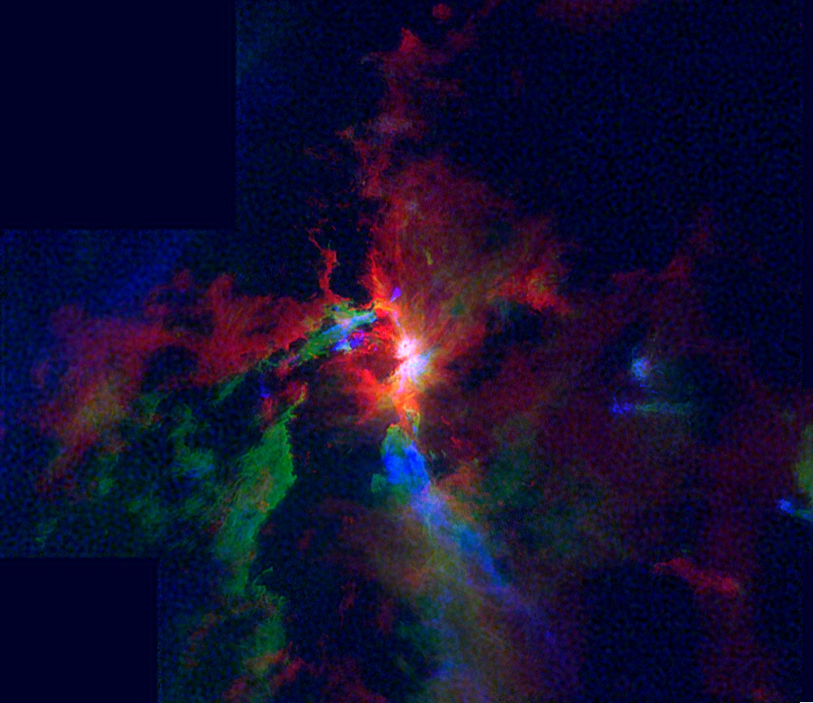
CARMAOrion ¹²CO (Kong+ 2019)
5
7
9
km/s

Slide 36
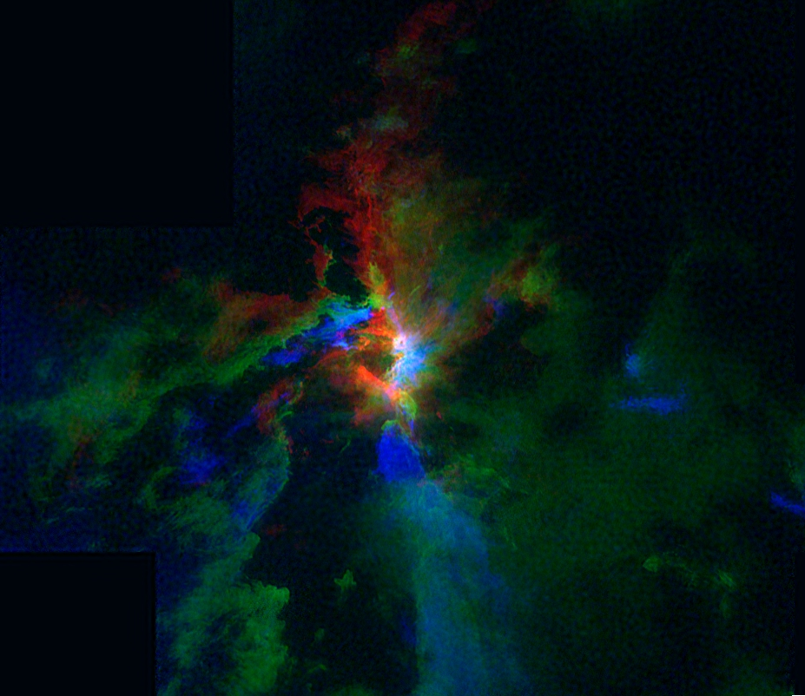
CARMAOrion ¹²CO (Kong+ 2019)
6
8
10
km/s

Slide 37
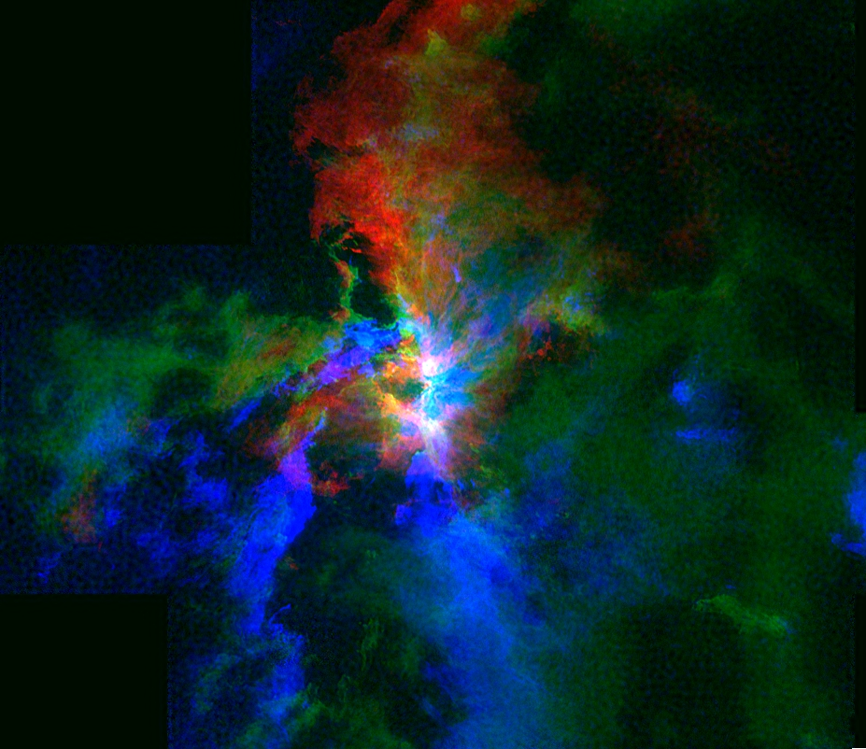
CARMAOrion ¹²CO (Kong+ 2019)
7
9
11
km/s

Slide 38
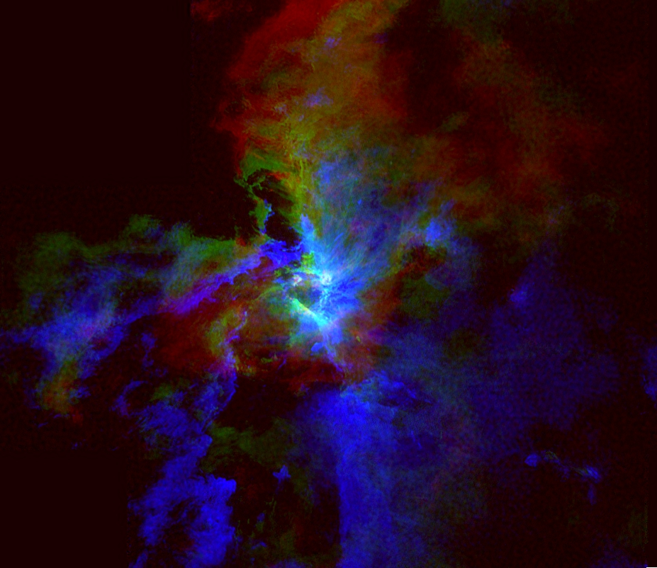
CARMAOrion ¹²CO (Kong+ 2019)
8
10
12
km/s

Slide 40
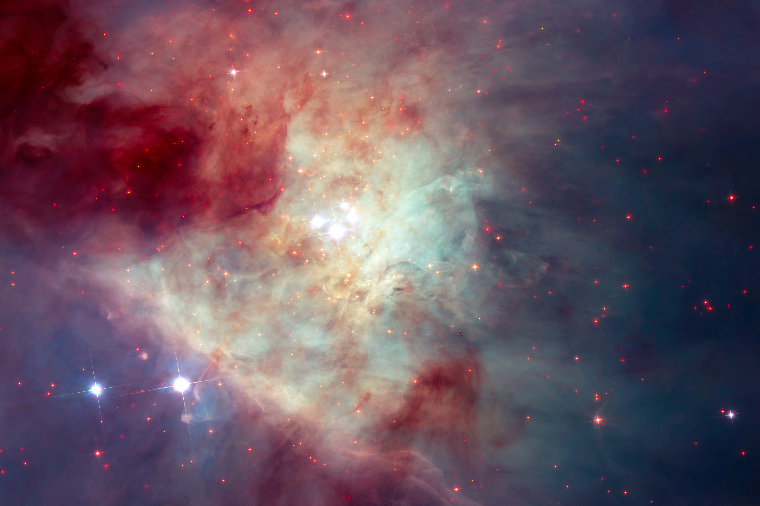

Slide 41
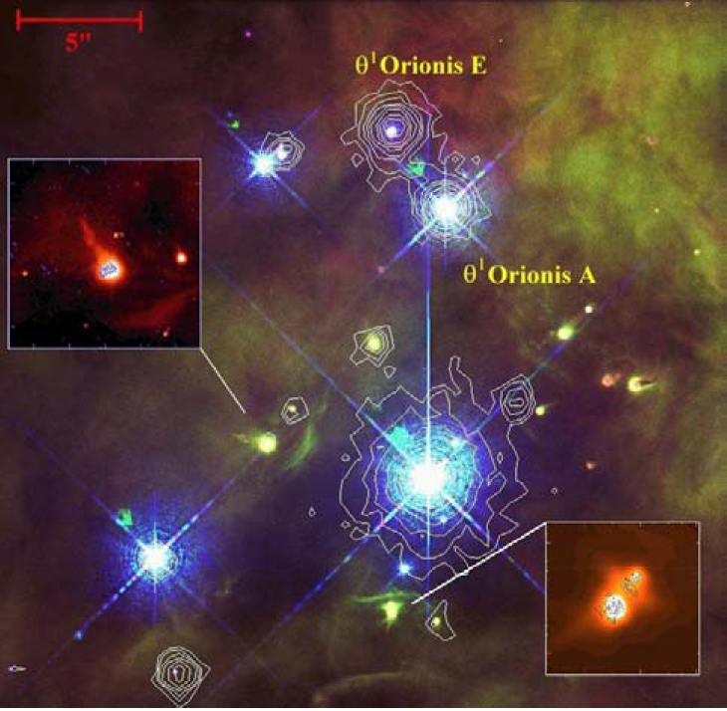

Slide 44
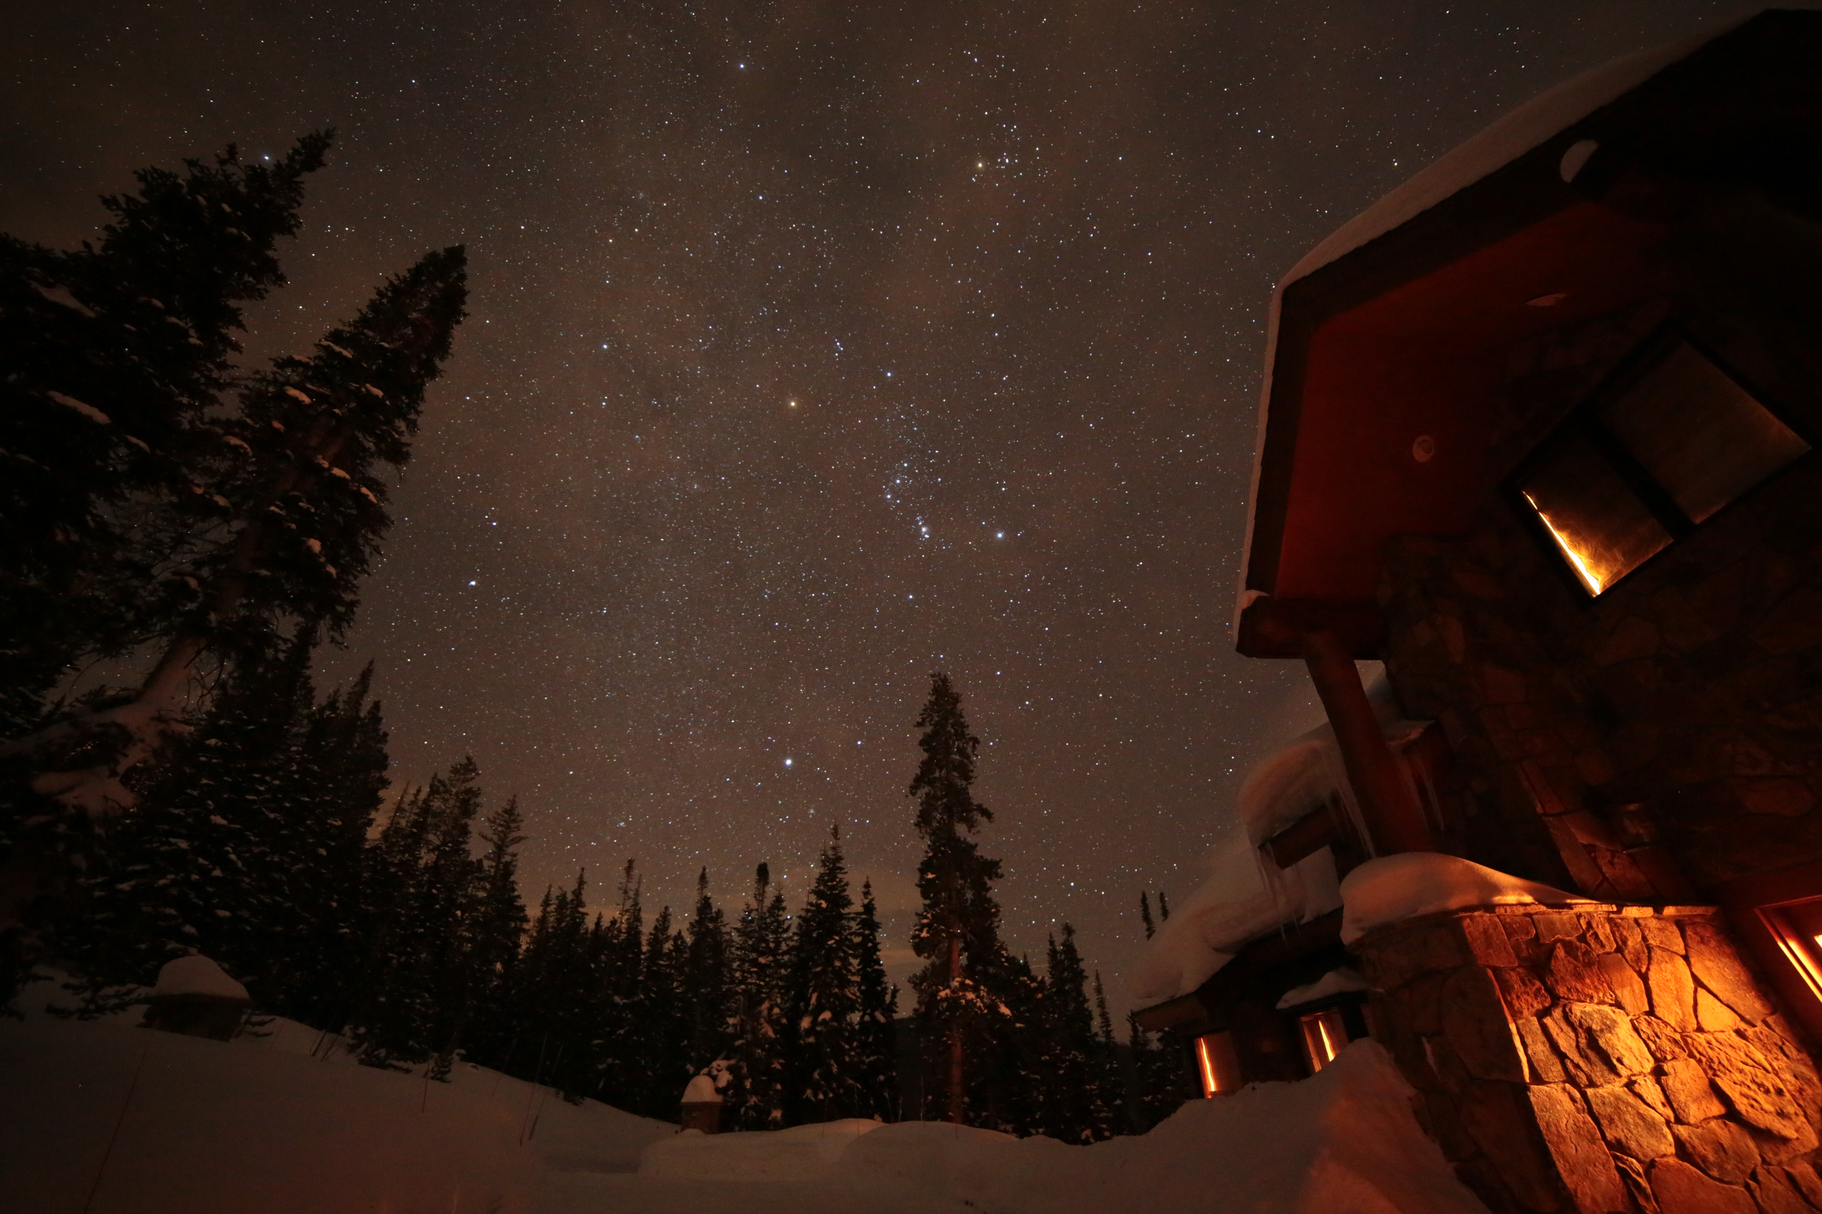
Orion
… Stellar collisions & Stellar mergers
The Explosion in Orion ….
in BCE 175 +/- 25 years
Released more energy than the
Sun puts out in 10 million years !

Slide 45
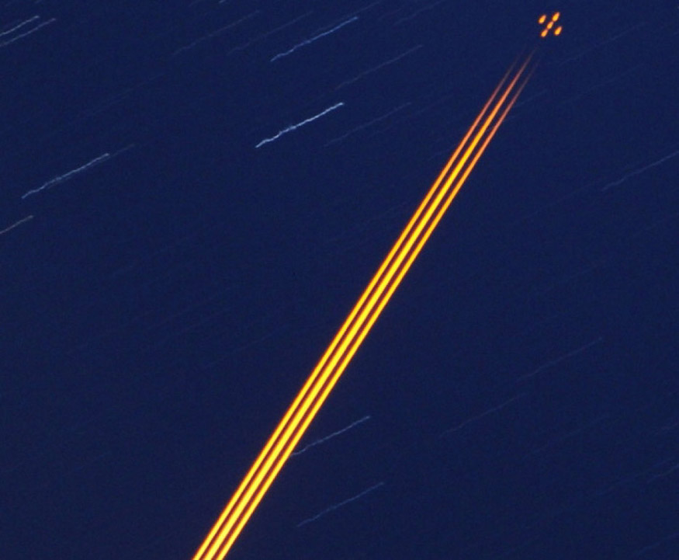
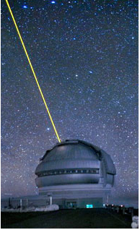
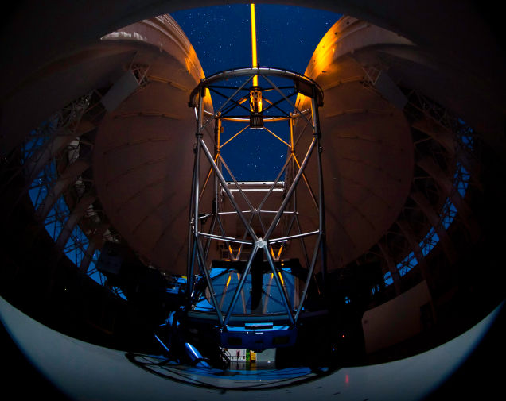
Gemini
South
Adaptive
Optics
Imager

Slide 46
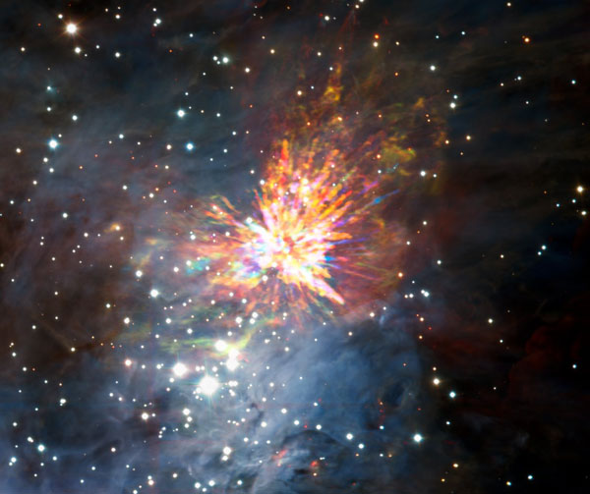

Slide 47
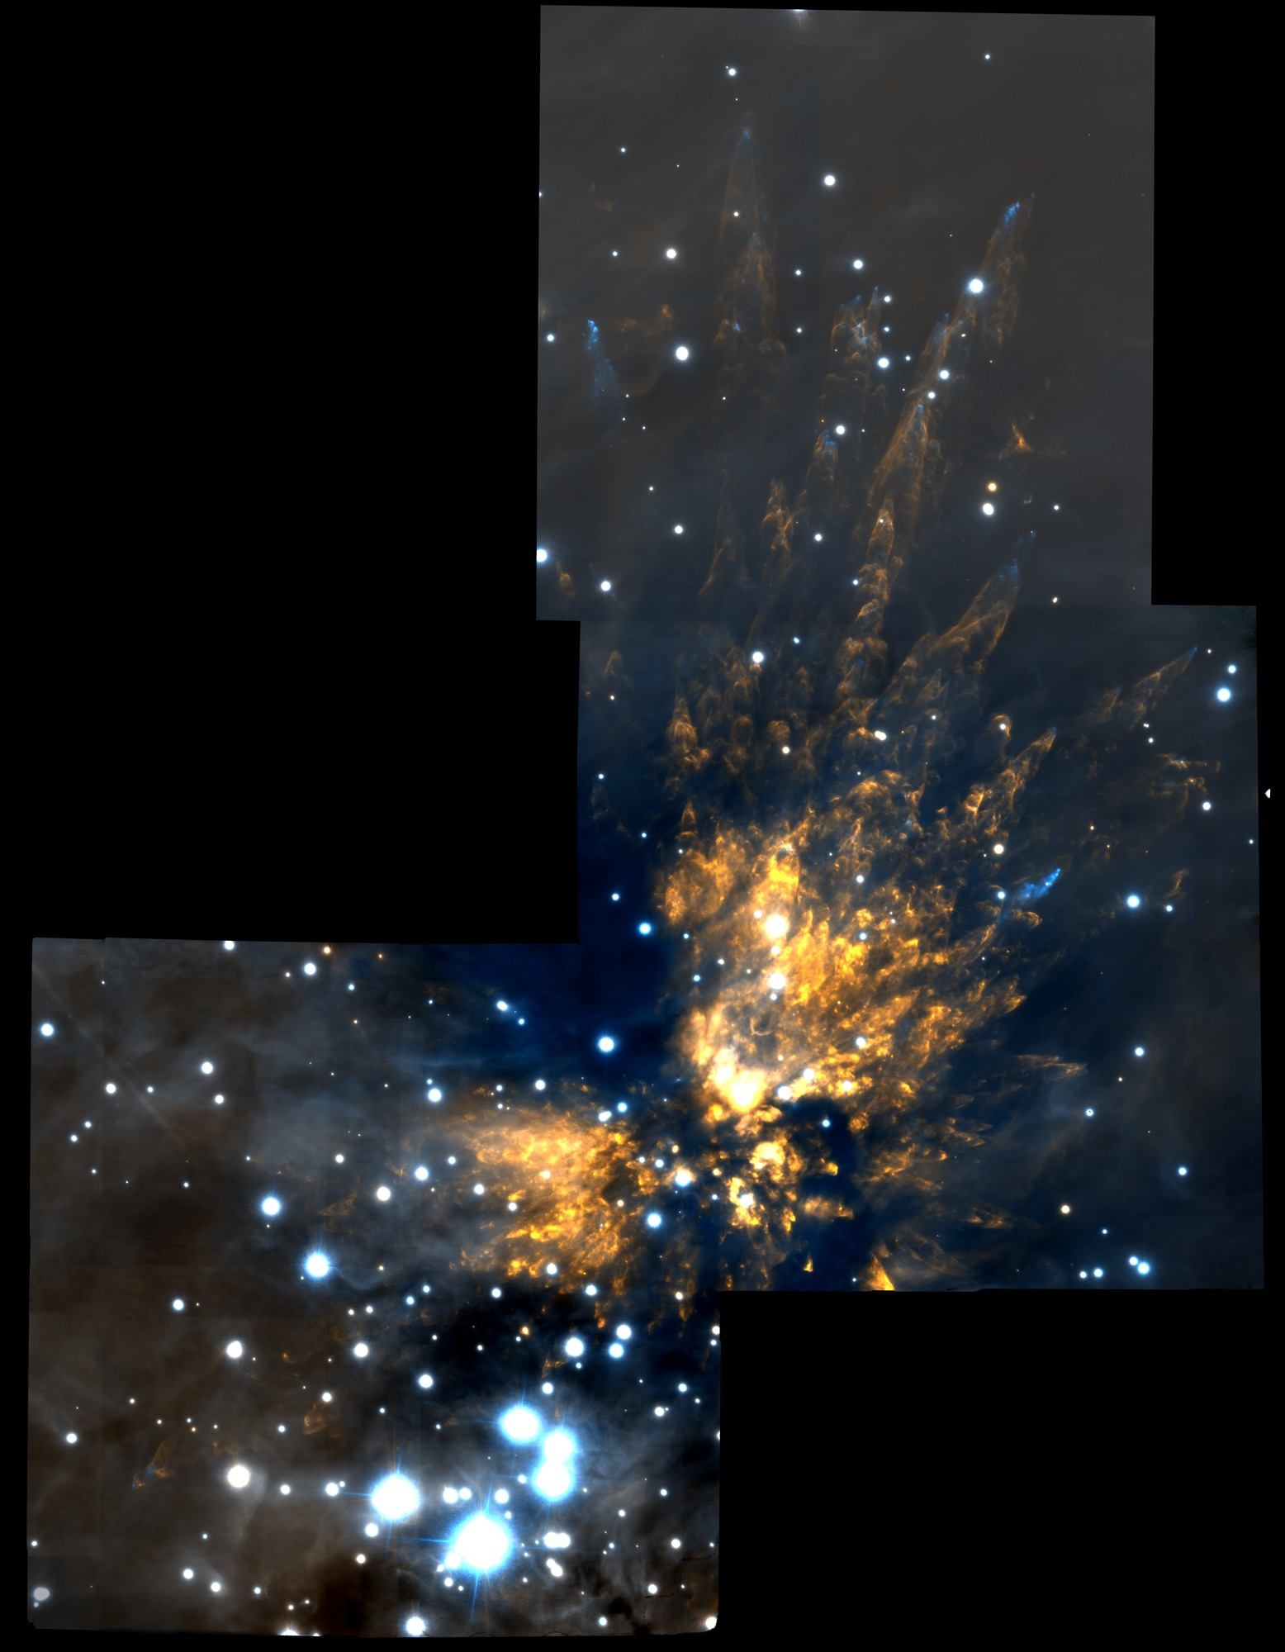
The Orion Explosion
Near-infrared (2 μm)
BN
Source I
n
IRc 4
Source x

Slide 48
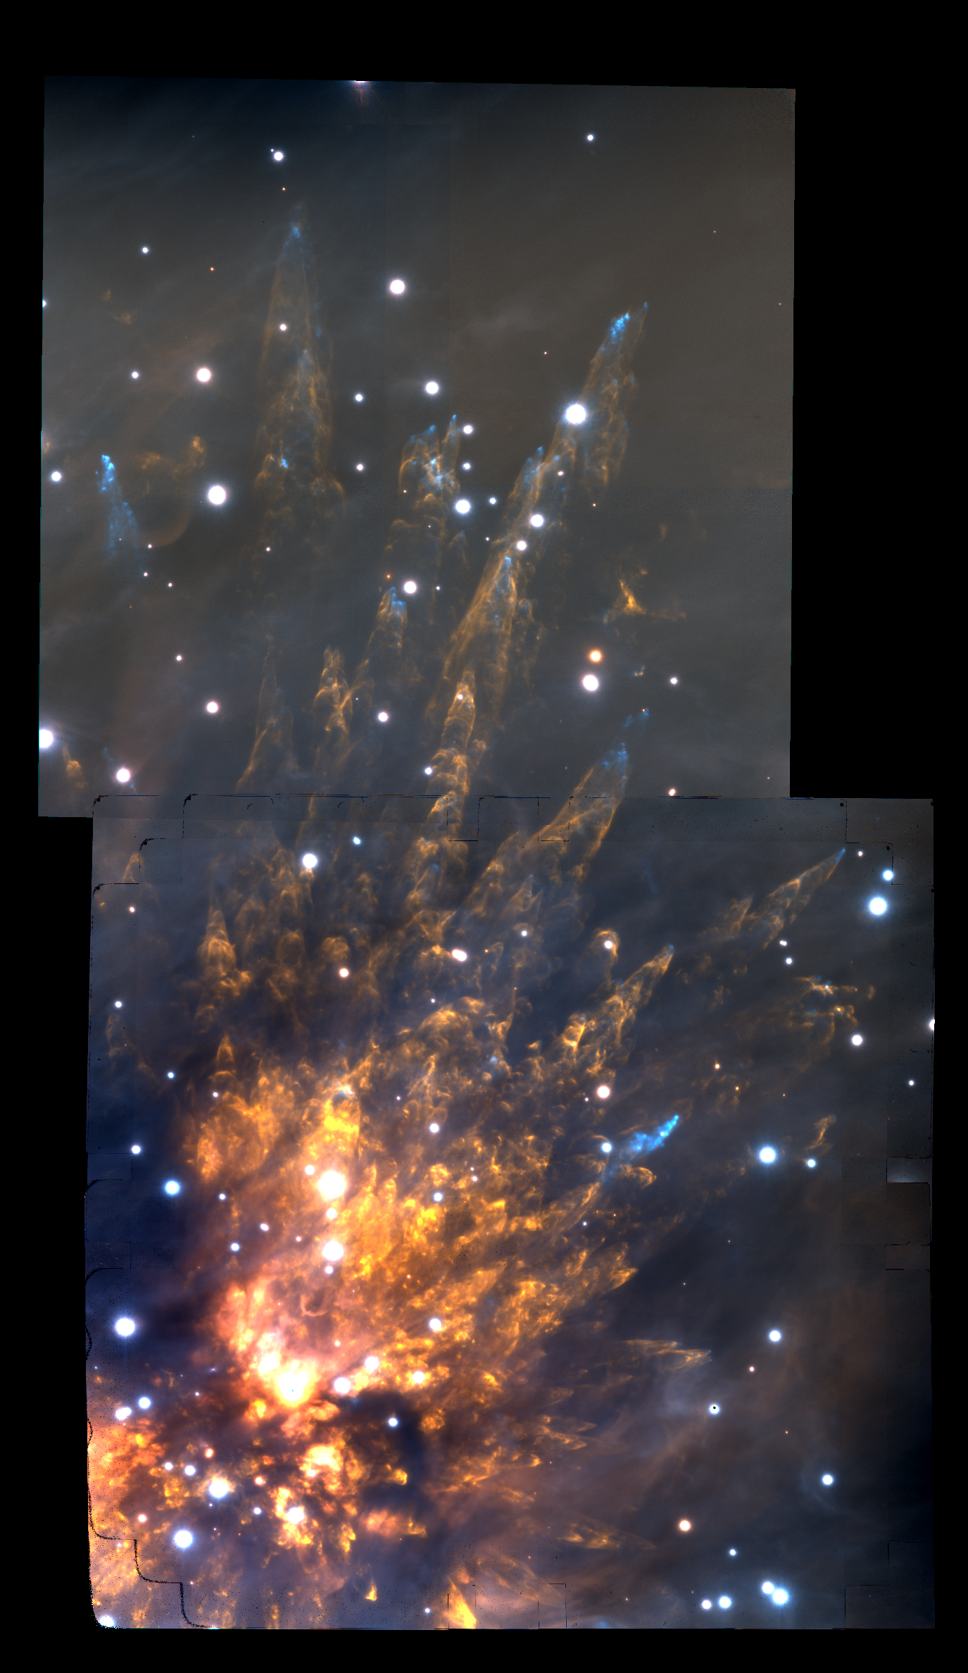

Slide 49
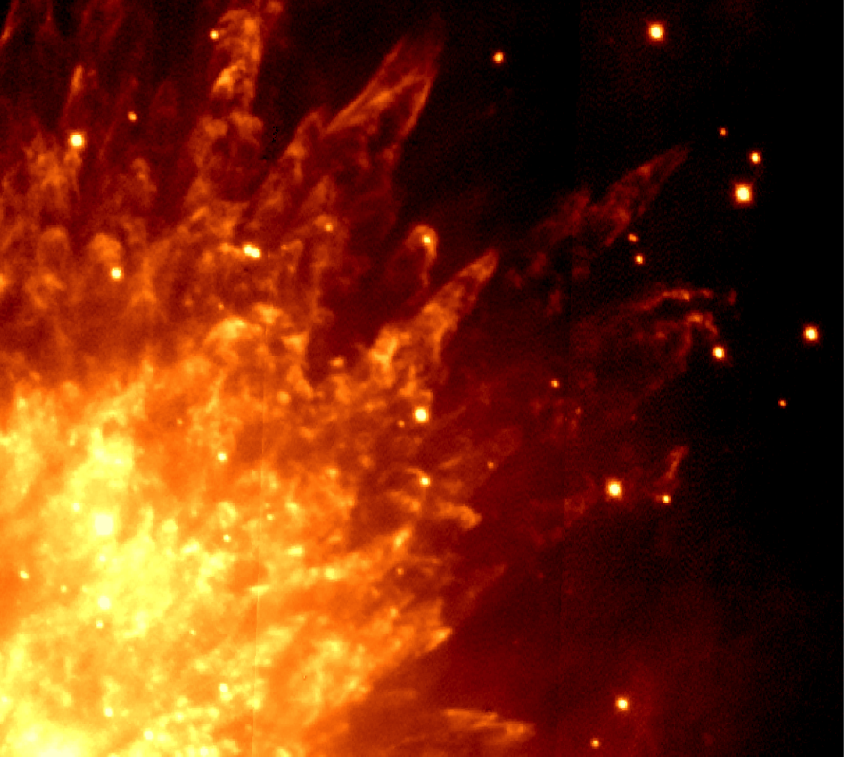
1999

Slide 50
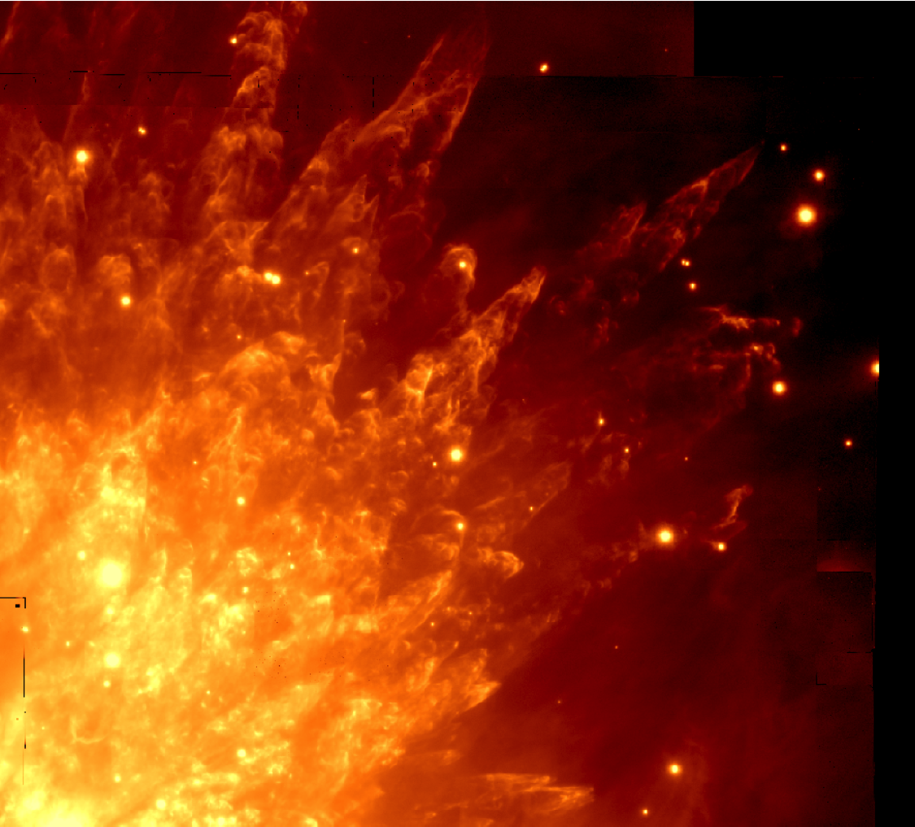
2013

Slide 51
Pre-explosion
cavities
by pre-existing
outflows?

Slide 52
Pre-explosion
cavities
by pre-existing
outflows?

Slide 53
Pre-explosion
cavities
by pre-existing
outflows?

Slide 54
Pre-explosion
cavities
by pre-existing
outflows?

Slide 55
Pre-explosion
cavities
by pre-existing
outflows?

Slide 56
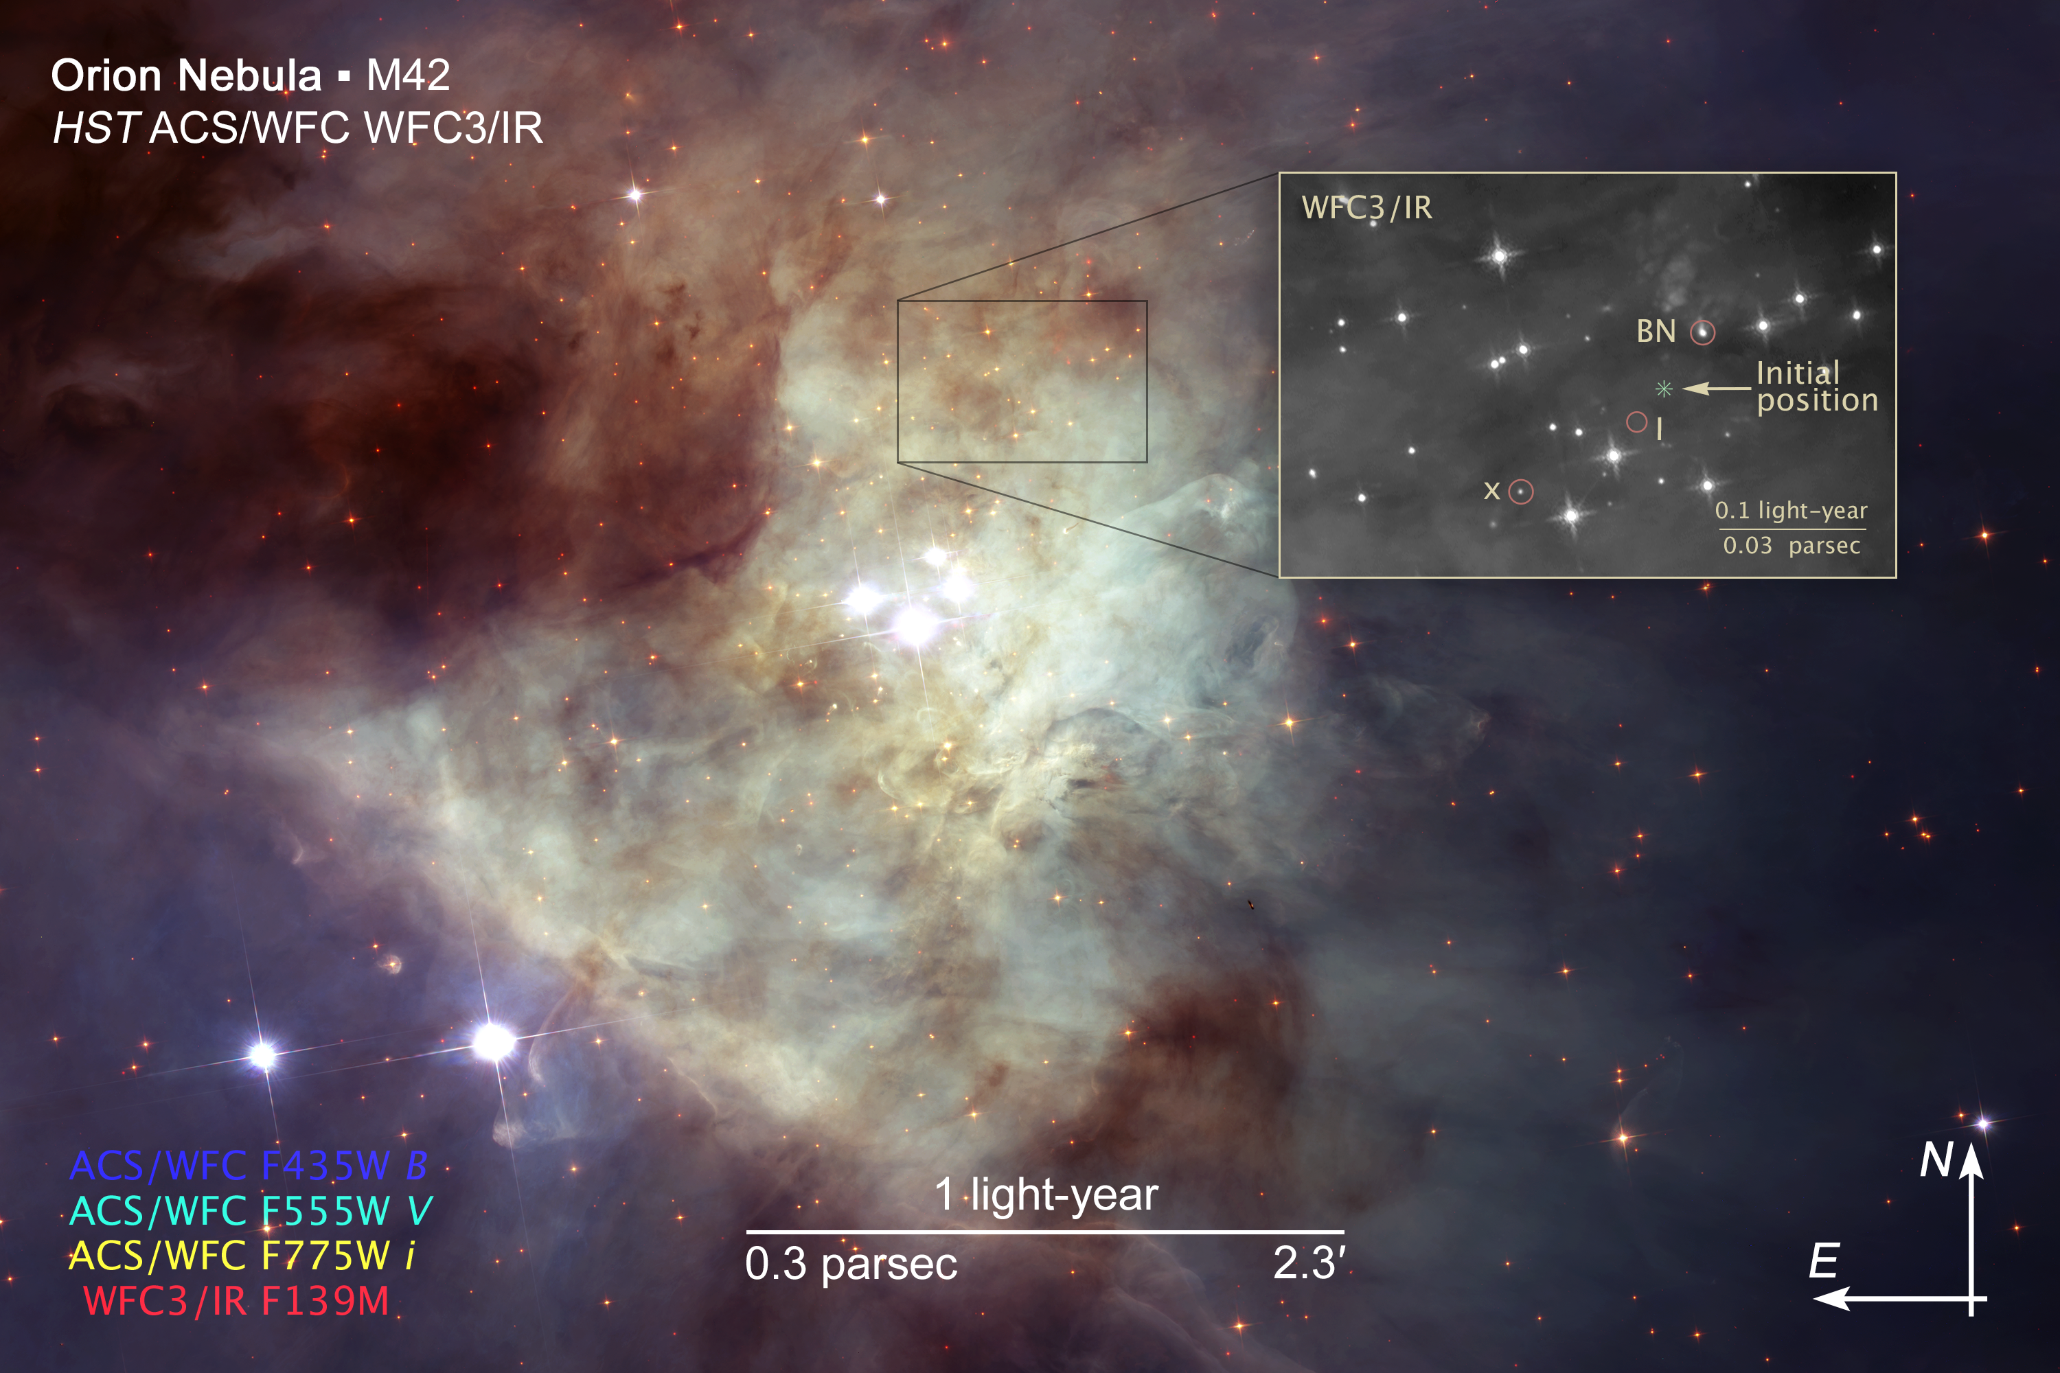

Slide 57
BN
n
“source x”
V = 55 km/s
1999

Slide 58
BN
n
“source x”
V = 55 km/s
2013

Slide 59
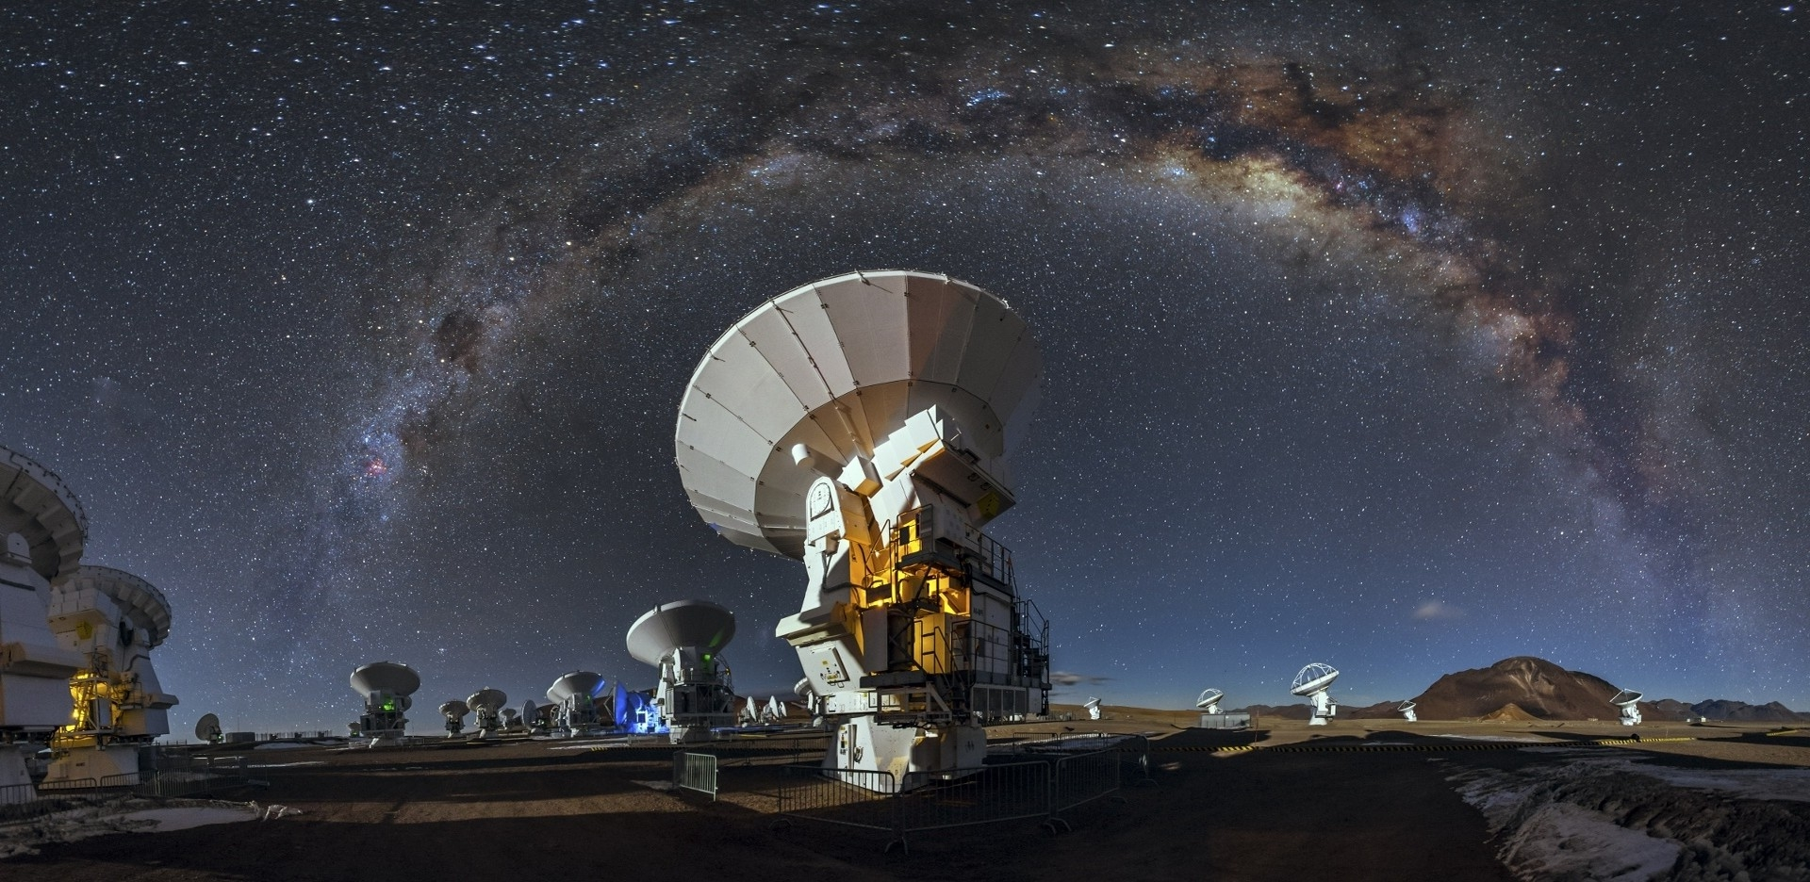

Slide 60
ALMA

Slide 61
~3 M_{o} Src X
V_{PM} = 55 km/s
ALMA
~15 M_{o} Src I
V_{PM} = 13 km/s
~10 M_{o} BN
V_{PM} = 26 km/s

Slide 62
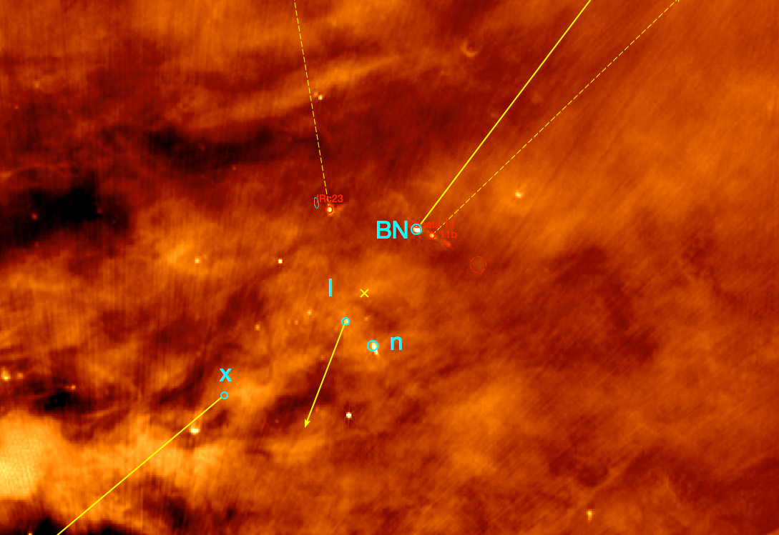
JVLA 4 – 8 GHz

Slide 63
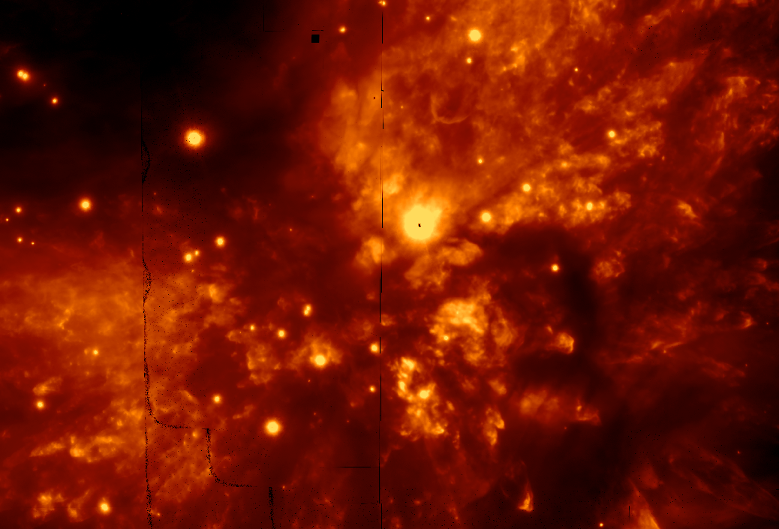
H₂ 2.12 μm (GSAOI)

Slide 64
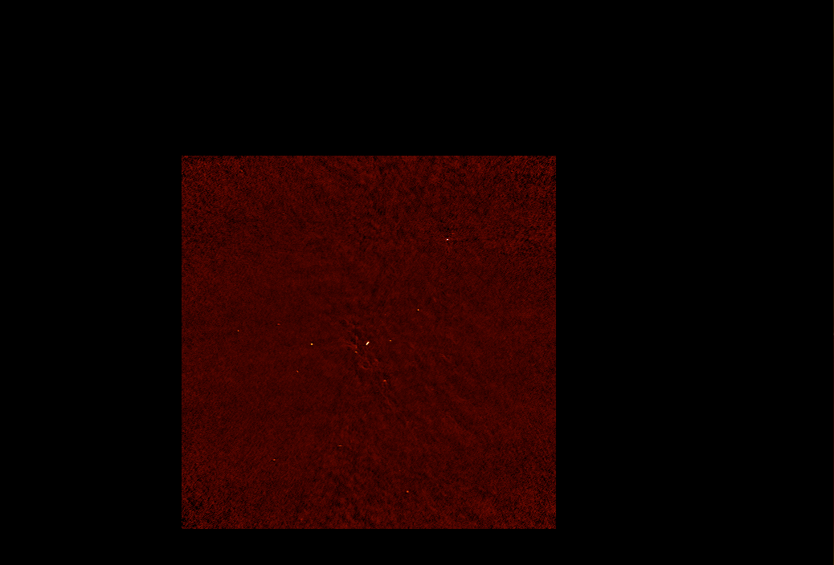
ALMA 1.3 mm continuum (0.05”)

Slide 65
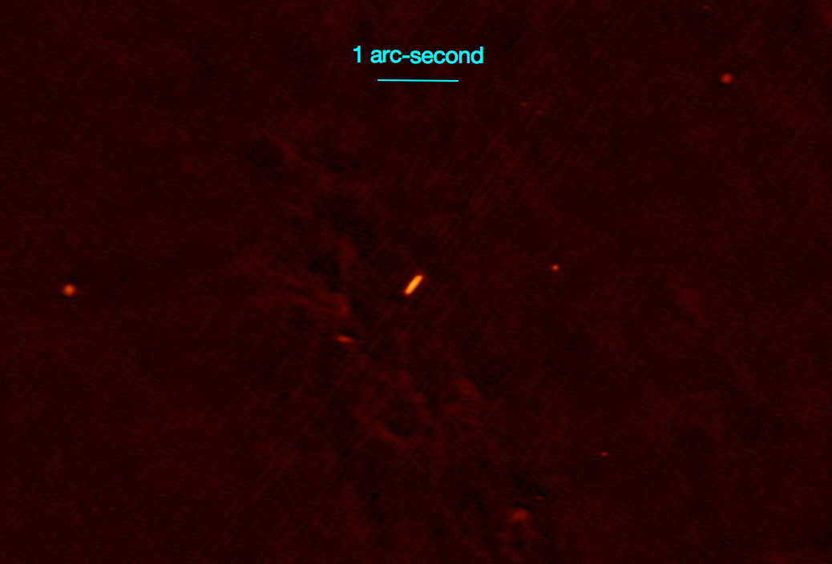
ALMA 1.3 mm continuum (0.05”)

Slide 66
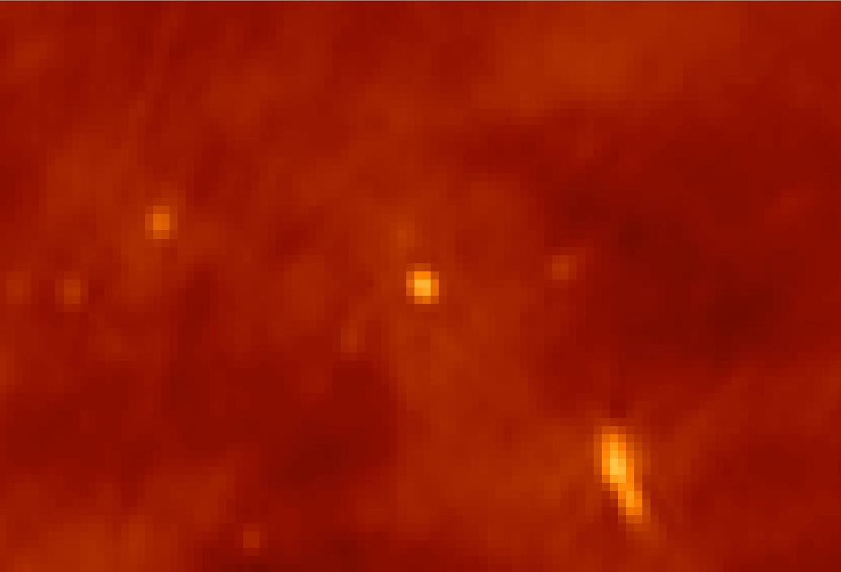
JVLA 4 – 8 GHz

Slide 67
ALMA 1.3 mm continuum (0.05”)

Slide 68
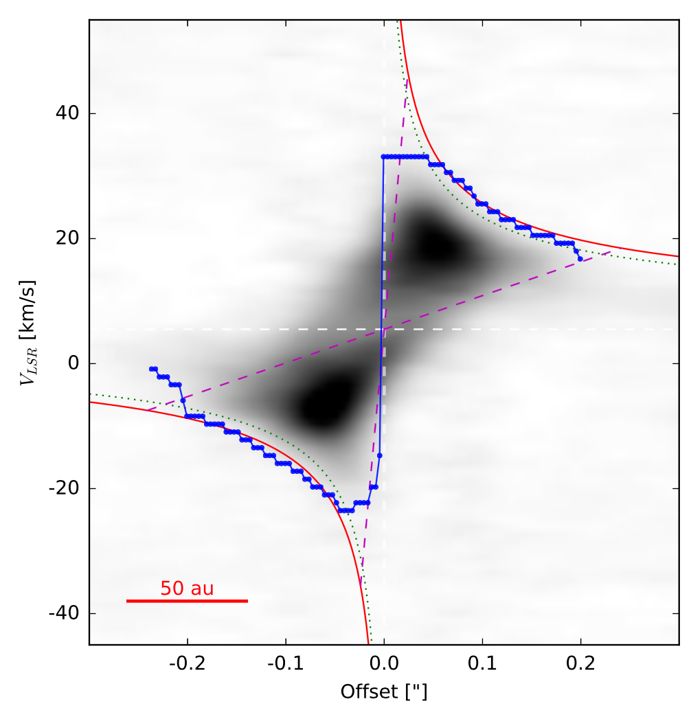
Mass of Src I
H₂O 5_{5,0}-6_{4,3}
232.6867 GHz
M ~ 15 M_{o}
Blue:
Fit to emission
Edge
Ginsburg+ 2018
See Seifried, Sanchez-Monge, Walch, & Banerjee 2016 for method

Slide 69
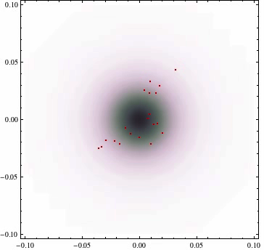

Slide 70
DR 21
H₂
D ~ 1.3 kpc

Slide 71
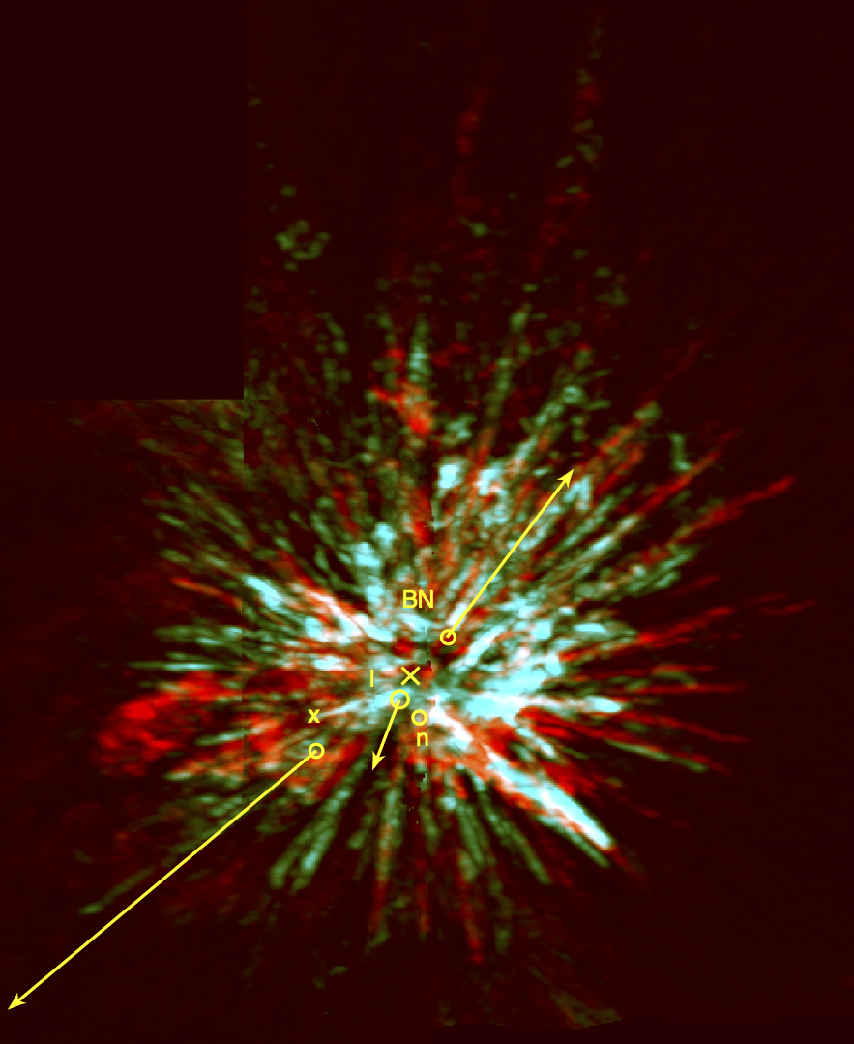
Conclusions:
Gravitational collapse & fragmentation
Most stars form in “transient” clusters
Feedback:
Outflows, UV, stellar winds,
supernovae
Self-regulation of star formation
4-star interaction in Orion:
A.D. 125+/-25 year
D = 1350 l.y. => 1475 A.D.
Eject 3 stars: BN, Src I, x
10⁴⁸ erg explosion in 10 M_{o} of gas
Src I - a 15 M_{o} merger remnant
N-body interactions / ejections
as important as
initial conditions for
stellar masses

Slide 72
Star & Planet Formation in Orion:
An update
The End
Frank Dibbell

