Slide 1
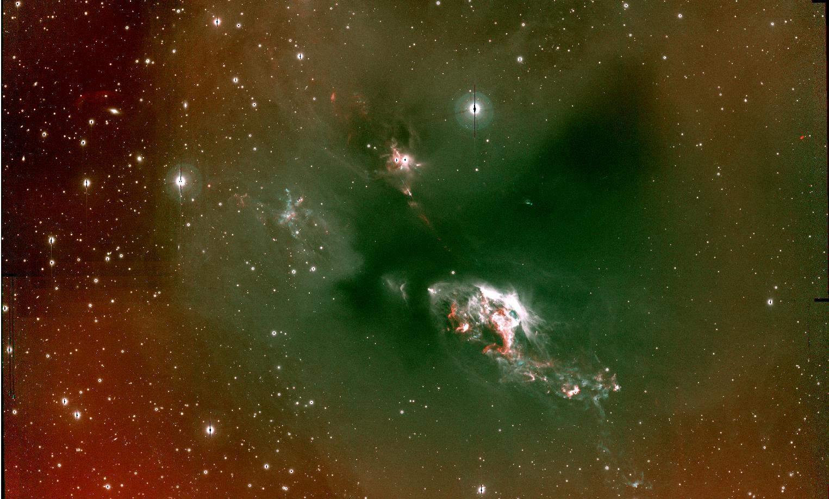
Outflows from Young Stars:
From Jets to Explosive Feedback
In Star Formation
John Bally¹
¹Center for Astrophysics and Space Astronomy (CASA)
Department of Astrophysical and Planetary Sciences (APS)
University of Colorado, Boulder

Slide 2
L1551
Hα [SII]
HL & XZ Tau
HH 30
IRS5

Slide 3
Accretion + Spin + Magnetic Fields
Fossil record of accretion history, N-body dynamics
Feedback Impact in Self-Regulation
(Couple P, E, directly into parent cloud)
Most (all ?) YSOs have them
(all accreting, spinning, magnetized systems?)
(or radiation)
Outflow

Slide 4
Some Problems in Star Formation
Star formation – a fundamental cosmic process:
Determines the cosmic evolution of baryons
IMF => massive stars => nucleo-synthesis => elemental enrichment
=> planet formation => life …
What determines stellar masses and the IMF?
Initial Conditions ? Feedback? N-body dynamics?
Why is the Star Formation Efficiency (SFE) so low?
Turbulence? B ? Feedback ?
- What determines the Star Formation Rate (SFR) ?
External or internal processes ?
Nearby star formation (e.g. Milky Way) insights to cosmic dawn
(JWST Science)

Slide 5
Self-Regulation in Star Formation
What stops accretion, sets M*, & the IMF?
Feedback + N-body dynamics ?
The “Feedback Ladder”
Progression of ever stronger feedback impacts
Protostar Outflows => local, low M*, couples directly to cloud
FUV/heating =>
EUV/ionization =>
Stellar winds =>
Radiation pressure =>
M.S. dynamic interactions / mergers =>
Post-M.S. outflows =>
SNe => global, high M*
Black holes
Feedback failure => High SFE, bound clusters?

Slide 6
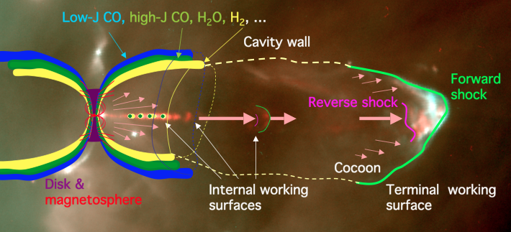
Protostellar Outflow Feedback:
<V(CO)> ~1–10 km/s <V(H₂)> ~10–100 km/s <V(Hα)> >30 – 500 km/s

Slide 7
Parsec-scale flows from Class 0 YSOs
HH 212 (Orion B) 4.5 μm (H₂), 8 μm
HH 91/92 (Orion B) 4.5 μm (H₂), 8 μm (note dust shell !)

Slide 8
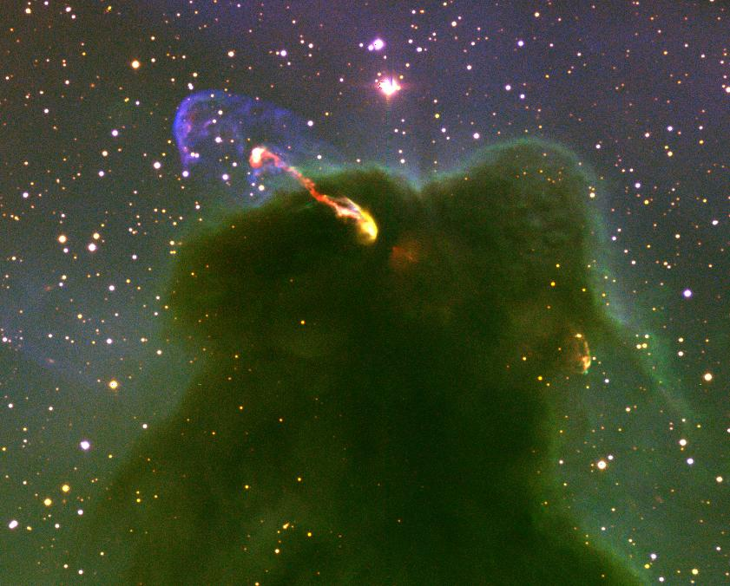
HH 46/47 NTT [OII] Ha [SII]        mm

Slide 9
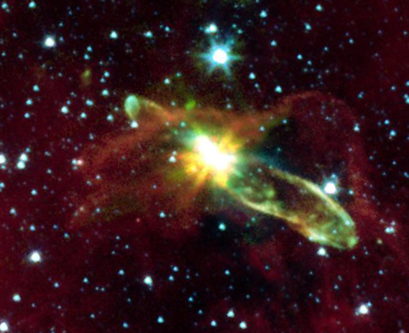
HH 46/47 Spitzer H₂ PAH 3.6, 4.5, 8 μm
(Noriega-Crespo+ 04)

Slide 10
HH 46/47 CO CO (ALMA), [SII] (HST)
(Arce+ 2013)

Slide 11
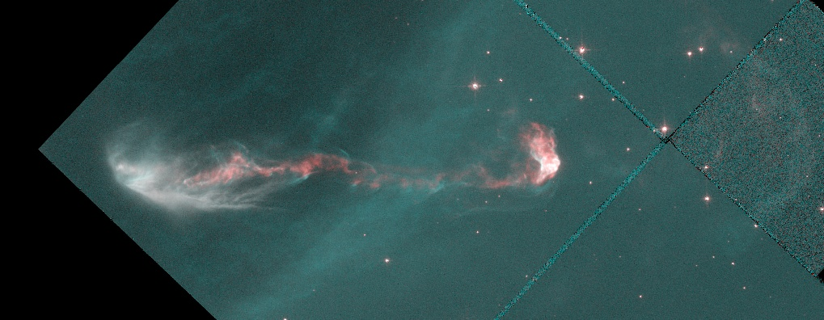
HH 46/47
(Hartigan et al. 05, AJ)
V_{PM} ~ 300 km/s
HST 1994

Slide 12
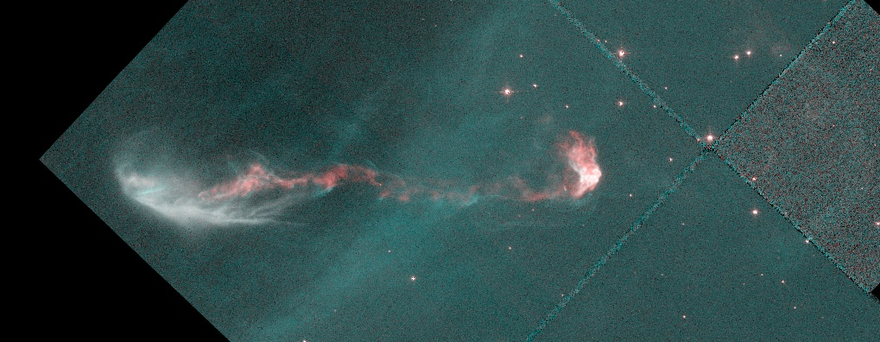
HH 46/47
(Hartigan et al. 05, AJ)
V_{PM} ~ 300 km/s
HST 1997

Slide 13
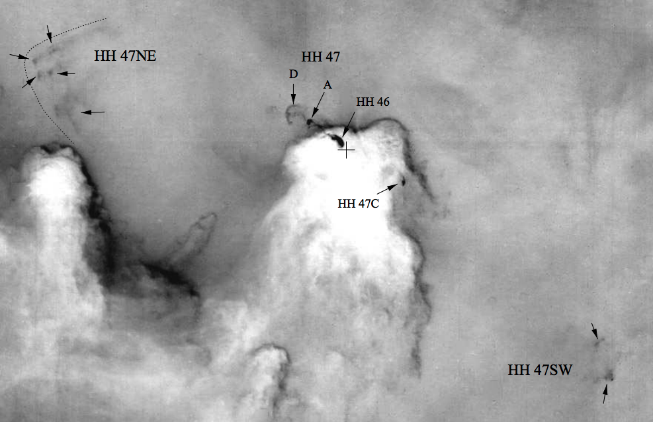
HH 46/47 Hα
CO confined to <10% of Size & Velocity !
(Stanke, McCaugrean, & Zinnecker 1999)

Slide 14
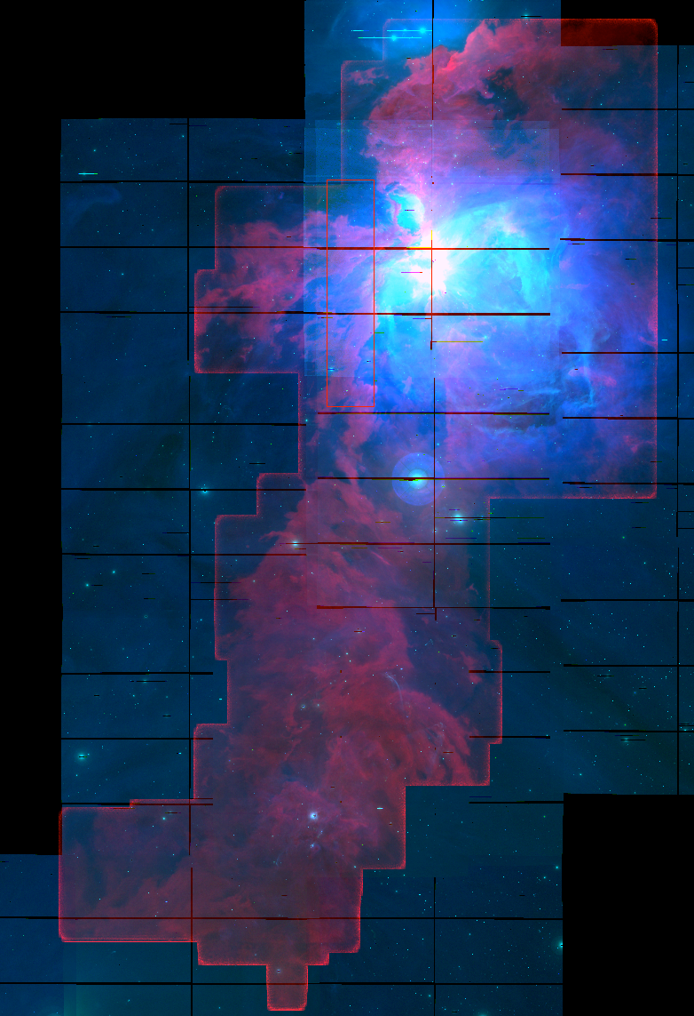
Orion A
CO 1-0 T_{peak}
CARMAOrion
(Kong S. et al. 2018)
[SII] CTIO 4m

Slide 15
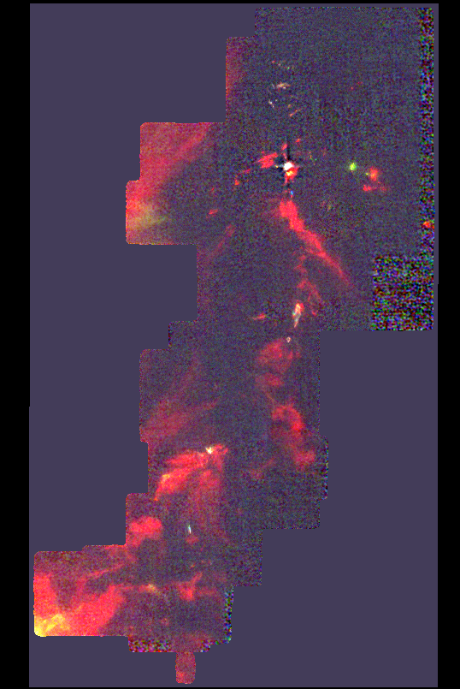
Orion OMC1:
N-body dynamics in dense gas => Orbit decay
=> N-body dynamics: important for IMF
CO 1-0
V = 4 – 12 km/s
Kong S. et al.2018

Slide 16
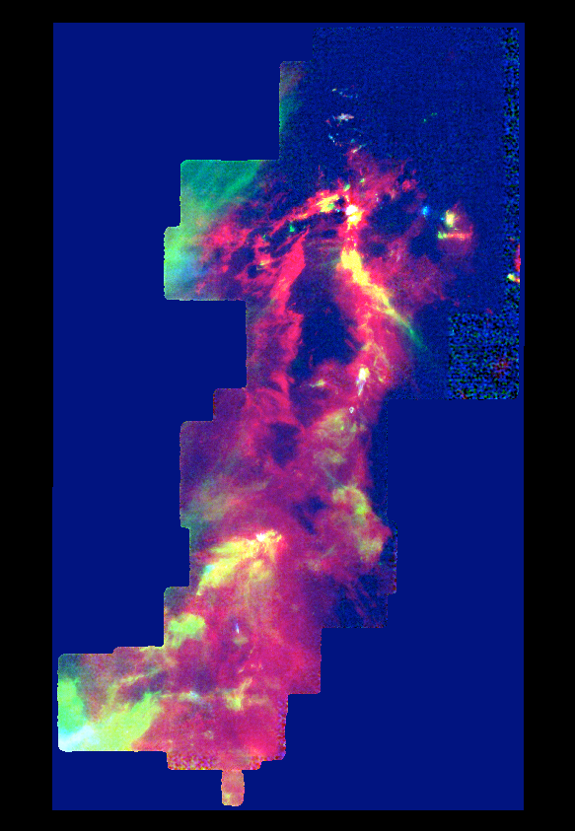
=> Novae, stellar mergers, SNe, Protostellar mergers?
CO 1-0
V = 4 – 12 km/s
Kong S. et al.2018

Slide 17
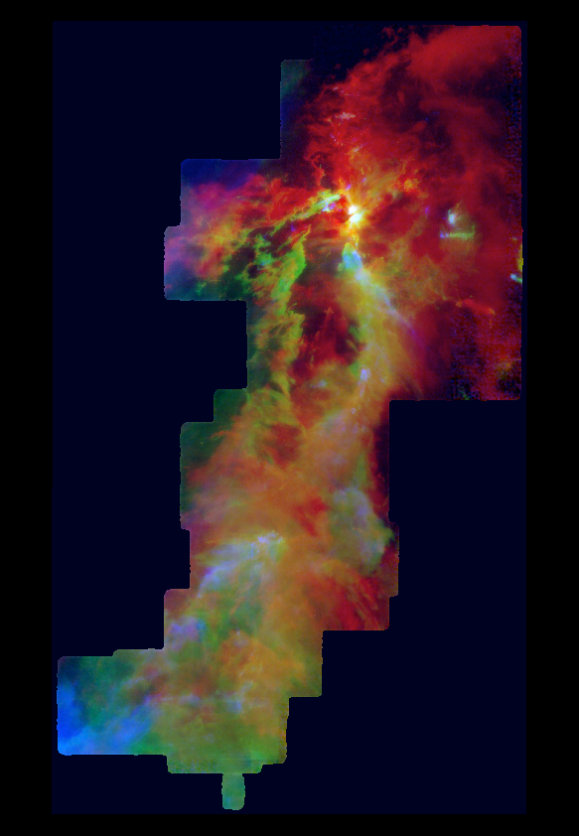
=> Novae, stellar mergers, SNe, Protostellar mergers?
CO 1-0
V = 4 – 12 km/s
Kong S. et al.2018

Slide 18
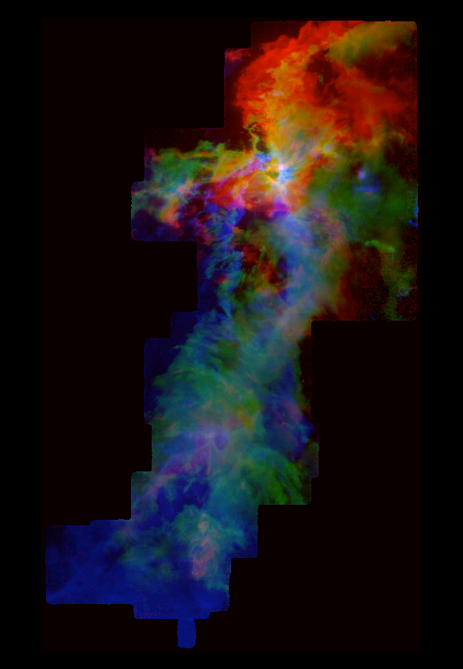
=> Novae, stellar mergers, SNe, Protostellar mergers?
CO 1-0
V = 4 – 12 km/s
Kong S. et al.2018

Slide 19
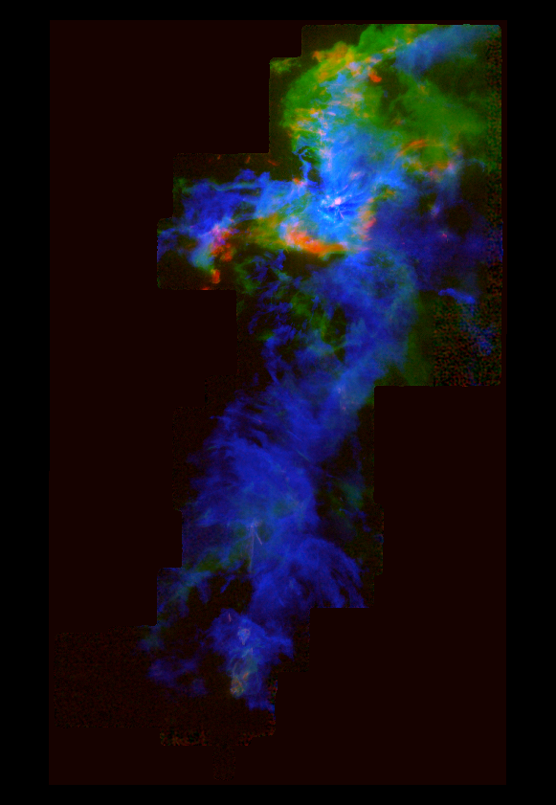
?
CO 1-0
V = 4 – 12 km/s
Kong S. et al.2018

Slide 20
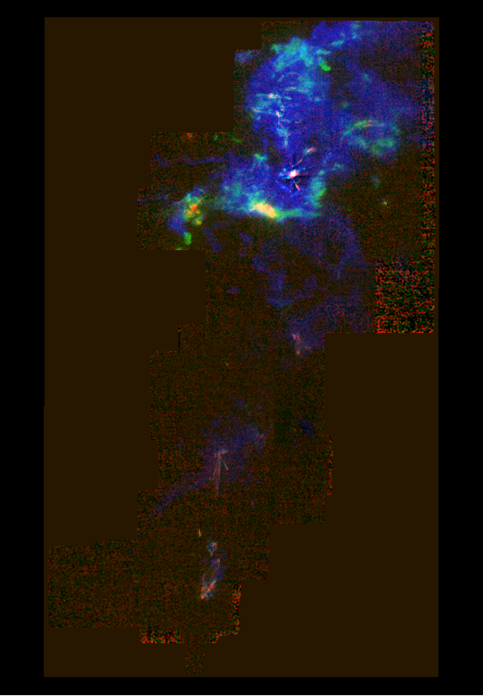
How?
CO 1-0
V = 4 – 12 km/s
Kong S. et al.2018

Slide 21
Orion A
CO 1-0 T_{peak}
CARMAOrion
(Kong S. et al. 2018)
[SII] CTIO 4m

Slide 22
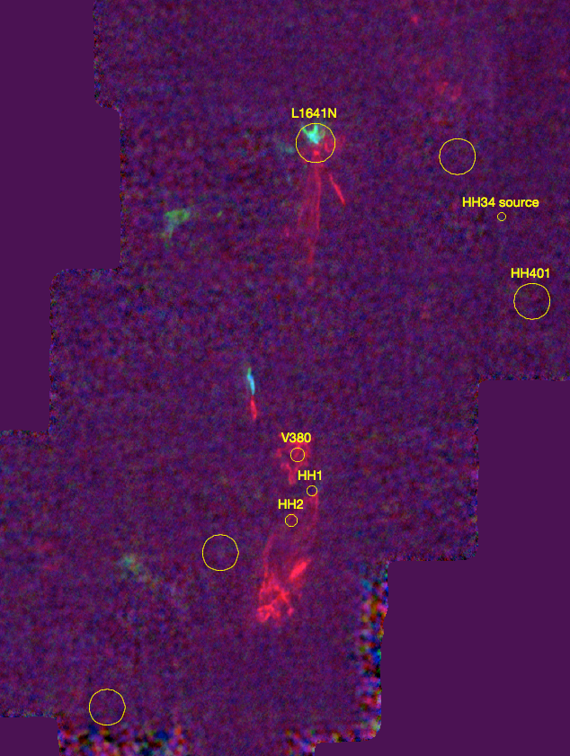
How Common are Explosive Outflows?:
Several `fossil’ Galactic candidates exist
~ isotropic for ~10³ years
bipolar on longer times (e.g. DR 21)
=> Few % of known (massive-star) outflows
Luminous Extra-Galactic IR-transients
~150 IR-only transients in ~20 nearby star-forming
galaxies
3.6 & 4.5 μm Spitzer SPIRITS Sources
(Kaslilwal+ 2017)
=> Novae, stellar mergers, SNe, Protostellar mergers?
Outflows
CO 1-0
2.6 mm

Slide 23
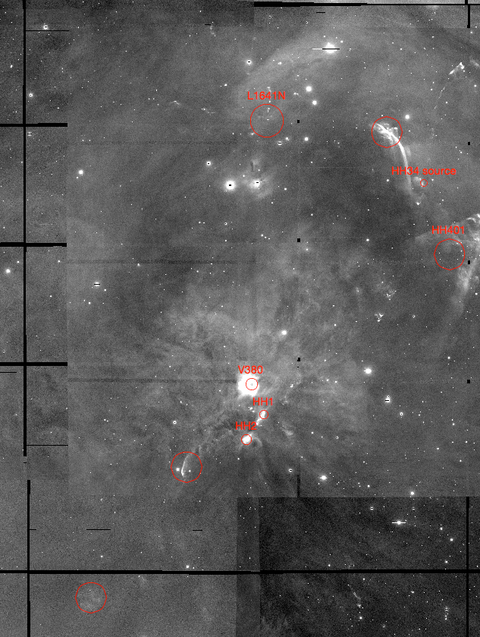
How Common are Explosive Outflows?:
Several `fossil’ Galactic candidates exist
~ isotropic for ~10³ years
bipolar on longer times (e.g. DR 21)
=> Few % of known (massive-star) outflows
Luminous Extra-Galactic IR-transients
~150 IR-only transients in ~20 nearby star-forming
galaxies
3.6 & 4.5 μm Spitzer SPIRITS Sources
(Kaslilwal+ 2017)
=> Novae, stellar mergers, SNe, Protostellar mergers?
Outflows
[SII]
6716/6731 A

Slide 24
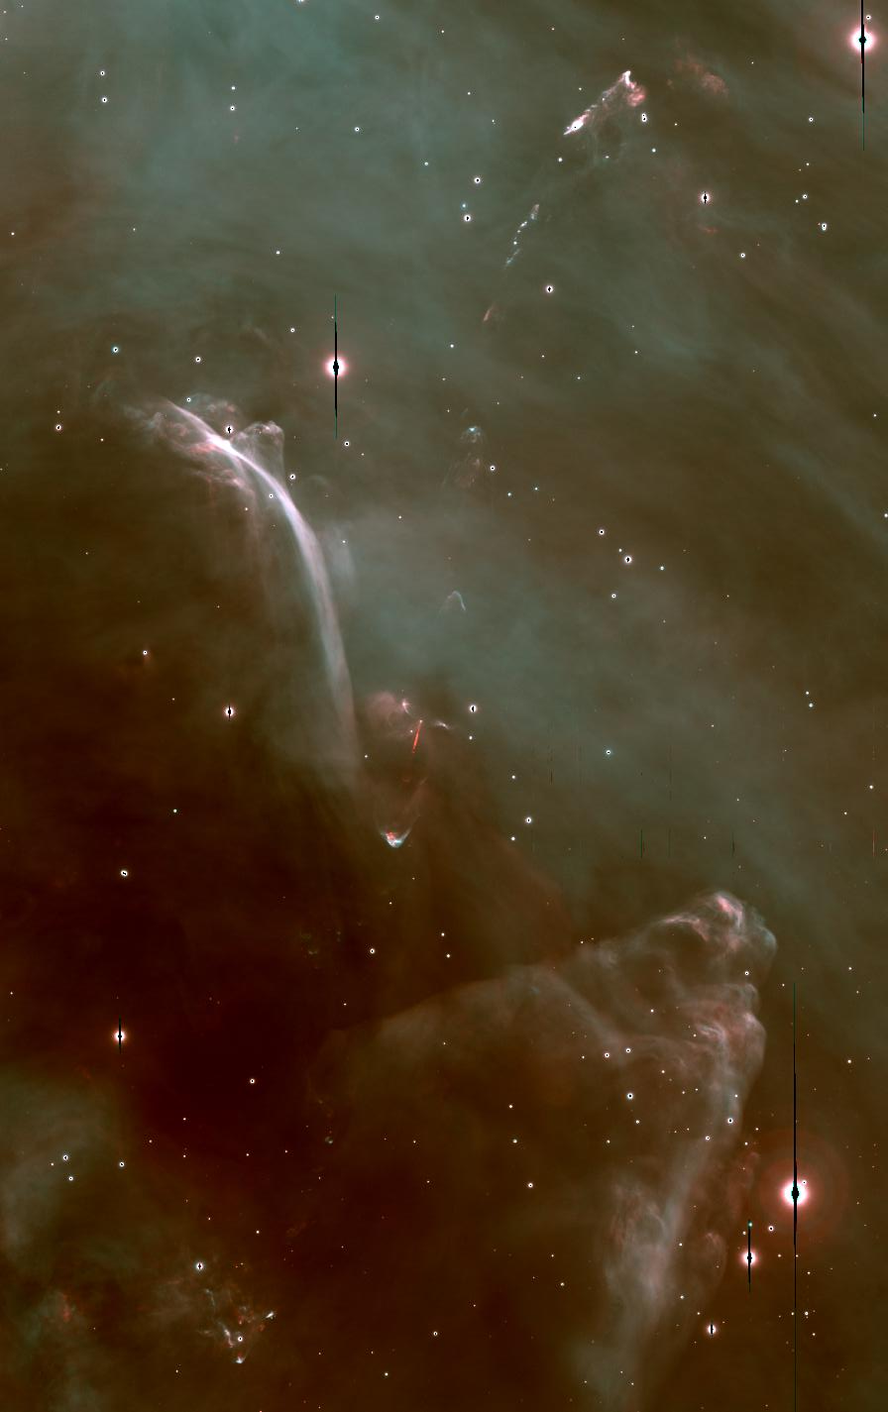
HH 34 / 201 / 222
Ha [S II]
(Reipurth+ Subaru)

Slide 25
HH 34 / 201 / 222
Ha [S II]
(Reipurth+ Subaru)

Slide 26
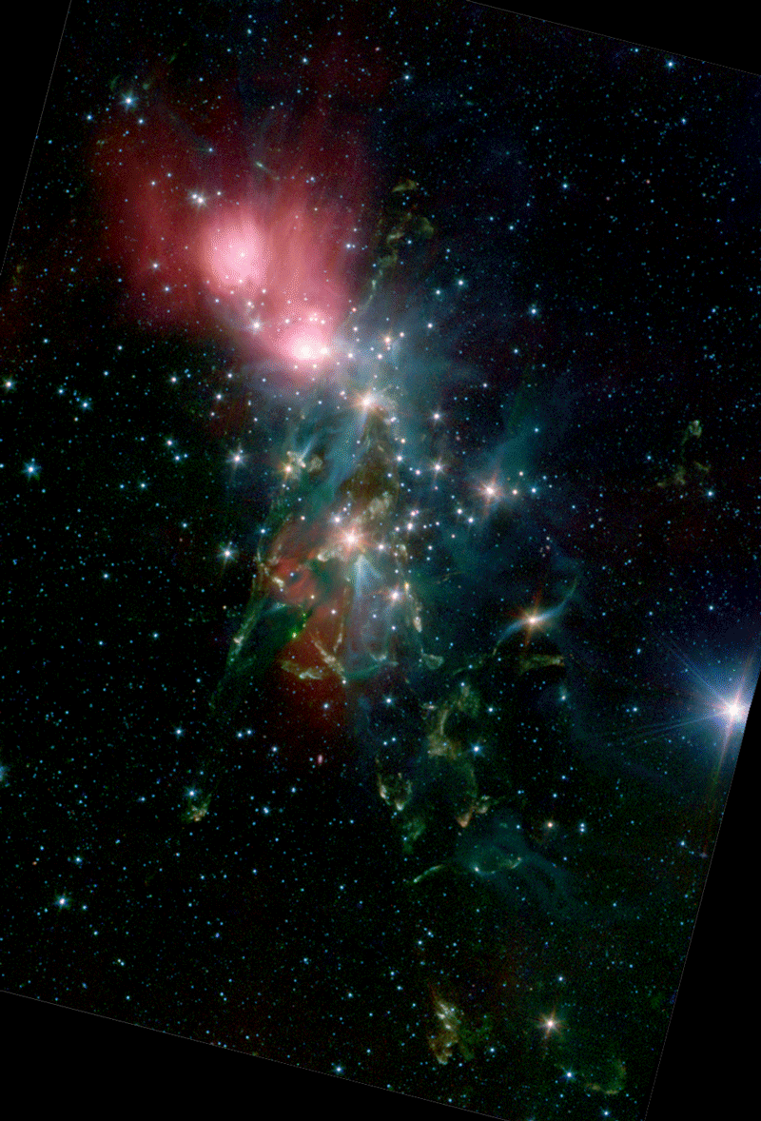
Outflows
~150 YSOs
in NGC 1333
Hα, [SII]
Walawender, Bally,
Reipurth (06)
Spitzer/IRAC
Jorgensen et. (06)

Slide 27
NGC 1333
Ha, [SII]
H₂

Slide 28
NGC 1333
8 μm
CO CO
CARMA
Plunkett+ (2013)

Slide 29
G28.37+0.07
8 μm
CO CO
ALMA
Kong+ (2019)

Slide 30
Class 0
Class I
Maud et al. (2015)

Slide 31
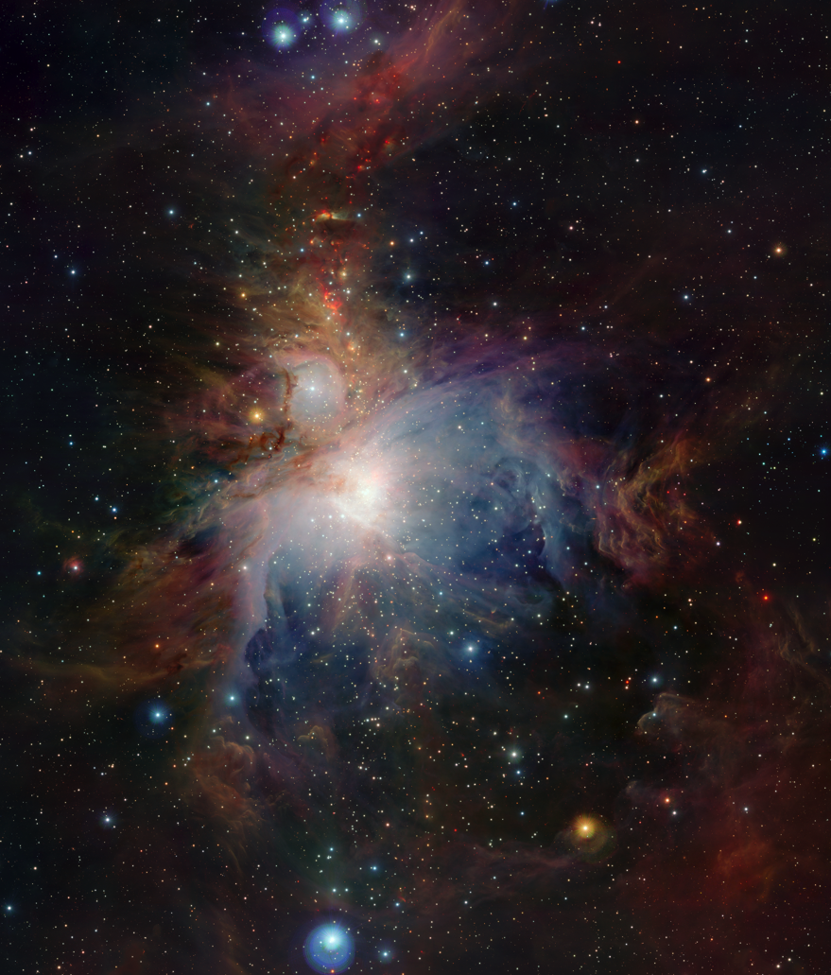

Slide 32
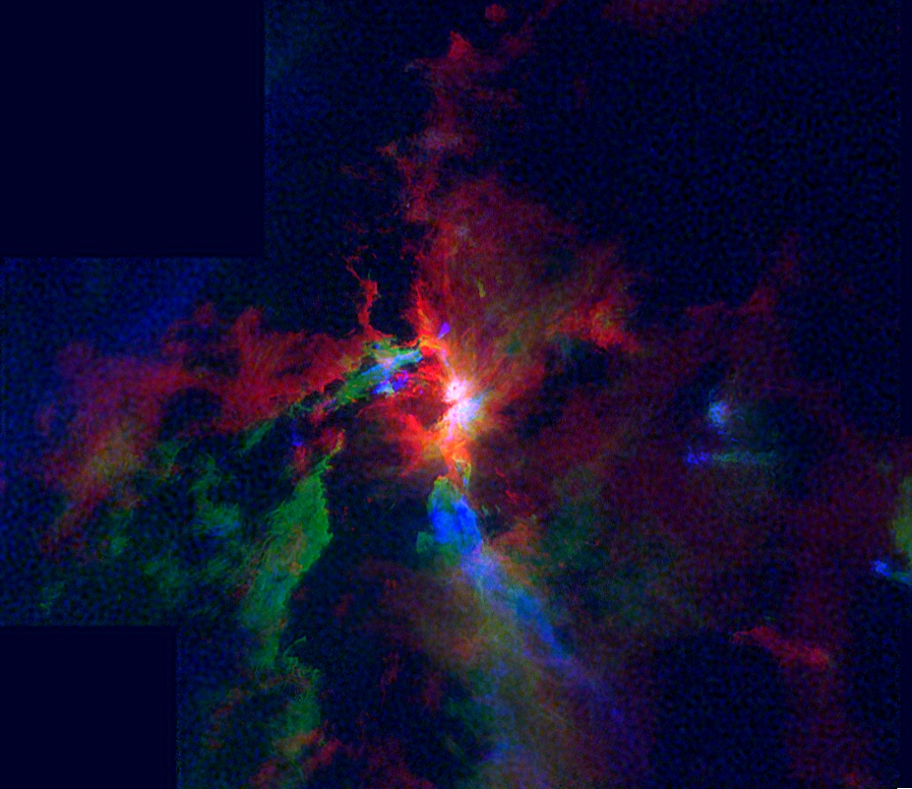
CARMAOrion ¹²CO (Kong+ 2018)
5
7
9
km/s

Slide 33
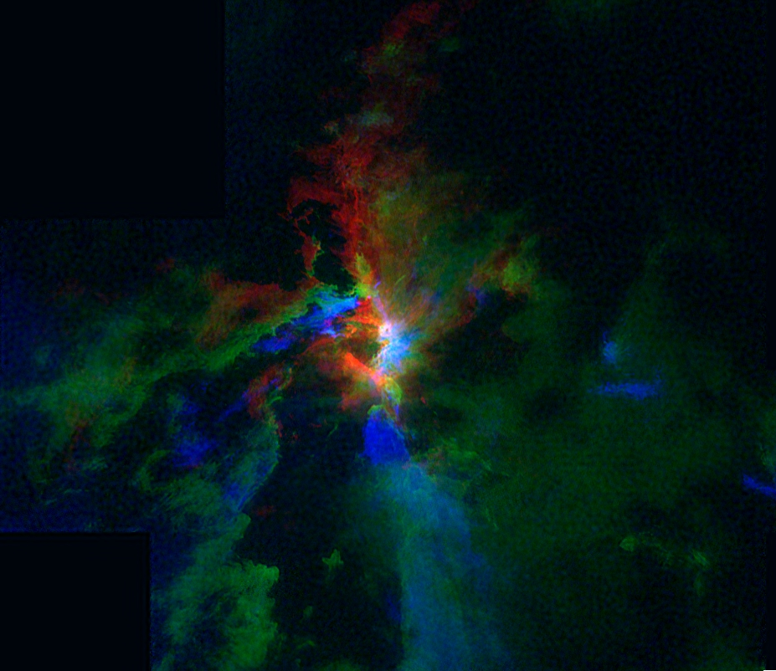
CARMAOrion ¹²CO (Kong+ 2018)
6
8
10
km/s

Slide 34
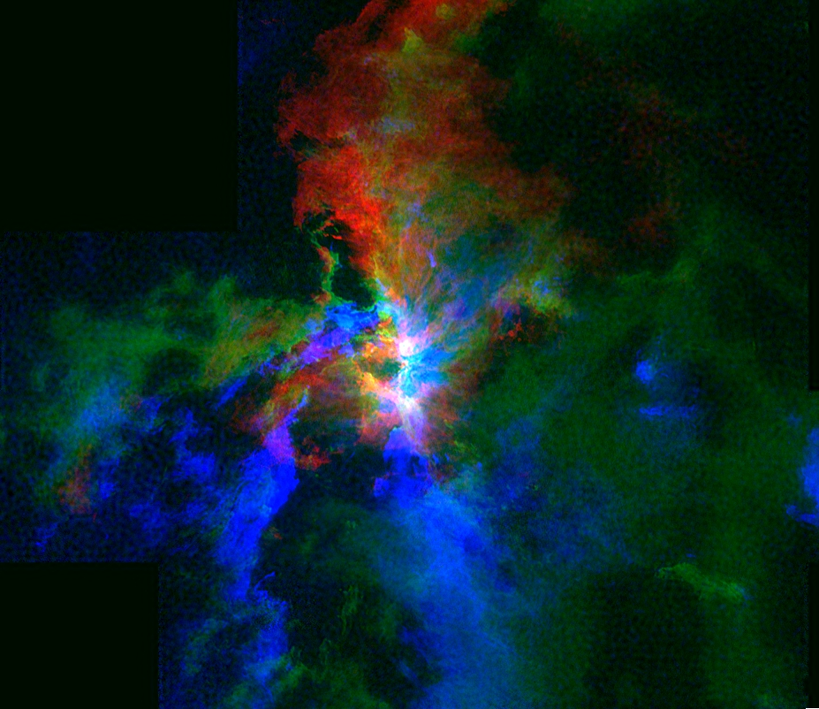
CARMAOrion ¹²CO (Kong+ 2018)
7
9
11
km/s

Slide 35
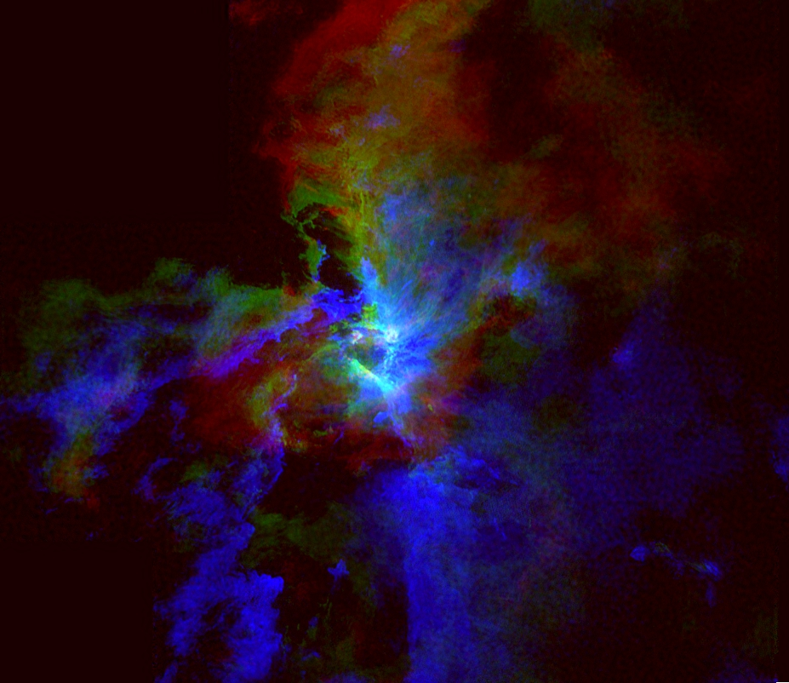
CARMAOrion ¹²CO (Kong+ 2018)
8
10
12
km/s

Slide 37
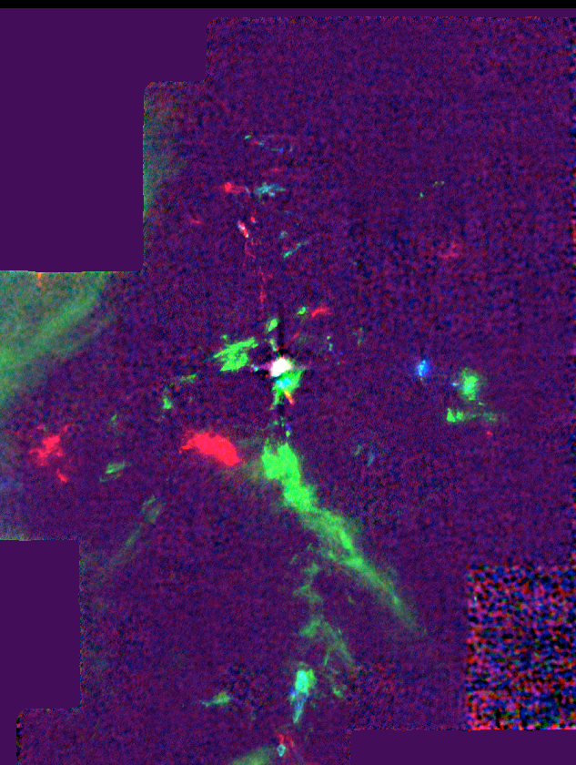
How Common are Explosive Outflows?:
Several `fossil’ Galactic candidates exist
~ isotropic for ~10³ years
bipolar on longer times (e.g. DR 21)
=> Few % of known (massive-star) outflows
Luminous Extra-Galactic IR-transients
~150 IR-only transients in ~20 nearby star-forming
galaxies
3.6 & 4.5 μm Spitzer SPIRITS Sources
(Kaslilwal+ 2017)
=> Novae, stellar mergers, SNe, Protostellar mergers?

Slide 38
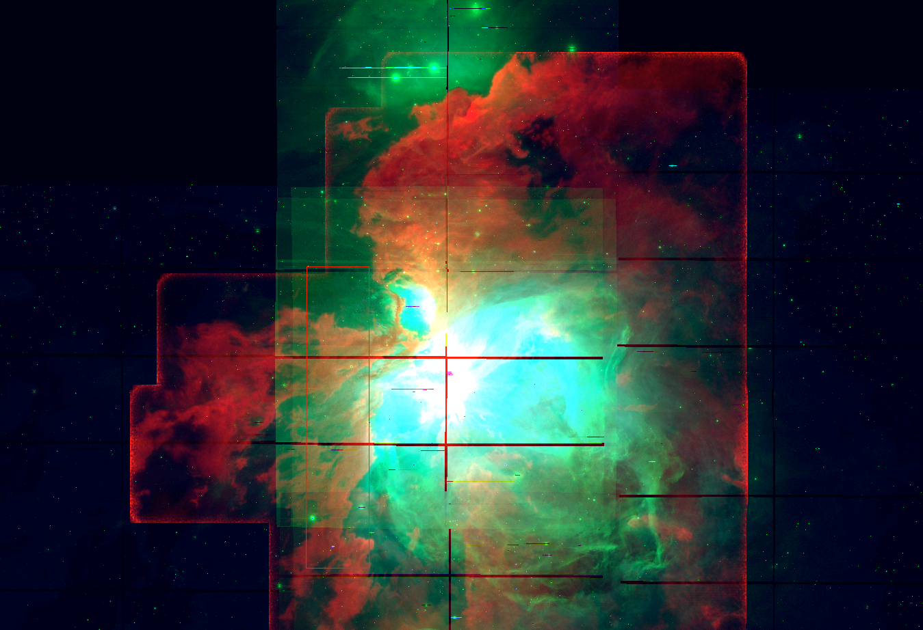
How Common are Explosive Outflows?:
Several `fossil’ Galactic candidates exist
~ isotropic for ~10³ years
bipolar on longer times (e.g. DR 21)
=> Few % of known (massive-star) outflows
Luminous Extra-Galactic IR-transients
~150 IR-only transients in ~20 nearby star-forming
galaxies
3.6 & 4.5 μm Spitzer SPIRITS Sources
(Kaslilwal+ 2017)
=> Novae, stellar mergers, SNe, Protostellar mergers?

Slide 39
Pre-explosion
cavities
by pre-existing
outflows?

Slide 45
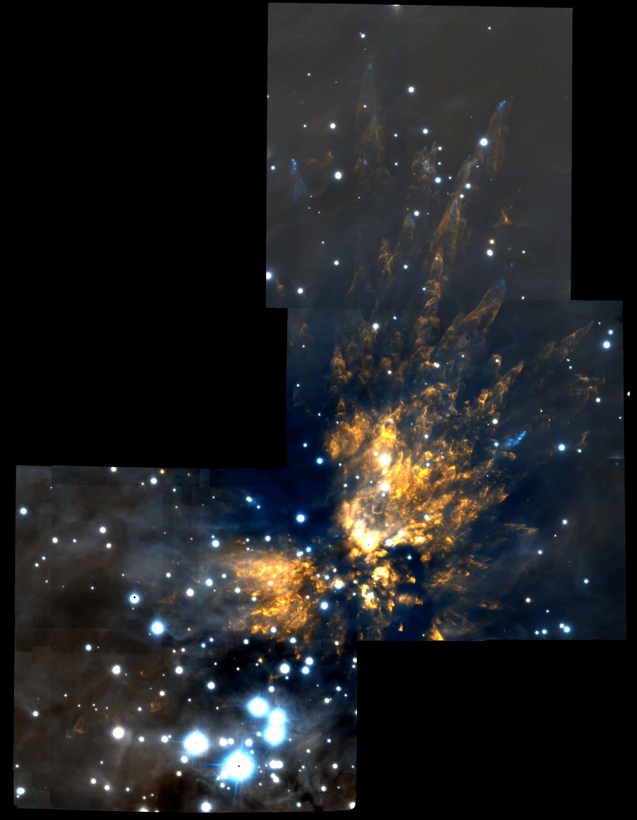
The Orion Explosion
Near-infrared (2 μm)
Gemini-S
GSAOI + GEMS
(Bally et al. 2015)

Slide 46
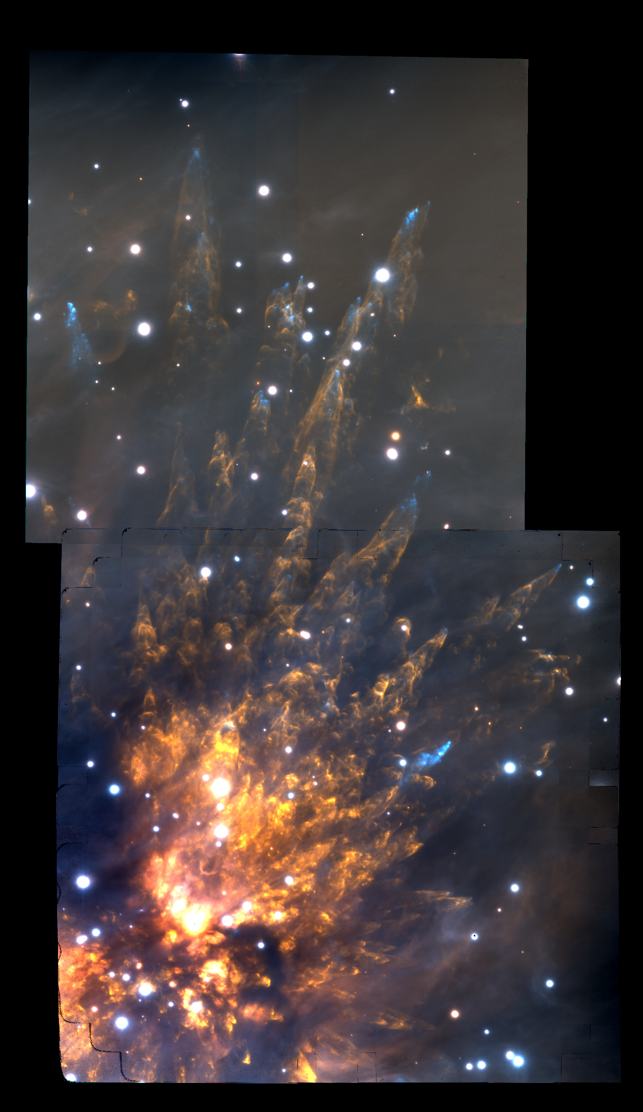

Slide 47
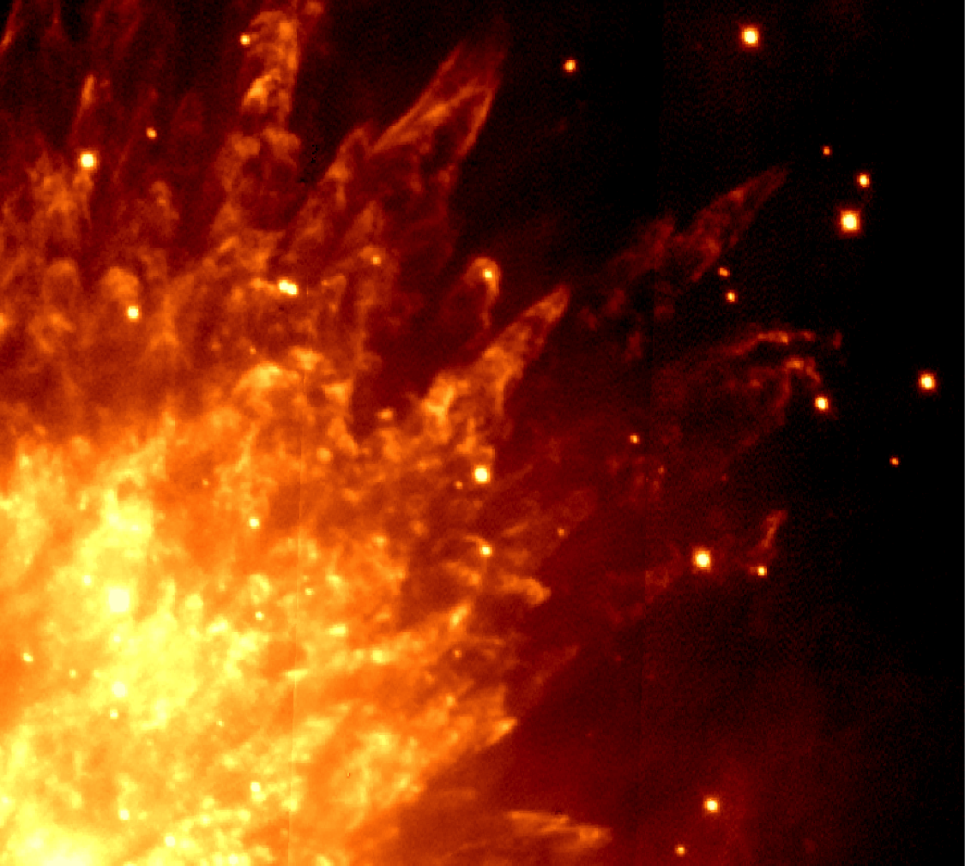
1999

Slide 48
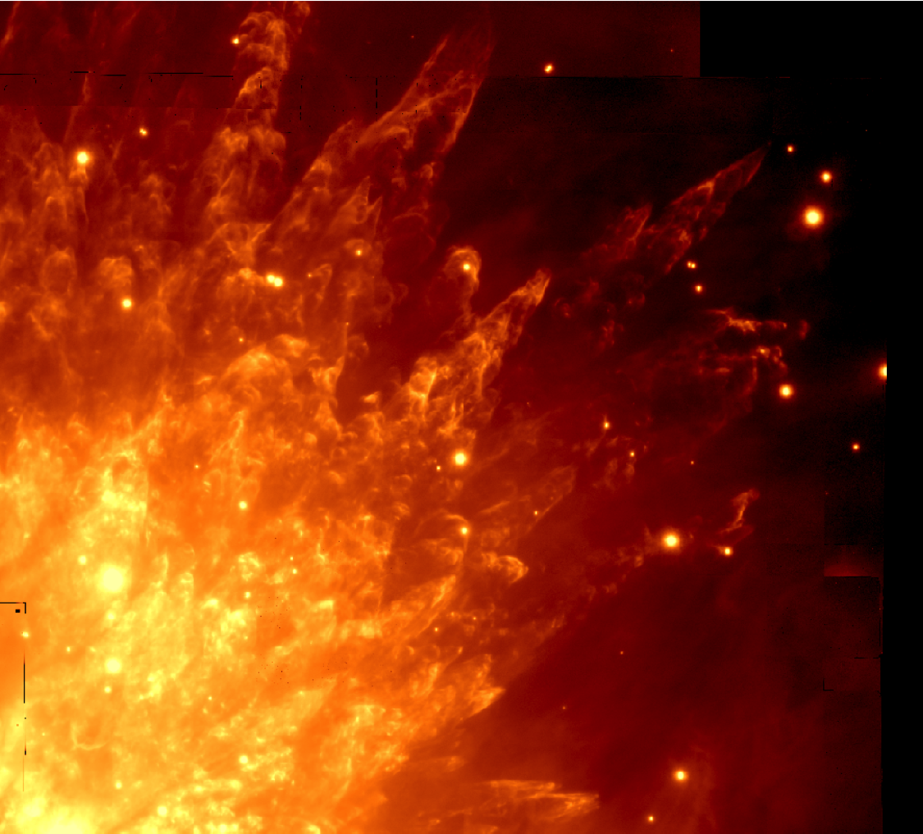
2013

Slide 49
BN
n
Lonsdale “source x”
V = 55 km/s (Luhman et al. 2017)
1999 Subaru 2.12 μm H₂ Kaifu et al. 2000

Slide 50
BN
n
Lonsdale “source x”
V = 55 km/s (Luhman et al. 2017)
2013 Gemini S 2.12 μm H₂ Bally et al. 2015

Slide 51

BN
Source I
n
IRc 4
Source x
2013 Gemini S H₂ at 0.002 mm

Slide 52
2015 ALMA
CO at 1.3 mm
(Bally+ 2017)
~3 M_{o} Src X
V_{PM} = 55 km/s
~15 M_{o} Src I
V_{PM} = 13 km/s
~10 M_{o} BN
V_{PM} = 26 km/s

Slide 53
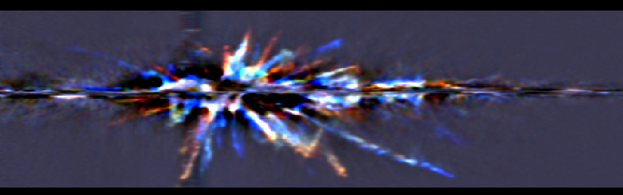
North-South Cut
V =+120 km / s
V = -120 km/s
No deceleration in wakes !
n ~ 100 linear ejecta streams with V proportional to R
ρ >> ρ_{ambient} ρ > 10⁸ cm⁻³
N ~10³ clumps with M_{clump}~10²⁸ - 10³⁰ grams ?

Slide 54
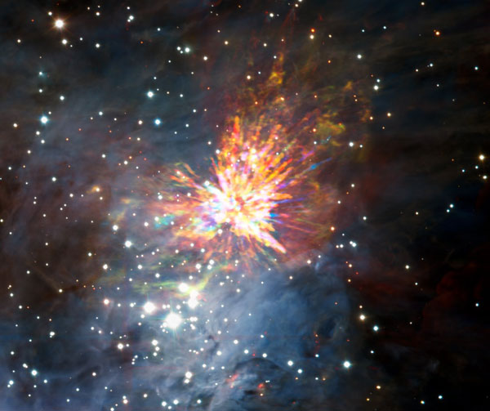

Slide 55
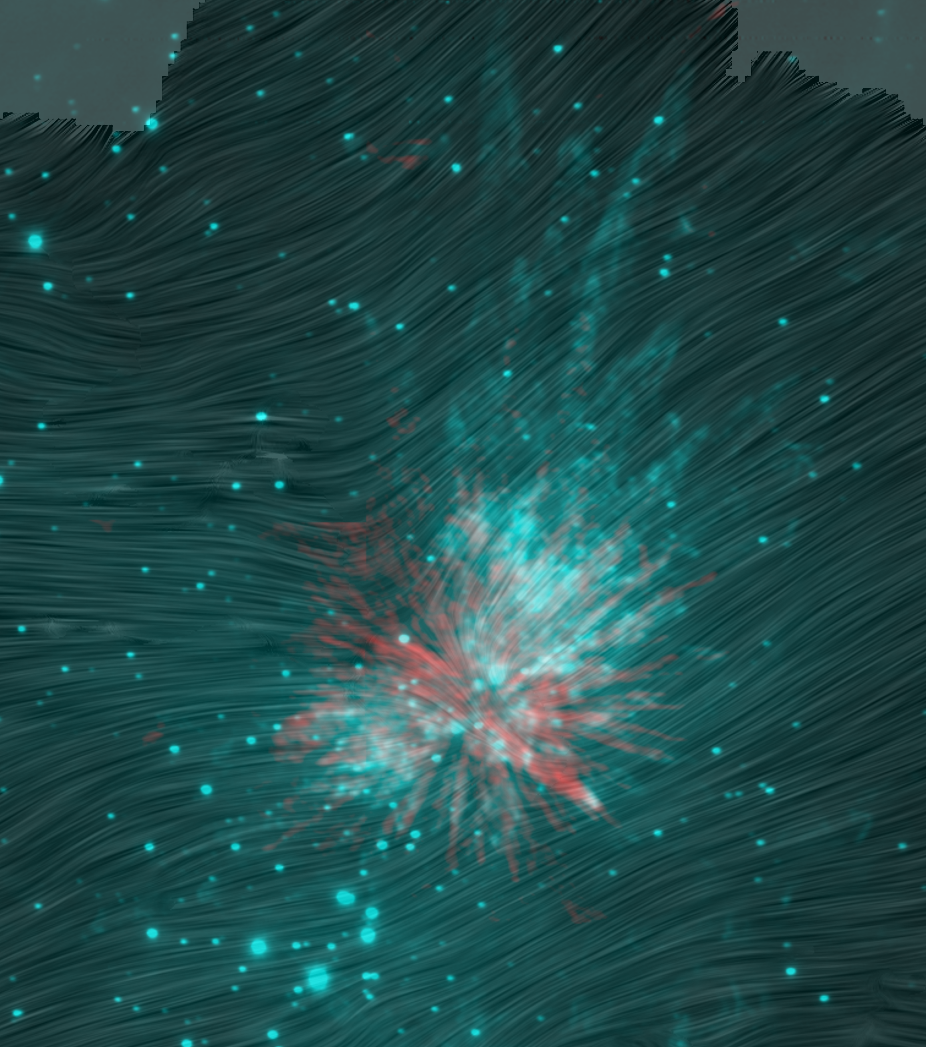
B-fields?
SOFIA/HAWC+
Chuss+2019

Slide 56
Orion OMC1:
Orbit decay
Non-hierarchical system
Form ~1 AU binary or merger (Src I)?
~550 years ago ~10⁴⁸ ergs
Explosion in gas:
~10 M_{o} V_{max}~400 km/s
Eject 3 stars:
BN (~10 Mo) Src I (~15 Mo) Src x (~3 Mo)
30 km/s 10 km/s 55 km/s
(CB or merger remnant?)
=> Luminous IR-transient (1475+/-25 AD)
(175 AD = 1475 – 1300 l.y)
=> N-body dynamics => IMF ? (Mikkola & Reipruth 2015)

Slide 57
How Common are Explosive Outflows?
isotropic for ~10³ yrs
bipolar for ~10⁵ yrs
…. Few % of outflows
Luminous Extra-Galactic IR-transients with JWST
~ 3.6 & 4.5 μm Spitzer SPIRITS Sources
(Kaslilwal+ 2017)
Novae, stellar mergers, SNe, supernova impostors
Protostellar mergers?

Slide 58
DR 21
H₂
D ~ 1.3 kpc

Slide 59
DR 21
H₂
D ~ 1.3 kpc

Slide 60
DR 21
H₂
D ~ 1.3 kpc

Slide 61
DR 21
H₂
D ~ 1.3 kpc

Slide 62
G34.26+0.15
Spitzer
D ~ 5.5 kpc

Slide 63
Summary
Outflows:
Direct Feedback impact
JWST:
0.05” [FeII], H₂ throughout Galaxy
H-recombination lines
MIRI spectra of mid-IR lines bands
Imaging dust: entrained dust, shells, & cavities
Protostellar Explosions and Runaway stars:
N-body ejections
JWST:
Proper motions
Luminous IR transients
Feedback + N-body interactions => IMF

