Slide 1
UFOs – from Dr. Doug Duncan’s CU class.
It takes time and work to explain fringe claims
Did 7 UFOs chase this plane? They have it on video!!
Play video
(Stop at 2 min)
Notes:
End 57m

Slide 2
After months of investigation…suspicion fell on gas flares from oil rigs in the Gulf of Mexico

Slide 3
Figure 2. A Landsat image of the three oil platforms in the Campec
the area off the coast of Mexico (Akal-C with 4 flares, Akal-J with 4 flares and Nohoch-A with 2 flares). The white lines indicate the narrow camera field during the video segment.

Slide 4
The pattern of oil rig flares matches the video almost perfectly!

Slide 5
Here’s an example from 2021. Just a week of investigation produced a reasonable explanation of an “Unknown UFO” reported by the Pentagon and NY Times ! Here’s it is: https://news.yahoo.com/aliens-havent-landed-why-skeptical-090251254.html Knowing what you see in the sky is difficult. If you don’t know what it is, you don’t know how big or how far!

Slide 6
The role of the commercial media
They like mysterious stories.
The news cycle is fast – they don’t have patience for explanations that take time to figure out.
“Unsolved Mysteries” are much better for ratings than solved ones. So they rarely report when something is explained later.
You do much better with public TV and National Public Radio. They are not commercial and, in my experience, much more accurate!

Slide 7
What to look for in GOOD science
Should be logical, based on facts and data, not just opinions.
Clear references are given so that you can look up data and check that statements are accurate.
Site is clearly and honestly identified (.edu or .gov can be good…)
Information has been published in peer reviewed (checked by other scientists before publication) journals.
Contrary information is given when it exists, not just information supporting an idea or theory.
What is not known is identified. It’s ok to say We don’t know!
If a claim is extraordinary, it demands extraordinarily strong evidence. - Carl Sagan

Slide 8
Scientists fool themselves too: Stanley Pons and Martin Fleischmann said they could make unlimited energy in a jar. They called it, “cold fusion….”
Not published in peer-reviewed journals.
Could not be replicated by other scientists…
Not banned…
ignored!
The method of science exposed the error. Other scientists could not confirm it.

Slide 9
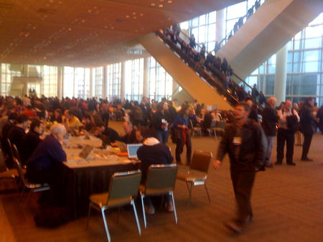
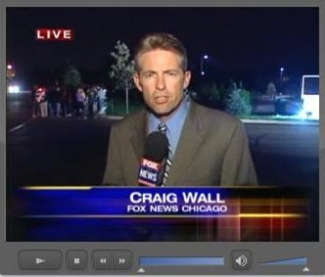
I call the latter,
“Faux News.”
A typical scientific meeting has 1000s of Posters and talks.
You can walk around to see what most scientists are finding...
-or find a few extreme views and publicize them, and mislead people.
Notes:
Think about it. If 97% of doctors said this helps, and this kills….

