Slide 1
ASTR 1020 – April 6
.
Next Observatory opportunity tonight at 8:30pm
Third mid-term April 20

Slide 2
Supernova Remnants
Four Phases
Free Expansion 200 years
Energy Conserving 10,000years
Momentum Conserving 100,000 years
Confusion 1,000,000years

Slide 3
SN1987A First Naked Eye Supernova since 1604
Located in Magellanic Cloud at 55,000pc

Slide 4
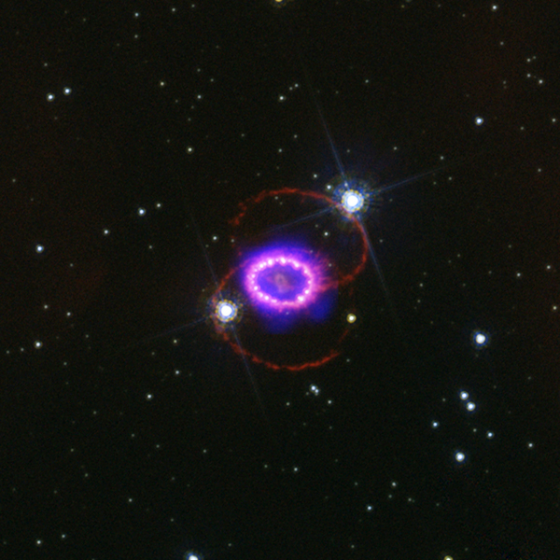
SN1987A Now

Slide 5
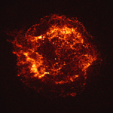
Cassiopeia A
Exploded in late 17th Century – Not Seen

Slide 6
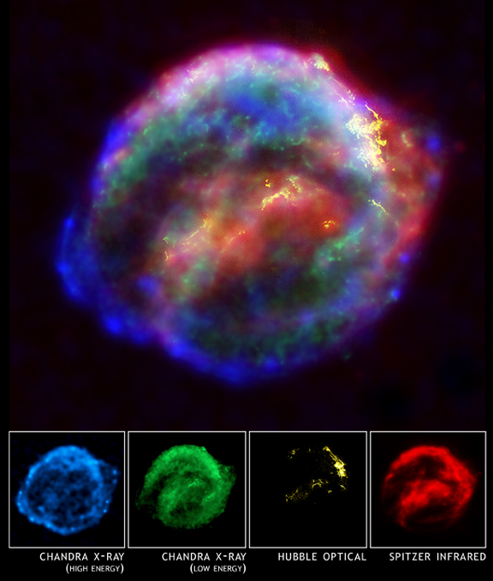
Kepler’s Supernova - 1604

Slide 7
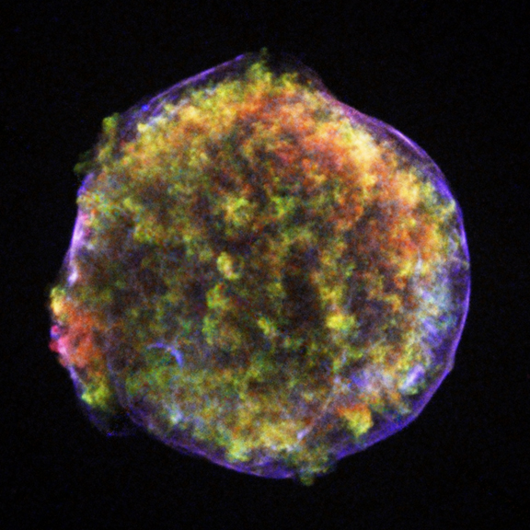
Tycho’s Supernova - 1579

Slide 8
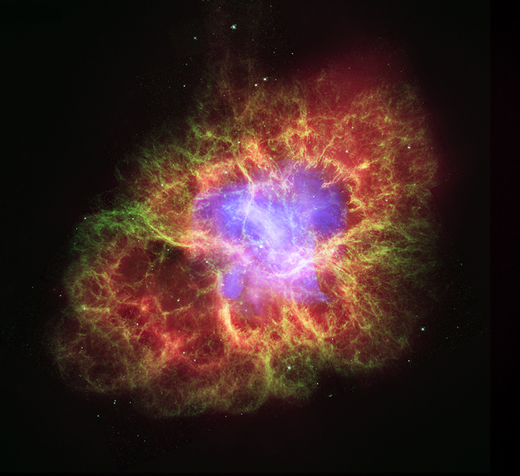
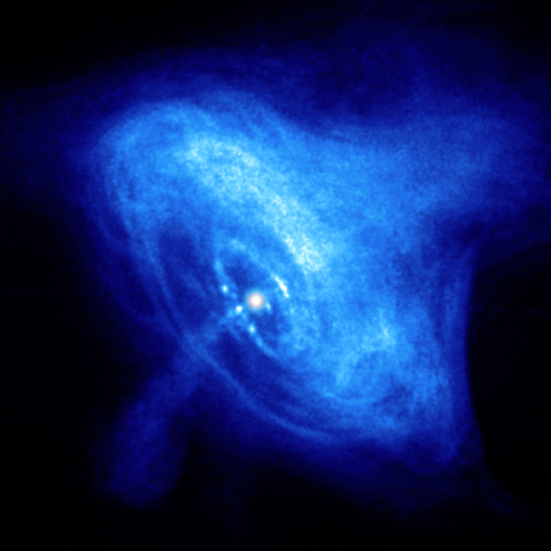
The Crab Nebula Supernova 1054
Visible Light
X-rays

Slide 9
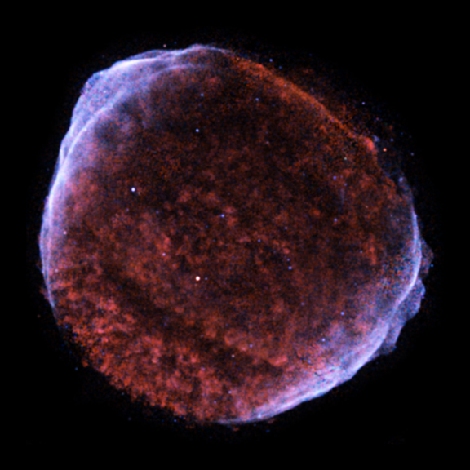
SN 1006

Slide 10
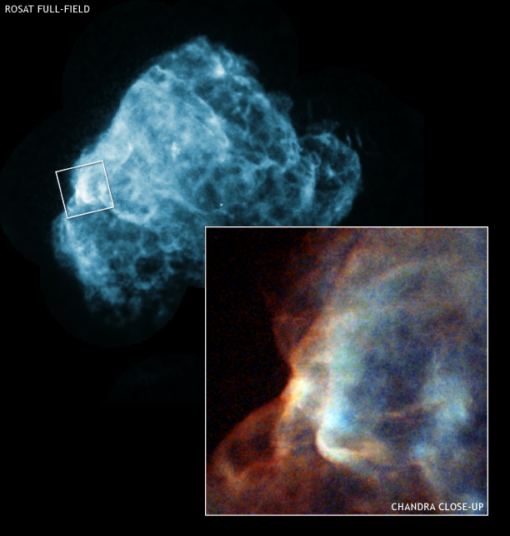
Puppis A

Slide 11
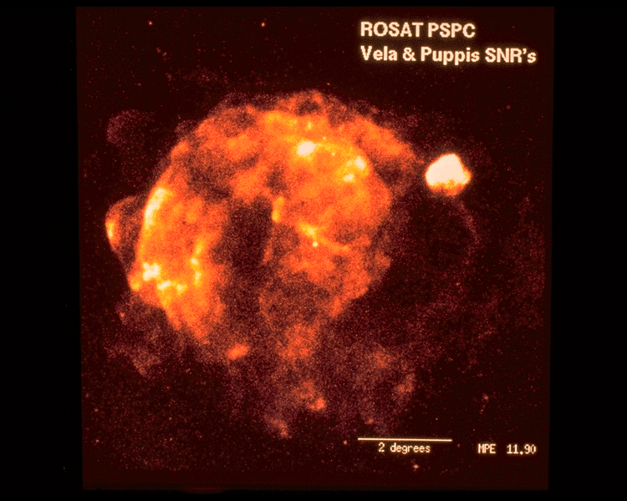
Vela SNR (and Puppis)

Slide 12
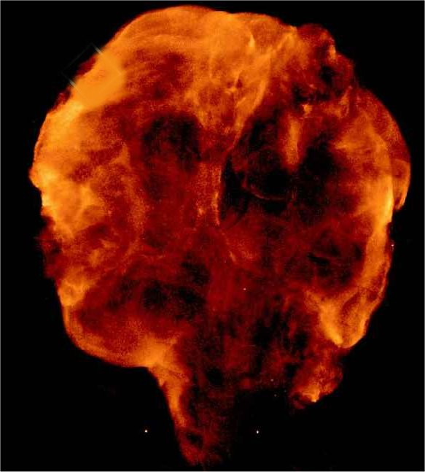
Cygnus Loop

Slide 13
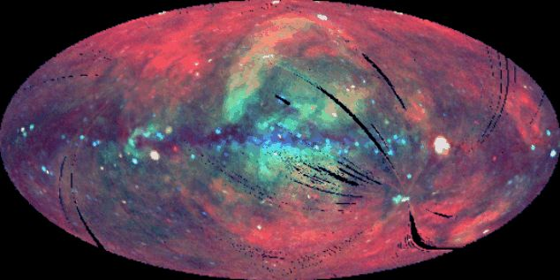
Entire Sky in Soft X-rays

Slide 14
Super Bubbles
Shock Wave
Hot Bubble
New Stars Form
Superbubble Grows
Takes Millions of Years to Grow

Slide 16
Galactic Fountain
Hot Material Churns Upwards
Rains back down
Galactic Halo
Galactic Fountain
Much like a bubble bath

Slide 17
Galaxies
There are about 100 Billion Galaxies in Visible Universe
The Milky Way is very typical (100Billion stars)
But they come in all kinds of shapes and sizes

Slide 18
Local Group
MW
M31
Magellanic Clouds
M33

Slide 19
M31 The Great Nebula in Andromeda

Slide 20
M33 The Third Wheel of the Local Group

Slide 21
Our Region
15,000,000pc
Local Group
Virgo Cluster
M81,82

Slide 22
Brightest Seen Through Telescopes
Photography showed galaxies all over sky in 1890’s
Debate raged until 1920’s “whirlpools of gas or island universes?”
Mt Wilson Telescope resolved M31 like Galileo did Milky Way
Distance scale very difficult to determine

Slide 25
Hubble Sequence
(not an evolutionary sequence!)

Slide 28
Elliptical Galaxy

Slide 29
Elliptical

Slide 30
Sombrero Galaxy

Slide 45
M87 in Virgo Cluster

Slide 49
Mass of Galaxies
From Orbital Considerations
Orbital velocity of stars
binary galaxy orbital velocities
clusters of galaxies
They All Show Dark Matter

Slide 50
Rotation Curves
Without Dark Matter
Hydrogen emits a radio emission line at λ = 21cm
Doppler shift allows us to measure orbital velocity of gas clouds vs radius

Slide 51
Dark Matter
Mass to Light Ratio:
Mass in Solar Masses divided by Luminosity in Solar Luminosities
Sun has M/L of 1 (by definition)
Rigel M=20 L=2000 --→ M/L = .01
Pros Cen M=.1 L = .001 → M/L = 100
Galaxies typically have M/L of 7 to 10
Something like 85% of the mass is dark matter

Slide 52
Dark Matter
Dark matter is in Ball → We can measure its distribution even though we don’t know what it is.
Dark Matter
Regular Matter

Slide 53
What is Dark Matter?
WHAT IS DARK MATTER?????
Some possibilities:
Ionized Gas
Small Stars
Planets
Baseballs
Black Holes
Neutrinos
Neutralinos
A flaw in Newton’s Laws
MAssive Compact Halo Objects (Machos)
Weakly Interacting Massive Particles (Wimps)
Astronomers don’t know what most of the matter in the universe is!

Slide 54
Galaxies are Close Together
Unlike stars, they run into each other.
30,000pc wide, but only 500,000pc apart
Stars million miles wide but trillions apart

Slide 55
Bullseye!

Slide 58
Cluster of Galaxies

Slide 59
X-ray Clusters
Over last 10 Billion years there have been many
galaxy collisions in these crowded clusters.
When two galaxies pass through each other stars
will continue on their original path – more or less.
Interstellar gas clouds collide and cannot pass through
each other. They get stripped and pass into the
gravitational well of the cluster. This fills with very
hot shocked gas over time.
So hot it emits x-rays.
Shows matter distribution. (Mostly dark matter again.)

Slide 60
Coalescence
After galaxies collide, on average, the friction causes them to drop
down toward the center. Eventually they settle to the bottom.

Slide 61
CD Galaxy
A Galactic Cannibal
M87 has eaten 100 of its own.

Slide 62
Gravitational Lenses
Einstein predicted light bends
as it goes around massive objects.
Just like an orbiting body.

Slide 65
The Distance Scale

