Slide 1
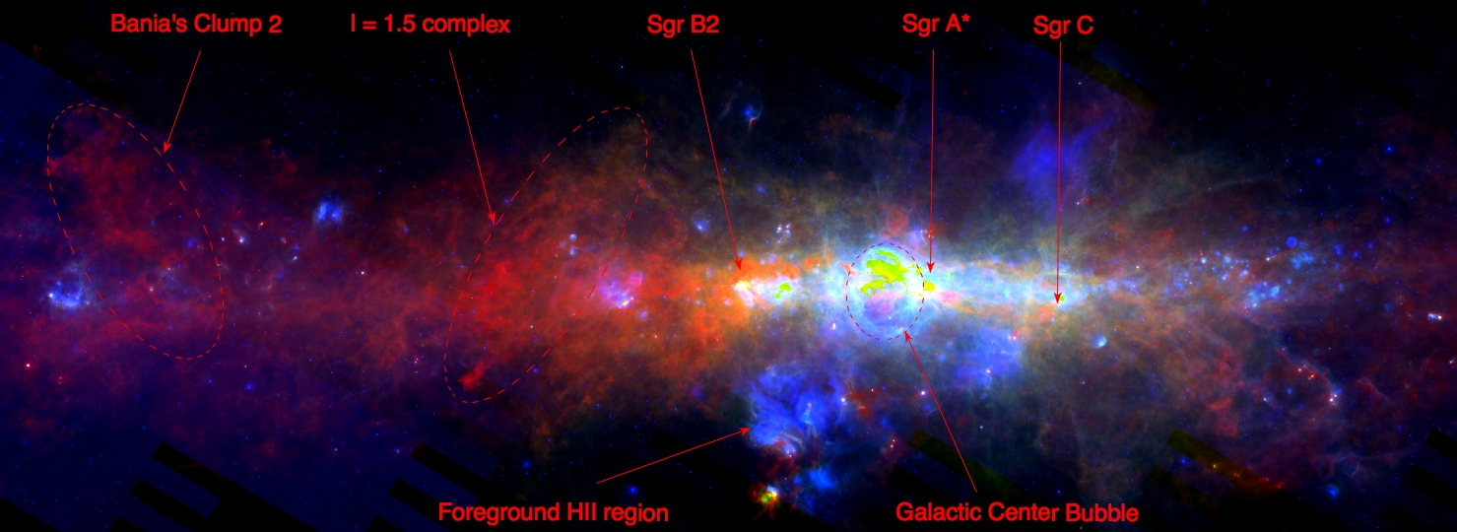
Galactic Center Star Formation:
How & at What Rate?
John Bally¹
¹Center for Astrophysics and Space Astronomy (CASA)
Department of Astrophysical and Planetary Sciences (APS)
University of Colorado, Boulder

Slide 2
The CMZ
24 μm 70 μm 250 μm
200 pc

Slide 3
Central Molecular Zone (CMZ)
x10 - x100 denser, more turbulent than disk GMCs
80% of Galactic dense gas [n(H₂) > 10⁴ cm⁻³] is in the CMZ
Traced by HCN, CS, etc. ΔV > 10 km/s
Star formation rate < 0.1 M_{o}/yr; Mostly at R~100 pc
A second parameter?
SFR ~ C ρ^{α} ΔV^{β} α~ 1 to 2, β~ -1 to -2
The Asymmetric CMZ:
Gas & cold dust: >2/3 at POSITIVE longitude, velocity
24 μm sources: >2/3 at NEGATIVE longitude
Short orbit times:
t_{orbit} ~ 6 Myr R_{100 pc} / V_{100 km/s}
(1 to 10 Myr)

Slide 4
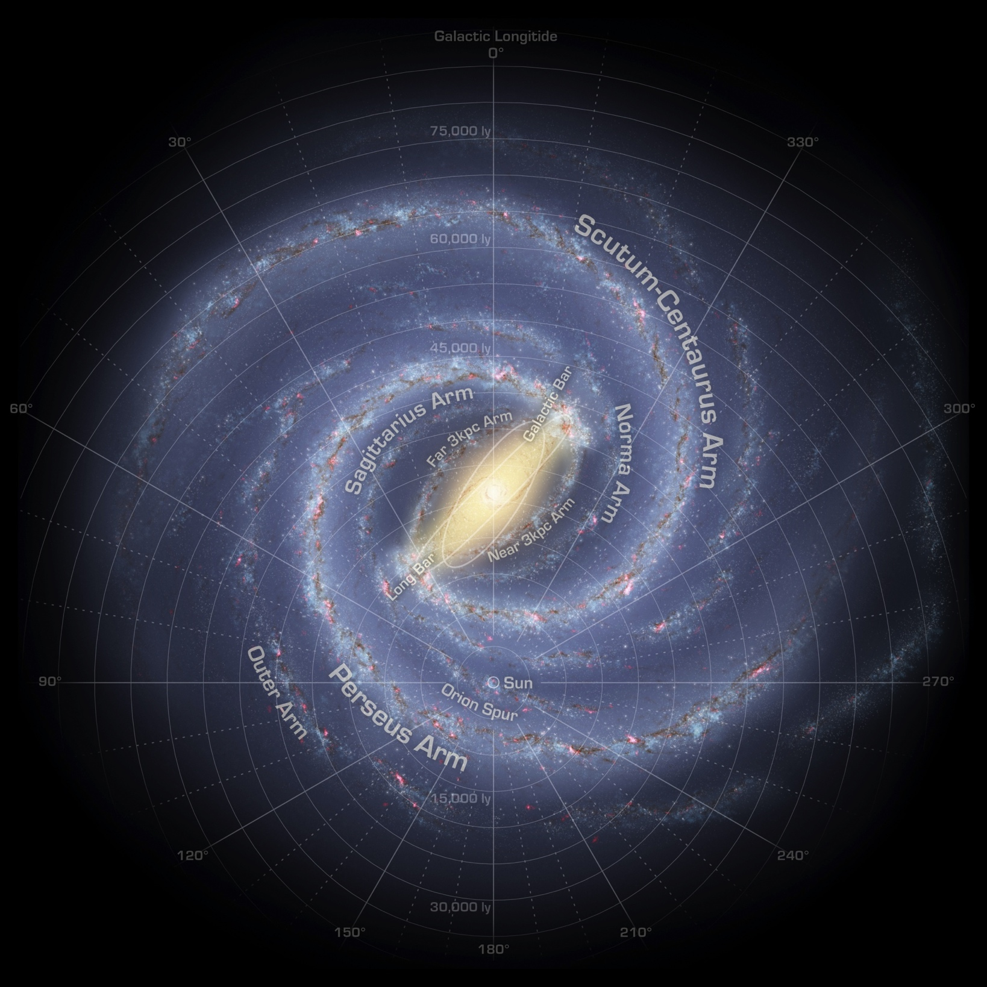
Milky Way cartoon: We live in a Barred Galaxy (Binney et al. 1991)
CMZ
W43
W51
RSGC1-3
Wd 1
M17
Wd 2
Sun

Slide 5
Life in a
barred
potential
(Shim & Kim+ 2017)

Slide 6
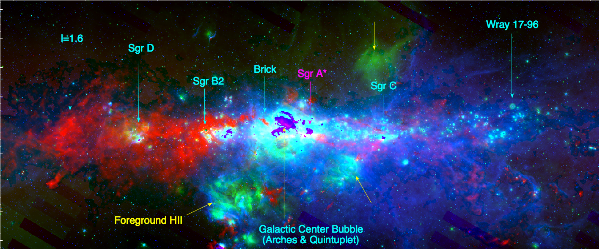
Inner CMZ 8 um 24 um N(H₂)
+2.0º -2.0º

Slide 7
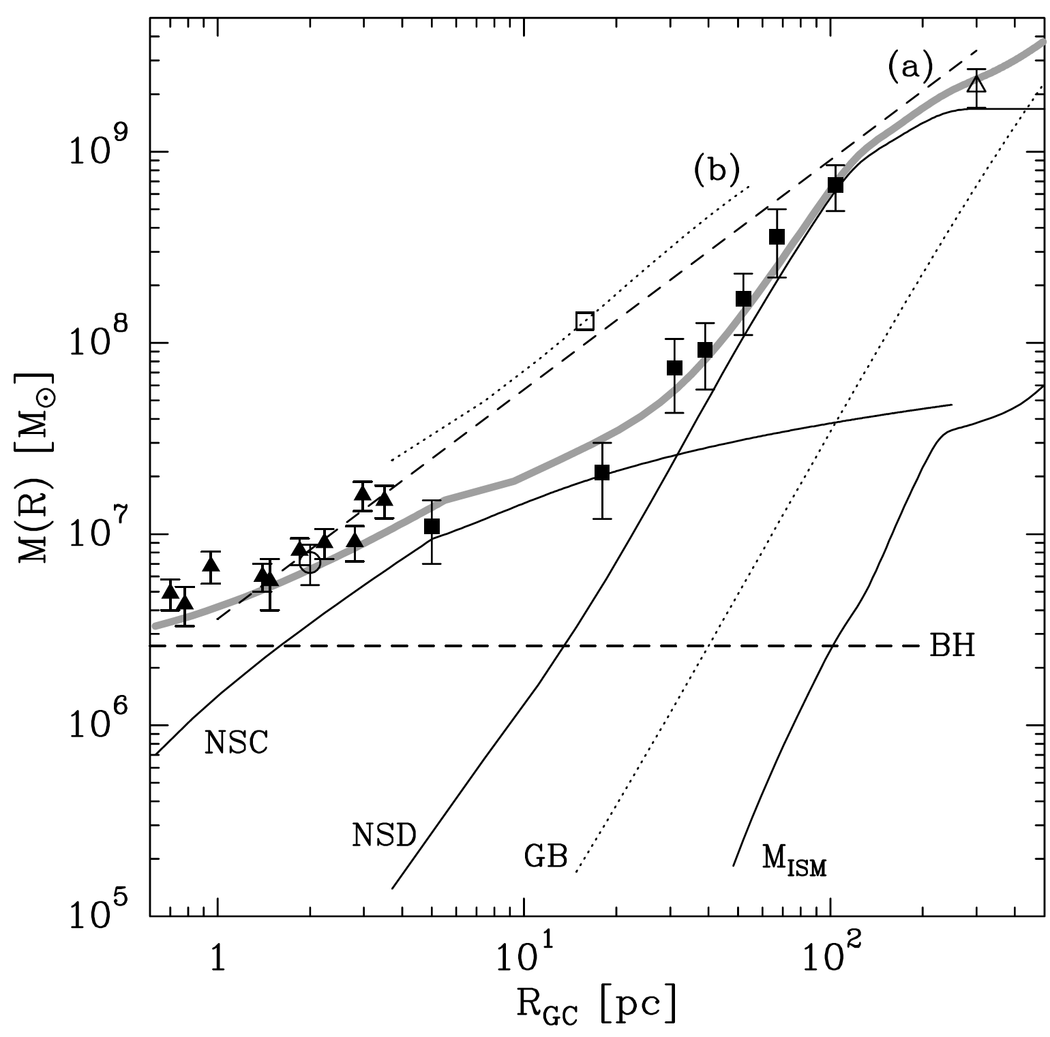
Enclosed Mass
(Launhardt 2002)
Low shear region
Most stars form
here
α R⁻²
V α const.
M α R
α R⁻¹
V α R^{1/2}
M α R²
= Nuclear Star Cluster
= Nuclear Stellar Disk
= Black Hole
= Galactic Bulge

Slide 8
SMA CMZoom survey of the inner CMZ
Battersby et al. 2020
Brickletts
Brick
Sgr A (CND)
20 km/s
Sgr B2
Sgr C

Slide 9
Conveyor Belt of Star Formation?
Close passage to Sgr A => tidal compression
Brick => Bricklets (“b”, “c”, “d”, “e/f”) => Sgr B2 => SgrB1
(Barnes et al.
2017; 2019)

Slide 10
Conveyor Belt of Star Formation ?:
Close passage to Sgr A => tidal compression
Brick => “Bricklets “c” => “e/f” => Sgr B2 => SgrB1
(Barnes et al. 2017; 2019)

Slide 11
Kruijssen, Dale, & Longmore 2015, Kruijssen et al. 2019

Slide 12
Sgr B2 starburst: 3 mm (ALMA) 10⁶ M_{o} GMC
Ginsburg, et al. (2018): 271 cores with M* > 8 M_{o}
Ginsburg & Kruijssen (2019) Total mass of YSOs ~ 46,000 M_{o}

Slide 13
Sgr B2 starburst: 3 mm dust continuum(ALMA)
~ 50 – 100 OB stars + 40,000 M_{o} lower mass stars
Ginsburg, et al. (2018)

Slide 14
FORCAST survey of the inner CMZ
Hankins et al. 2020
8 um 25 um 37 μm
25 um 37 um 70 μm

Slide 15
Arches
FORCAST survey
of the inner CMZ
Hankins et al. 2020
Sgr B2
Quintuplet
Sgr B1

Slide 16
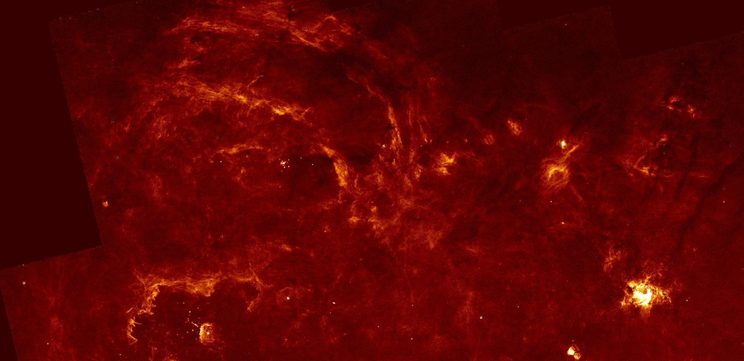
Arches, Quintuplet, Nuclear Star Cluster: Paschen α:
Dong, H., Wang, Q.D., Cotera, A. et al. 2011; Wang, Q.D., Dong, H., Cotera, A. et al. 2010
Nuclear Star Cluster,
Mini-spiral, Sgr A*
10⁷ M_{o} (old & young)
Arches cluster (~3 Myr)
3x10⁴ M_{o}
Quinuplet cluster (~5 Myr) 10⁴ M_{o}

Slide 17
Models of the CMZ: Sormani M., C. et al. 2020 arXiv2004.06731
Quasi-static SFR? ~ 0.1 Mo/yr
DLR =
“Dust Lane Region”

Slide 18
Orbits of Arches & Quintuplet cluster in Sormani model
Arches:
V_{PM} ~ 172+/-15 km/s
V_{r} ~ +80+/-5 km/s
Clarkson, W.I,+ 2012
Arches:
V_{PM} ~ 132+/-15 km/s
V_{r} ~+102+/-5 km/s
Stolte, A,+ 2014
To Sun
Sormani, M+ 2020

Slide 19
Feedback:
The Sofu-Handa Lobe
Sofue & Handa1984
Nature
Galactic Center Bubble
& the Arches
Sgr A*
MeerKat; 1 GHz
Heywood et al. 2019
Nature

Slide 20
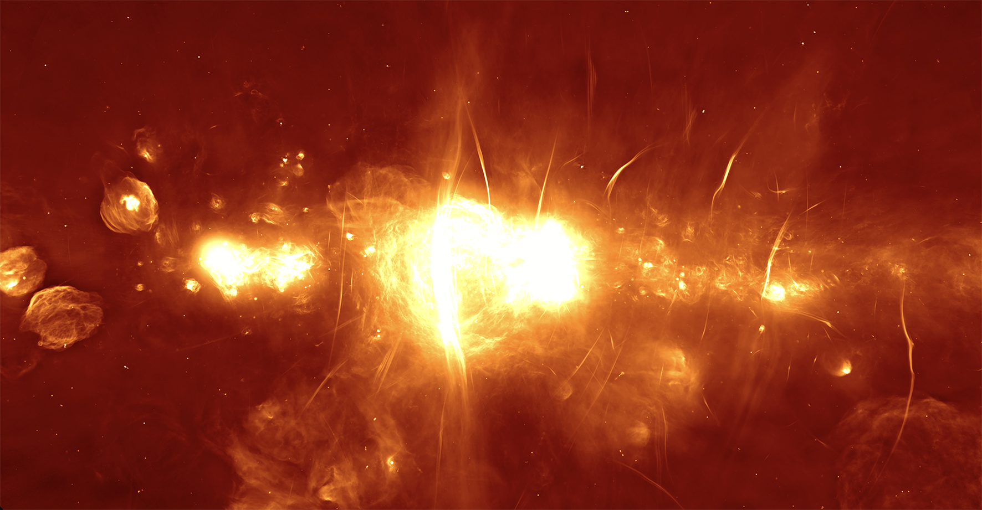
MeerKAT ~1 GHz (July 2018 press release)
Sgr B2 SgrB1 Galactic Center Bubble Sgr A Sgr C

Slide 21
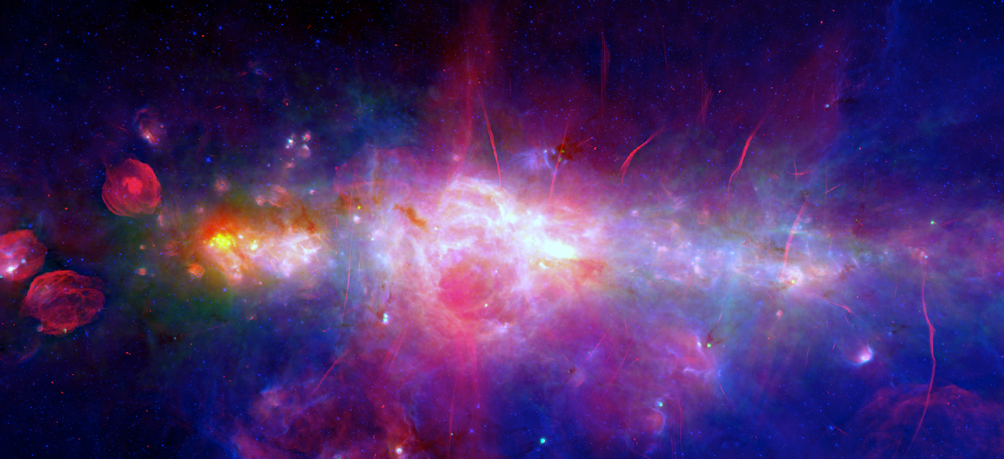
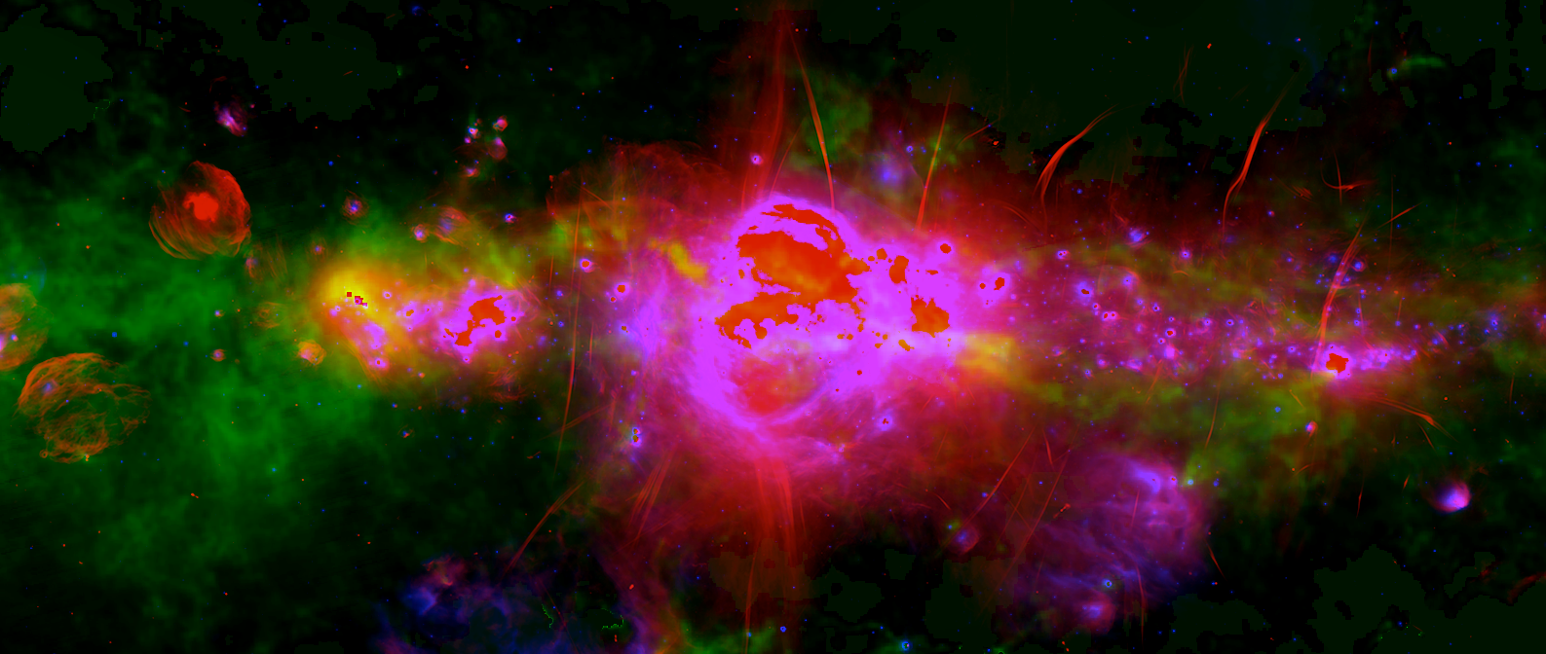
Inner CMZ ~1 GHz, 70 μm, 24 μm
Sgr B2 SgrB1 Galactic Center Bubble Sgr A Sgr C

Slide 22
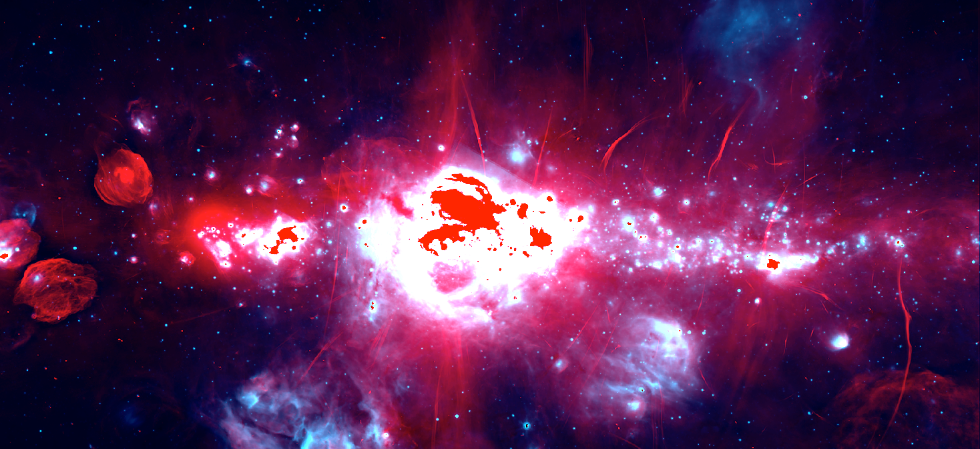
Inner CMZ ~1 GHz (July 2018 MeerKAT press release)
24 μm (Spitzer)
Sgr B2 SgrB1 Galactic Center Bubble Sgr A Sgr C

Slide 23
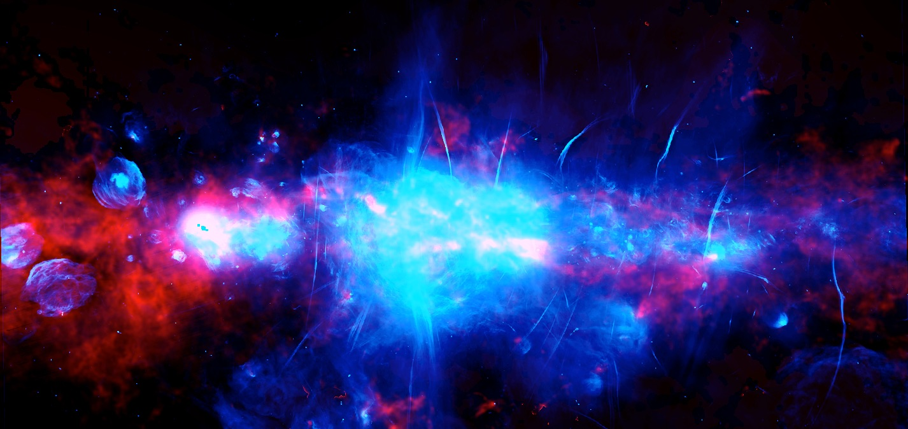
Inner CMZ ~1 GHz (July 2018 MeerKAT press release)
N(H₂) (Hi-GAL – Battersby et al.)
Sgr B2 SgrB1 Galactic Center Bubble Sgr A Sgr C

Slide 24
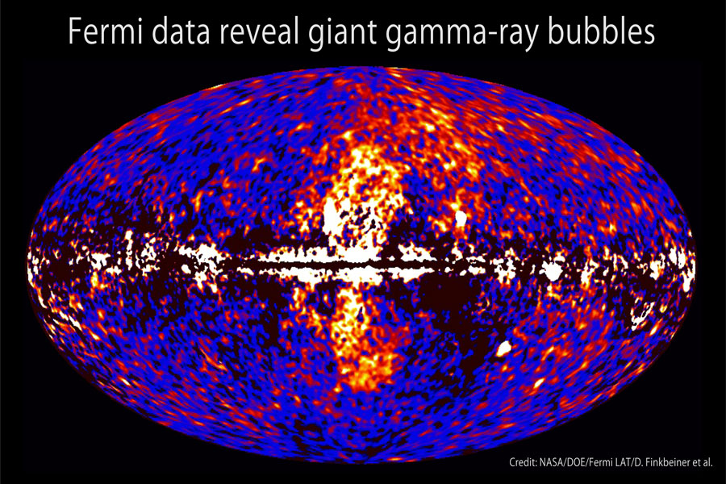
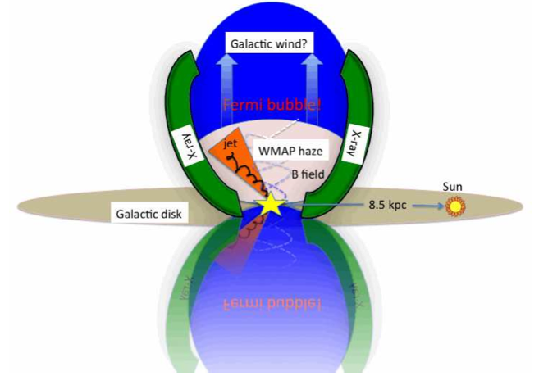
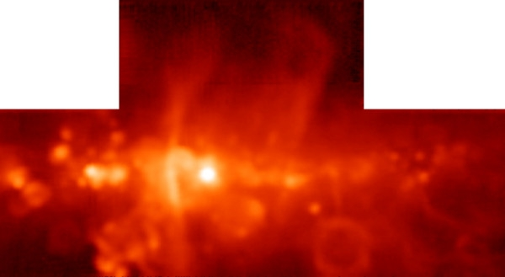
Galactic Center Bubble => Sofue-Handa Lobe
=> Fermi-LAT Bubble ?
Finkbeiner et al. (2010)
Sofue-
Handa
Lobe
3.5 cm
(GBT)
Beware of foreground confusion:
Sco-Cen superbubble
150 pc from Sun
- Intervening spiral arms
2 deg.
Law et al. (2008)

Slide 25
Questions:
What is the gas infall rate from R ~ 3 kpc?
~ 1 M_{o}/yr ? (Tress+ 2020)
Why is the ~5 x 10⁷ M_{o} CMZ so asymmetric? (t _{orbit 100pc} ~ 6 Myr)
Starburst + blow-out by feedback ? Stochastic infall?
Star Formation Rate: Is there a 2-nd parameter? (SFR ~ C ρ^{α} ΔV^{-β} )
Quasi-Steady @ ~0.04 – 0.1 M_{o}/yr? (Sormani+ 2020)
Quasi-periodic bursts ~ 30 -50 Myr? (Armillotta+ 2019, 2020)
Conveyor-Belt? (Kruijjsen, Longmore 2015, 2019)
Where Does Most Gas Go? (Low-M stars or ejected: Not the SMBH!)
Nuclear Superwind? Fermi/LAT Bubbles?
What ejects it?
OB star feedback? Transient AGN outbursts?

Slide 26
What Can SOFIA Do?
- Develop highly multiplexed, high-R, mid-IR ‘data-cube generators’
- Develop new detector and instrument technologies for future
missions!
- Future CMZ Legacy Programs:
* Map CMZ, GCB, Sofue-Handa Lobes, base of Fermi-Bubbles
5 to 250 μm emission lines
(C+, O, O++, N+, Ar, Ar+, Ar++, Fe, Fe+, N+, OH, H₂, HD, high-J CO..)
* Polarization Survey
Toroidal B in CMZ? Relation to Poloidal B?
* Characterize compact 24 μm sources
MYSOs? main-sequence stars (“impostor MYSOs”)? W-R ? or RSGs,?

Slide 27
Summary
The CMZ:
Fed by infall from Galactic disk @ ~1 M_{o}/yr ?
M ~5x10⁷ M_{o}, 80% of dense (n > 10⁴ cm⁻³) gas in Galaxy
Lab. for high pressure, density S.F. e.g. High-z S.F.
Star Formation in ~100 pc low-shear region: SFR ~ 0.04 – 0.1 M_{o}/yr
“Conveyor Belt”? Eccentric orbits => tidal “crush” in z
=> Brick=>Sgr B2 => Sgr B1 …
Bursts? quasi-steady?
> 3x10⁴ M_{o} clusters: Arches, Quinuplet, Nuclear star cluster
Asymmetries: Blow out by feedback? Or Stochastic feeding?
Gas-dust, MYSOs, at Positive longitude/velocity
24 μm compact sources at Negative longitude
Compact 24 μm Sources
MYSO (t < 0.1 Myr) ?
Main-Sequence stars encountering CMZ ISM ? (Impostor MYSOs)?
post-Main-Sequence OH/IR, RSGs? (t >3 to 30 Myr old stars)
CMZ Star Formation Feedback:
UV, winds,~10³ SNe in ~few x 10 Myr => Mass-load Fermi Bubble ?
Does Feedback prevent SMBH growth?

